Slide 1



ITU-R Membership

Slide 2
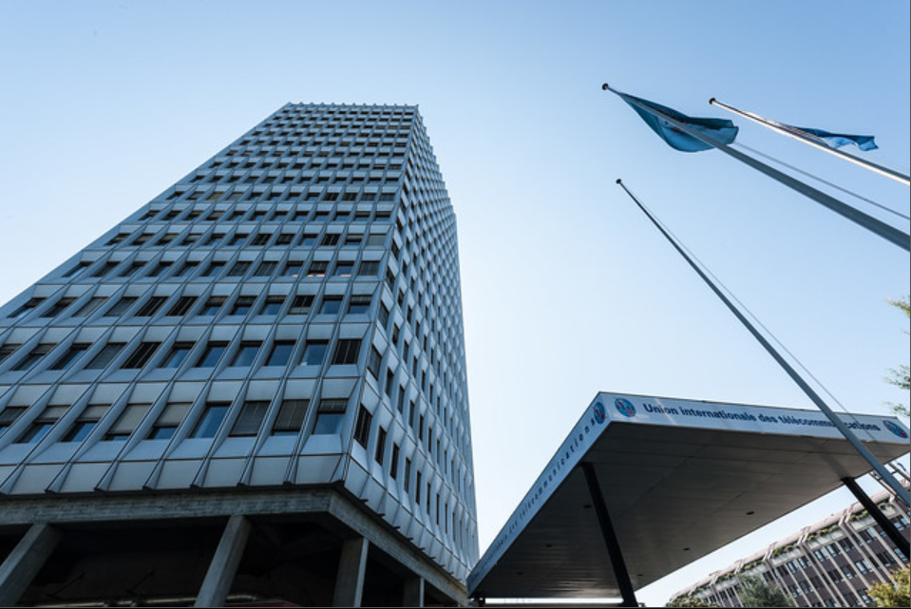

International Telecommunication Union
Who we are
United Nations specialized agency
Headquartered in Geneva, Switzerland
Works towards harnessing innovation and connecting everyone to ensure a better future for all
Oldest agency in the UN family
Established in 1865
Connecting the world since the dawn of the telegraph

Slide 3






ITU Members
Who we are
194
1000+
Member States
Companies, universities, research institutions
international and regional organizations

Slide 4

ITU global presence
Who we are
Regional offices
Brasilia
Addis Ababa
Cairo
Geneva
Moscow
Bangkok
Area offices
ITU Headquarters
Tegucigalpa
Santiago
Bridgetown
Dakar
Yaounde
Harare
New Delhi
Jakarta
Geneva
UN office
New York
Innovation Centre
New Delhi

Slide 5



ITU’s work spans across three areas:
Who we are
Radiocommunication
(ITU-R)
Standardization
(ITU-T)
Development
(ITU-D)

Slide 6
Who we are
ITU-R ITU Radiocommunication Sector

Slide 7

What we do
About the ITU Radiocommunication Sector
The mission of the ITU Radiocommunication Sector is, inter alia, to ensure rational, equitable, efficient and economical use of the radio-frequency spectrum by all radiocommunication services, including those using satellite orbits, and to carry out studies and adopt recommendations on radiocommunication matters.
This mission lies within the broader framework of the purposes of ITU, as defined in Article 1 of the ITU Constitution and is, in particular, to "maintain and extend international cooperation among all the Member States of the Union for the improvement and rational use of telecommunications of all kinds".
www.itu.int/en/ITU-R

Slide 8
What we do
About the ITU Radiocommunication Sector
​The strategic goal of the Radiocommunication Sector (ITU-R) is threefold, and includes:​
To ensure interference-free operations of radiocommunication systems by implementing the Radio Regulations and regional agreements, as well as updating these instruments in an efficient and timely manner through the processes of world and regional radiocommunication conferences;
To establish Recommendations intended to assure the necessary performance and quality in operating radiocommunication systems;
To seek ways and means to ensure the rational, equitable, efficient and economical use of the radio-frequency spectrum and satellite-orbit resources and to promote flexibility for future expansion and new technological developments.

Slide 9
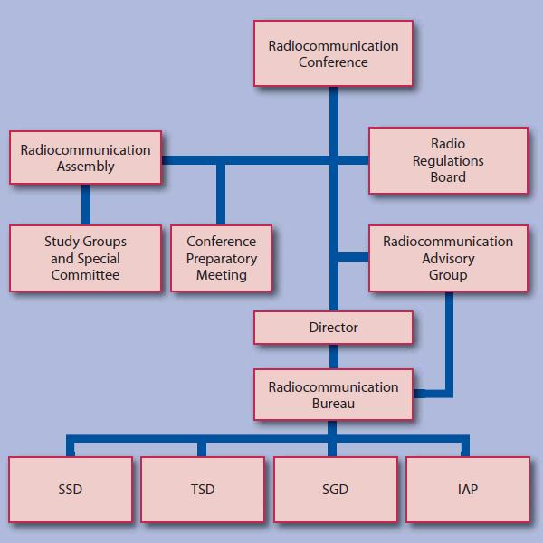
What we do
ITU Radiocommunication Sector Organization
The Radiocommunication Bureau (BR) is the secretariat for the Sector. Created on 1 March 1993, it resulted from the fusion of the Secretariats of the former International Radio Consultative Committee (CCIR), and the International Frequency Registration Board (IFRB). It also included the Maritime Mobile document services, Radio Regulations and Associated Administrative Matters formerly of the ITU General Secretariat.
Space Services Department (SSD)
Terrestrial Services Department (TSD)
Study Groups Department (SGD)
Informatics, Administration and Publications Department (IAP)

Slide 10
What we do
ITU-R Study Groups
ITU-R Study Groups develop the technical bases for decisions taken at World Radiocommunication Conferences (WRCs) and develop global standards (Recommendations), Reports and Handbooks on radiocommunication matters.
ITU-R Study Groups are established and assigned study questions by a Radiocommunication Assembly (RA) to prepare draft Recommendations, etc. for approval by ITU Member States.
Except for ITU-R Recommendations incorporated by reference in the ITU Radio Regulations, compliance with ITU-R Recommendations is not mandatory.
ITU-R Recommendations enjoy a high reputation and worldwide implementation, having the status of international standards in their domain of application.

Slide 11
What we do
ITU-R Study Groups
ITU-R Study Groups carry out preparatory studies for Regional Radiocommunication Conferences (RRCs).
On the basis of the input material from the Study Groups, alongside any new material submitted by ITU Member States and ITU-R Sector Members, the Conference Preparatory Meeting (CPM) prepares a Report on the technical, operational and regulatory or procedural matters to be considered by a given Conference.
Study Groups accomplish their work in cooperation with other international radiocommunication organizations. Particular attention is paid to the radiocommunication needs of developing countries.

Slide 12
What we do
ITU-R Study Groups
efficient management and use of the spectrum/orbit resource
radio systems characteristics and performance
emergency radiocommunications for public protection and disaster relief
5000
Study Groups
Specialists
from administrations,
the telecommunications industry and
academic organizations
operation of radio stations
spectrum monitoring

Slide 13
What we do
ITU-R Study Groups
At present, there are six Study Groups (SGs) specializing in the following areas:
SG 1 Spectrum management www.itu.int/ITU-R/go/rsg1
SG 3 Radiowave propagation www.itu.int/go/ITU-R/rsg3
SG 4 Satellite services www.itu.int/ITU-R/go/rsg4
SG 5 Terrestrial services www.itu.int/go/ITU-R/rsg5
SG 6 Broadcasting service www.itu.int/ITU-R/go/rsg6
SG 7 Science services www.itu.int/ITU-R/go/rsg7
Subgroups, known as Working Parties (WPs) and Task Groups (TGs) are established to study the Questions assigned to the different Study Groups.

Slide 14
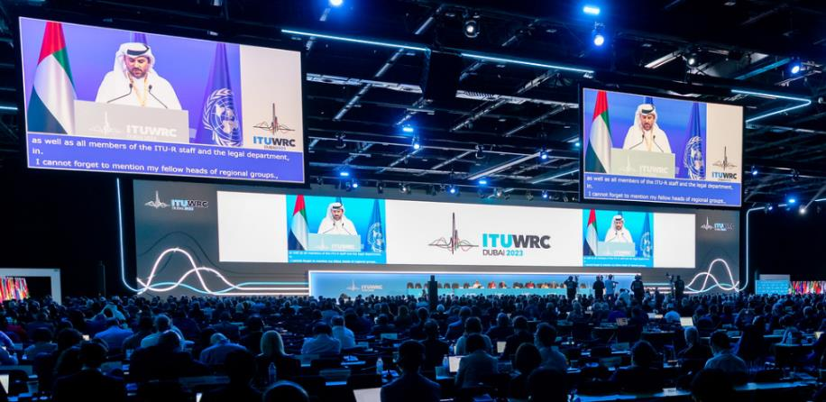
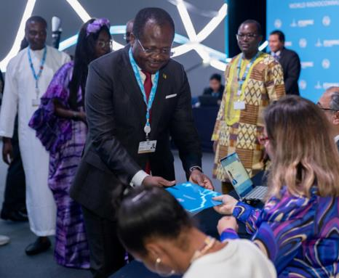
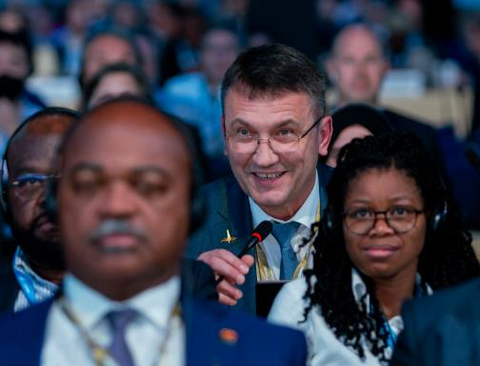
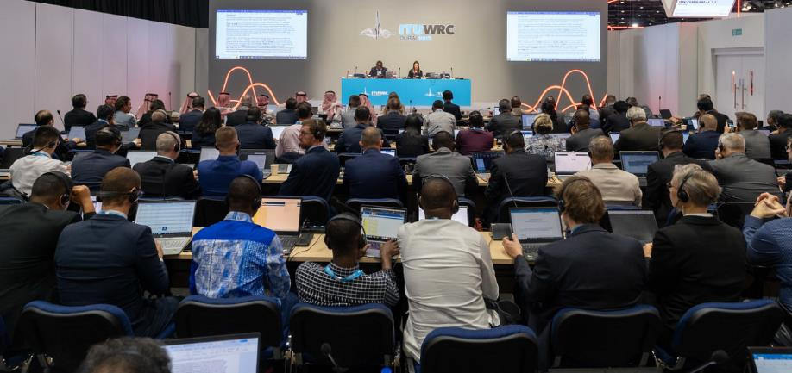
Decision-making assemblies, groups and high-level policy meetings
World Radiocommunication Conference
World Radiocommunication Conferences (WRCs) review and revise the Radio Regulations, the international treaty governing the use of the radio frequency spectrum and the satellite orbit.
Revisions are made based on an agenda determined by the ITU Council, which takes into account recommendations made by previous world radiocommunication conferences.
WRCs consider the results of the studies on options to improve the international spectrum for the ITU Radio Regulations with respect to the evolution of existing, emerging and future applications, systems and technologies.

Slide 15
Decision-making assemblies, groups and high-level policy meetings
World Radiocommunication Conference
World Radiocommunication Conferences (WRCs) make regulatory framework based on the effectiveness, appropriateness and impact decisions on the most profitable and efficient ways to exploit the limited resource of radio frequency spectrum and manage satellite orbits, which will be critical and increasingly valuable for the development of the global economy in the 21st Century.
WRCs also address any radiocommunication matter of worldwide character, instruct the Radio Regulations Board and the Radiocommunication Bureau, and review their activities, and determine the topics for study by Radiocommunication Assemblies and the Radiocommunication Study Groups in preparation for future radiocommunication conferences.

Slide 16
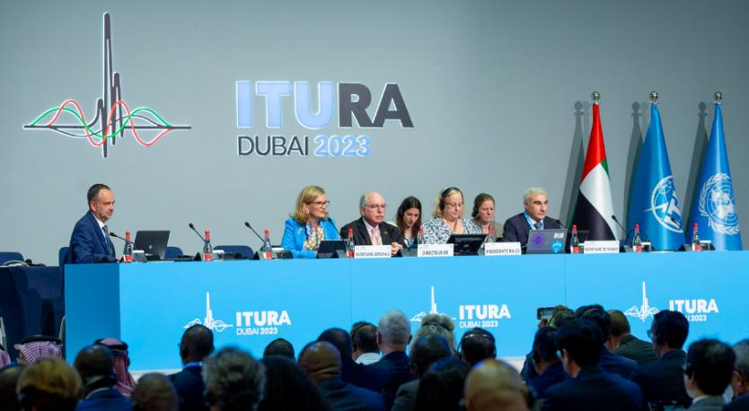
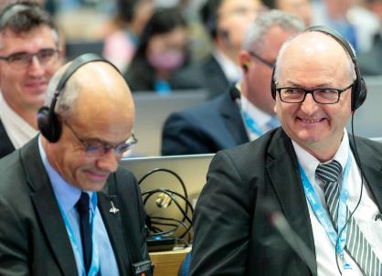
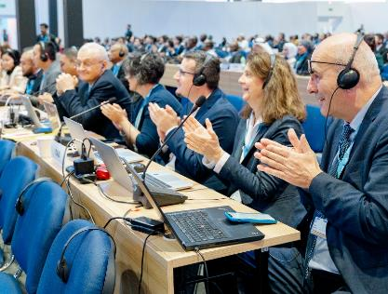
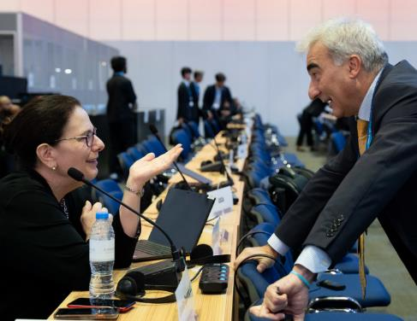
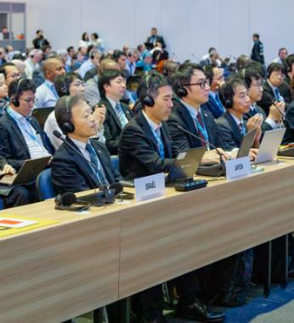
Decision-making assemblies, groups and high-level policy meetings
Radiocommunication Assemblies
Radiocommunication Assemblies (RAs) are responsible for the structure, programme and approval of radiocommunication studies.
They are normally convened every four years and may be associated in time and place with World Radiocommunication Conferences (WRCs).
The Assemblies provide the necessary technical basis for the work of WRCs, respond to other requests from ITU conferences, and suggest suitable topics for the agenda of future WRCs.
They also approve and issue ITU-R Recommendations and Questions developed by the Study Groups, set the programme for and disband or establish Study Groups according to need.

Slide 17


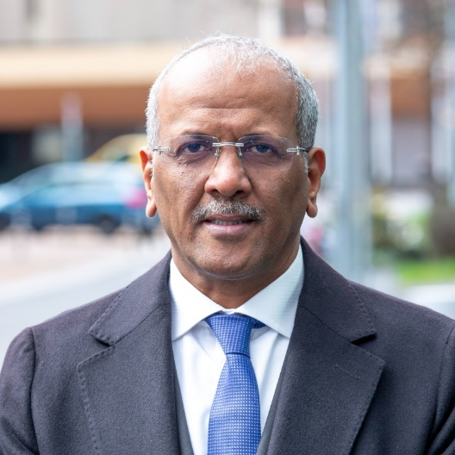

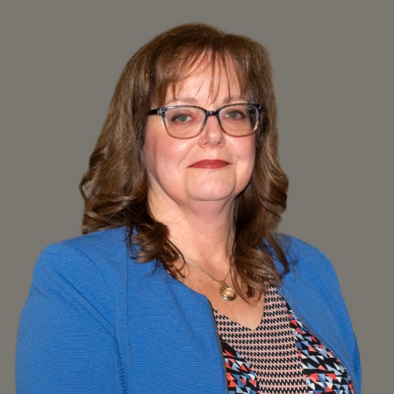



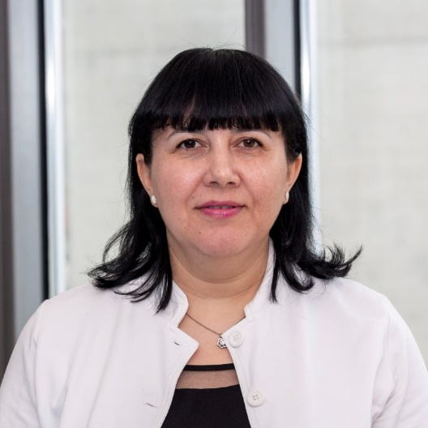



Decision-making assemblies, groups and high-level policy meetings
Radio Regulations Board
The Radio Regulations Board (RRB) consists of twelve members thoroughly qualified in the field of radiocommunications and possessing practical experience in the assignment and utilization of frequencies. The members of the RRB are elected at the Plenipotentiary Conference to serve, not as representing their respective Member States nor a region, but as custodians of an international public trust. They perform their duties independently and on a part-time basis, normally meeting up to four times a year, in Geneva.
The Director of the Bureau is the Executive Secretary of the Radio Regulations Board.

Slide 18
Decision-making assemblies, groups and high-level policy meetings
Radio Regulations Board
Approves Rules of Procedure, used by the Radiocommunication Bureau in applying the provisions of the Radio Regulations and registering frequency assignments made by the Member States;
Addresses matters referred by the Bureau which cannot be resolved through application of the Radio Regulations and Rules of Procedure;
Considers reports of unresolved interference investigations carried out by the Bureau at the request of one or more administrations and formulates Recommendations;
Provides advice to Radiocommunication Conferences and the Radiocommunication Assemblies;
Considers appeals against decisions made by the Radiocommunication Bureau regarding frequency assignments;
Performs any additional duties prescribed by a competent conference or by the Council.

Slide 19
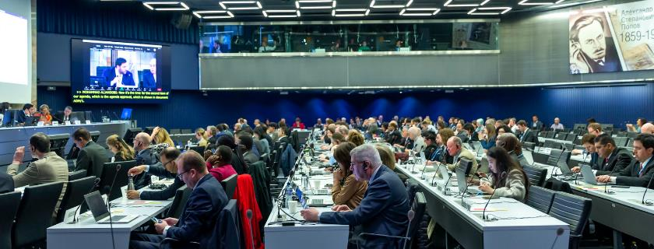
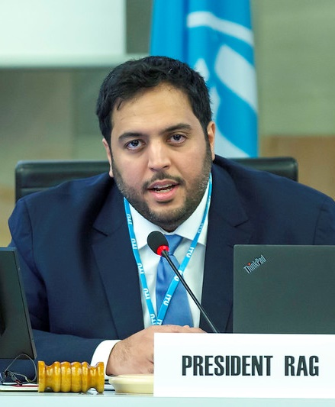
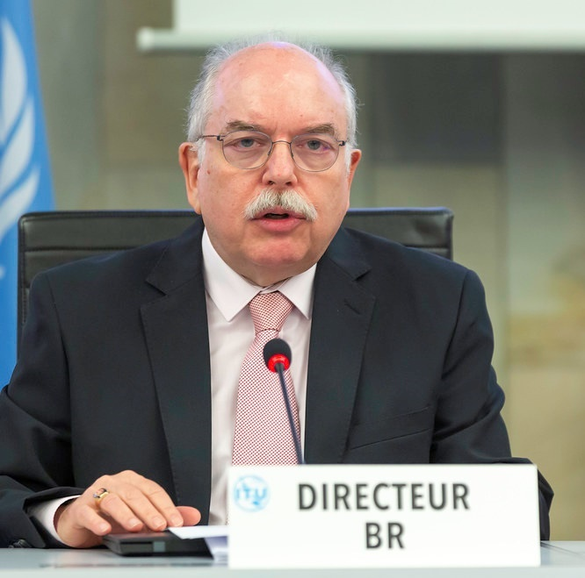
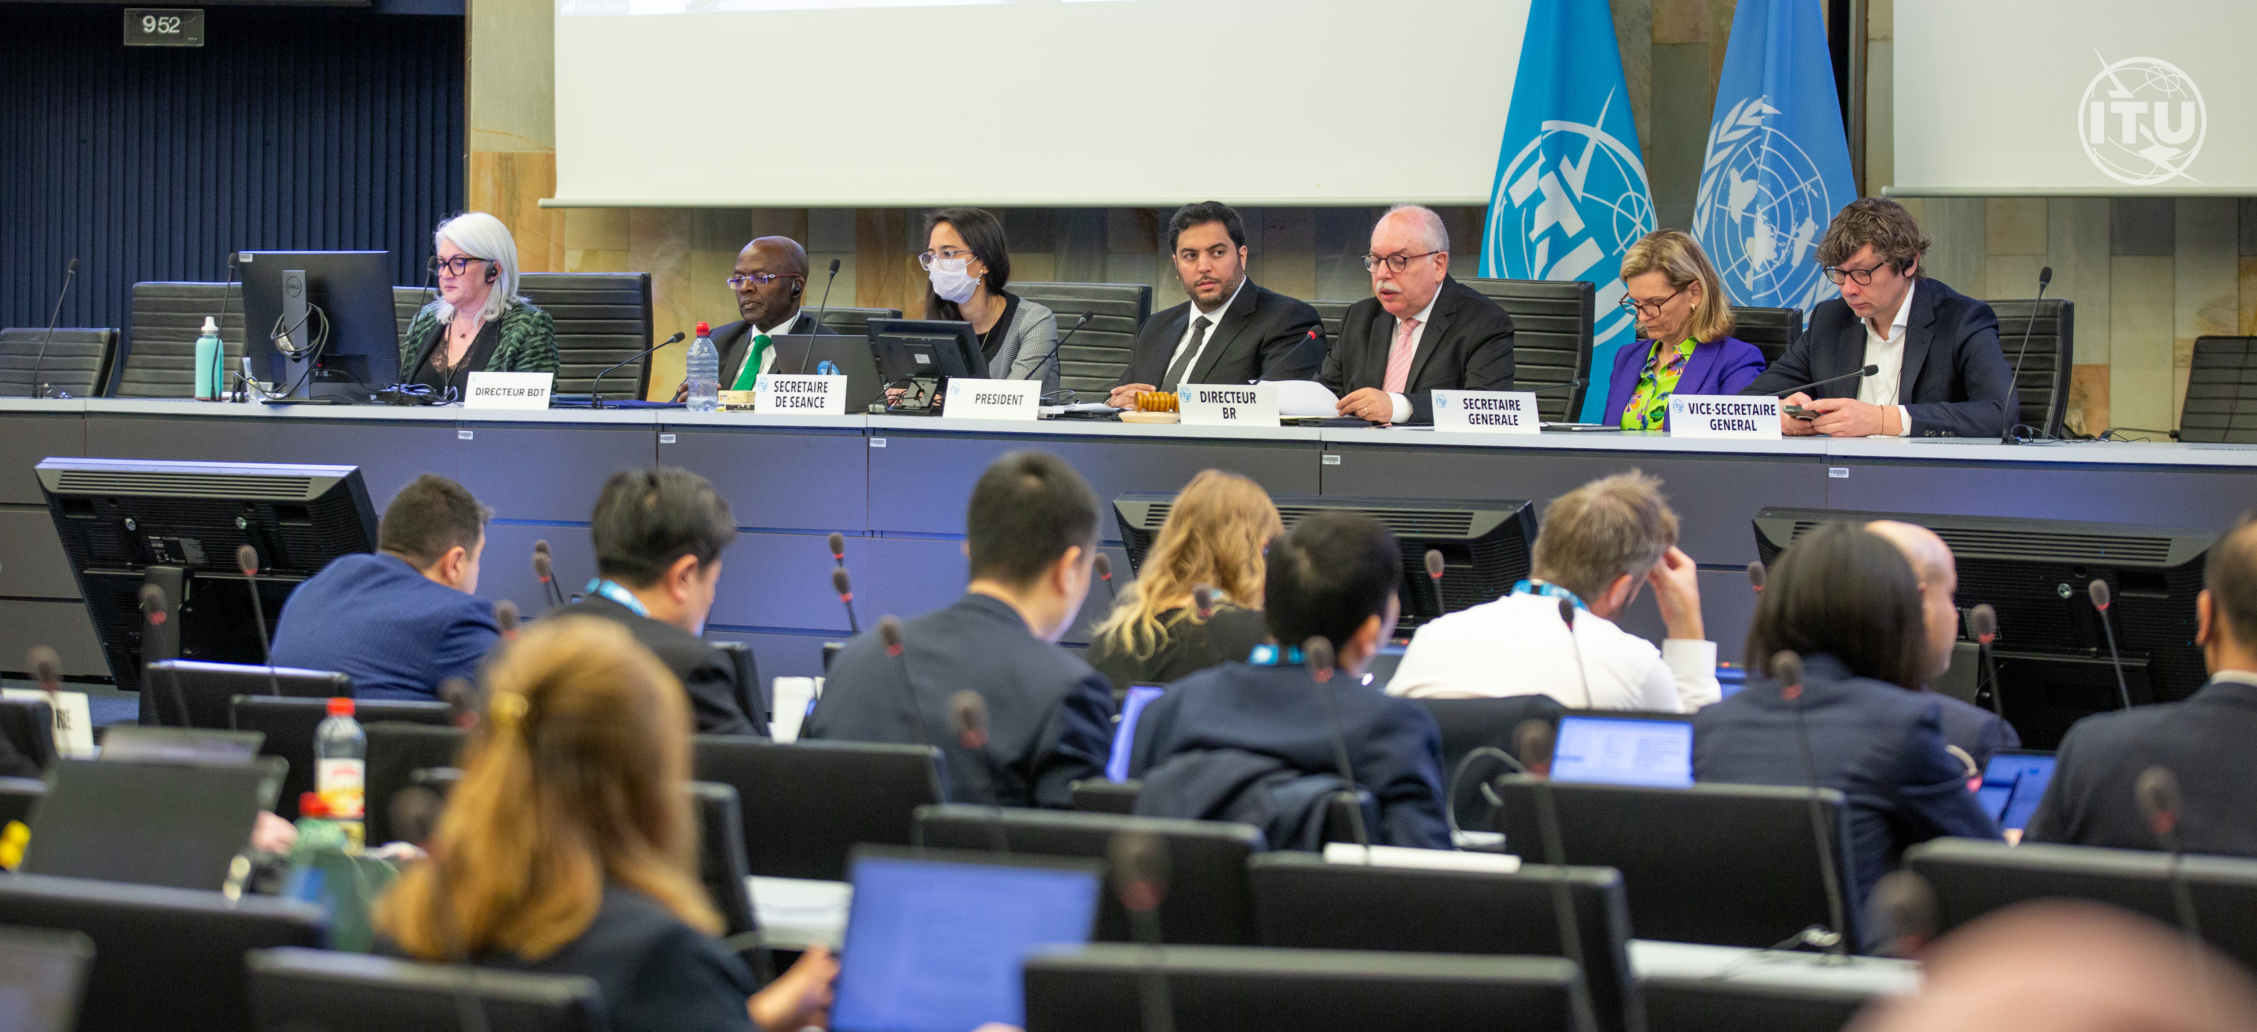
Decision-making assemblies, groups and high-level policy meetings
Radiocommunication Advisory Group
The Radiocommunication Advisory Group (RAG) is tasked to:
review the priorities and strategies adopted in the Sector;
monitor progress of the work of the Study Groups;
provide guidance for the work of the Study Groups;
recommend measures to foster cooperation and coordination with other organizations and with the other ITU Sectors.
The RAG provides advice on these matters to the Director of the Radiocommunication Bureau (BR). Radiocommunication Assemblies (RAs) may refer specific matters within its competence to the RAG.
The RAG may be authorized to act on behalf of the RA between two Assemblies.

Slide 20
ITU-R Membership
Who we are

Slide 21

ITU Membership
ITU’s membership is growing and diversifying to reflect the changing ecosystem
ITU brings together a global community of 194 Member States and over 1,000 industry companies, universities, research institutes, and international organisations — all working together to shape the future of digital technologies.
The world of technology is changing rapidly and ITU is changing with it, welcoming companies of all sizes, active in different sectors of the economy.

Slide 22

ITU-R membership categories:
What we do
ITU-R Sector membership:
Participation in all activities of ITU-R and decision-making meetings.
Eligibility to hold chair and vice-chair positions in all Radiocommunication Study Groups.
Participate in the final phase of the standards development process alongside Member States.
Opportunity to make written and oral contributions.
Hold rapporteur and editor positions in all ITU-R Study Groups.
Participate as observers in the World Radiocommunication Conferences.
Annual fee:
31,800 Swiss Francs
3'975 Swiss Francs — for Developing Countries with annual per capita income <2,000.00 USD (UNDP), that has not yet joined either or both Sectors and shall not be subsidiaries of a multinational corporation with HQ in a developed country.
Notes:
Note: companies are eligible for the ITU-T Associate SME fee if they have an annual revenue of no more than 15 million Swiss Francs and an employee count of no more than 250.

Slide 23
ITU-R membership categories:
What we do
ITU-R Associates:
Participation in ​a single ITU-R Study Group.
Opportunity to make written and oral contributions.
Can hold rapporteur and editor positions in the chosen Radiocommunication Study Group.
Associates cannot hold chair or vice-chair positions within the chosen ITU-R Study Group.​​
Annual fee:
10,600 Swiss Francs (for non-SMEs)
1,987.50 Swiss Francs (for SMEs from Developing Countries & LDCs)
3’975 Swiss Francs (for SMEs from Developed Countries)
Notes:
Note: companies are eligible for the ITU-T Associate SME fee if they have an annual revenue of no more than 15 million Swiss Francs and an employee count of no more than 250.

Slide 24
ITU-R membership categories:
What we do
Academia:
Academia Members have the right to participate in all three ITU sectors (Development, Radiocommunication, Standardization) with an annual reduced fee.
Accredited universities, technical institutes, and research organizations involved in teaching, research, or innovation in the field of ICT can become ITU Academia Members.
Annual fee:
3,975 Swiss Francs
1,987.50 Swiss Francs (Academia from developing countries)
Notes:
Note: companies are eligible for the ITU-T Associate SME fee if they have an annual revenue of no more than 15 million Swiss Francs and an employee count of no more than 250.

Slide 25

Membership admission process
What we do
Submit an online application for either for ITU-R Sector Membership or ITU-R Associate status in a single Radiocommunication Study Group of choice.
ITU will then seek approval for the membership application from the national administration of where your organization is located.
Once approval is granted by the national administration, ITU will provide your organization with the annual membership invoice.
your organization can activate the membership by making payment of the annual fee.
Apply for membership here: www.itu.int/hub/membership/become-a-member/application/

Slide 26

Discover our selection of publications
www.itu.int/hub/pubs

Slide 27

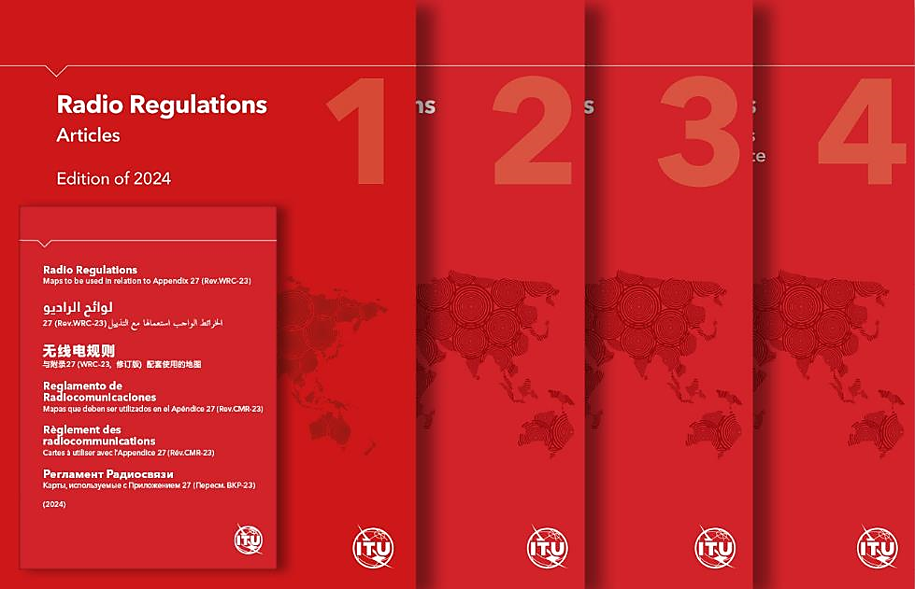
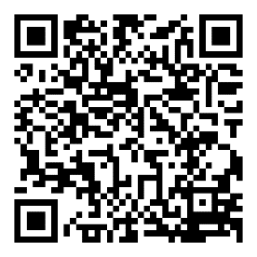
ITU Radio Regulations
2024 edition
The Radio Regulations is the international treaty governing the global use of radio-frequency spectrum and satellite orbits.
Updated every four years, the treaty serves as the cornerstone of international radio frequency management, ensuring that spectrum allocations keep pace with the rapidly evolving technological landscape and meet the needs of modern communication systems.
The 2024 Radio Regulations identifies new spectrum resources to support technological innovation, deepen global connectivity, increase access to and equitable use of space-based radio resources, and enhance safety at sea, in the air, and on land.
Scan or Browse link to learn more:
Available in all six languages of the Union
www.itu.int/pub/R-REG-RR

Slide 28

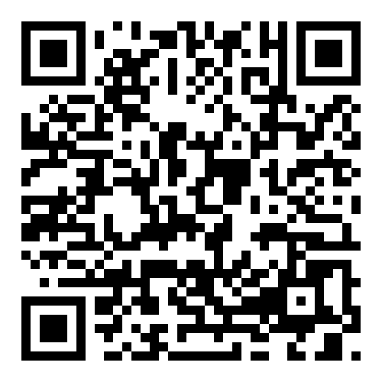
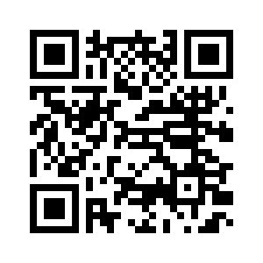
WRS-24 on Demand
Replay the World Radiocommunication Seminar (WRS-24) Plenary Sessions and Workshops to catch up on the use of the radio-frequency spectrum, satellite orbits, the application of the ITU Radio Regulations, and trends in radiocommunication services.
Scan or Browse links to learn more: www.itu.int/wrs-24/plenary-sessions-on-demand/
Workshops
Plenary Sessions
www.itu.int/wrs-24/workshops/

Slide 29

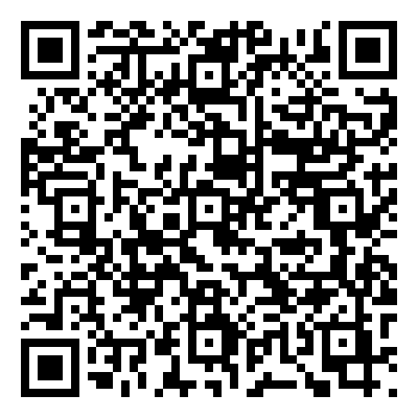
ITU Space Explorer
ITU Space Explorer provides a user-friendly access to the Space Networks Systems Database (SNS) of the Radiocommunication Bureau.
It contains data on geostationary satellite filings, non-geostationary satellite filings, Earth station filings, and Radio Astronomy filings.
It aims to enhance the accessibility and transparency of information stored in the Master International Frequency Register (MIFR) and other space-related databases.
Scan or Browse link to learn more: www.itu.int/itu-r/space/apps/public/spaceexplorer/networks-explorer

Slide 30

BR IFIC Online Hub
The BR International Frequency Information Circular (BR IFIC) provides essential information on frequency assignments and allotments submitted by administrations for recording in the Master International Frequency Register and Plans.
The BR IFIC is published once every two weeks by the Bureau, pursuant to Article 20 of the Radio Regulations.
The BR IFIC Online HUB brings together information and useful links for Space and Terrestrial Services
Scan or Browse link to learn more:
www.itu.int/itu-r-brific-hub

Slide 31
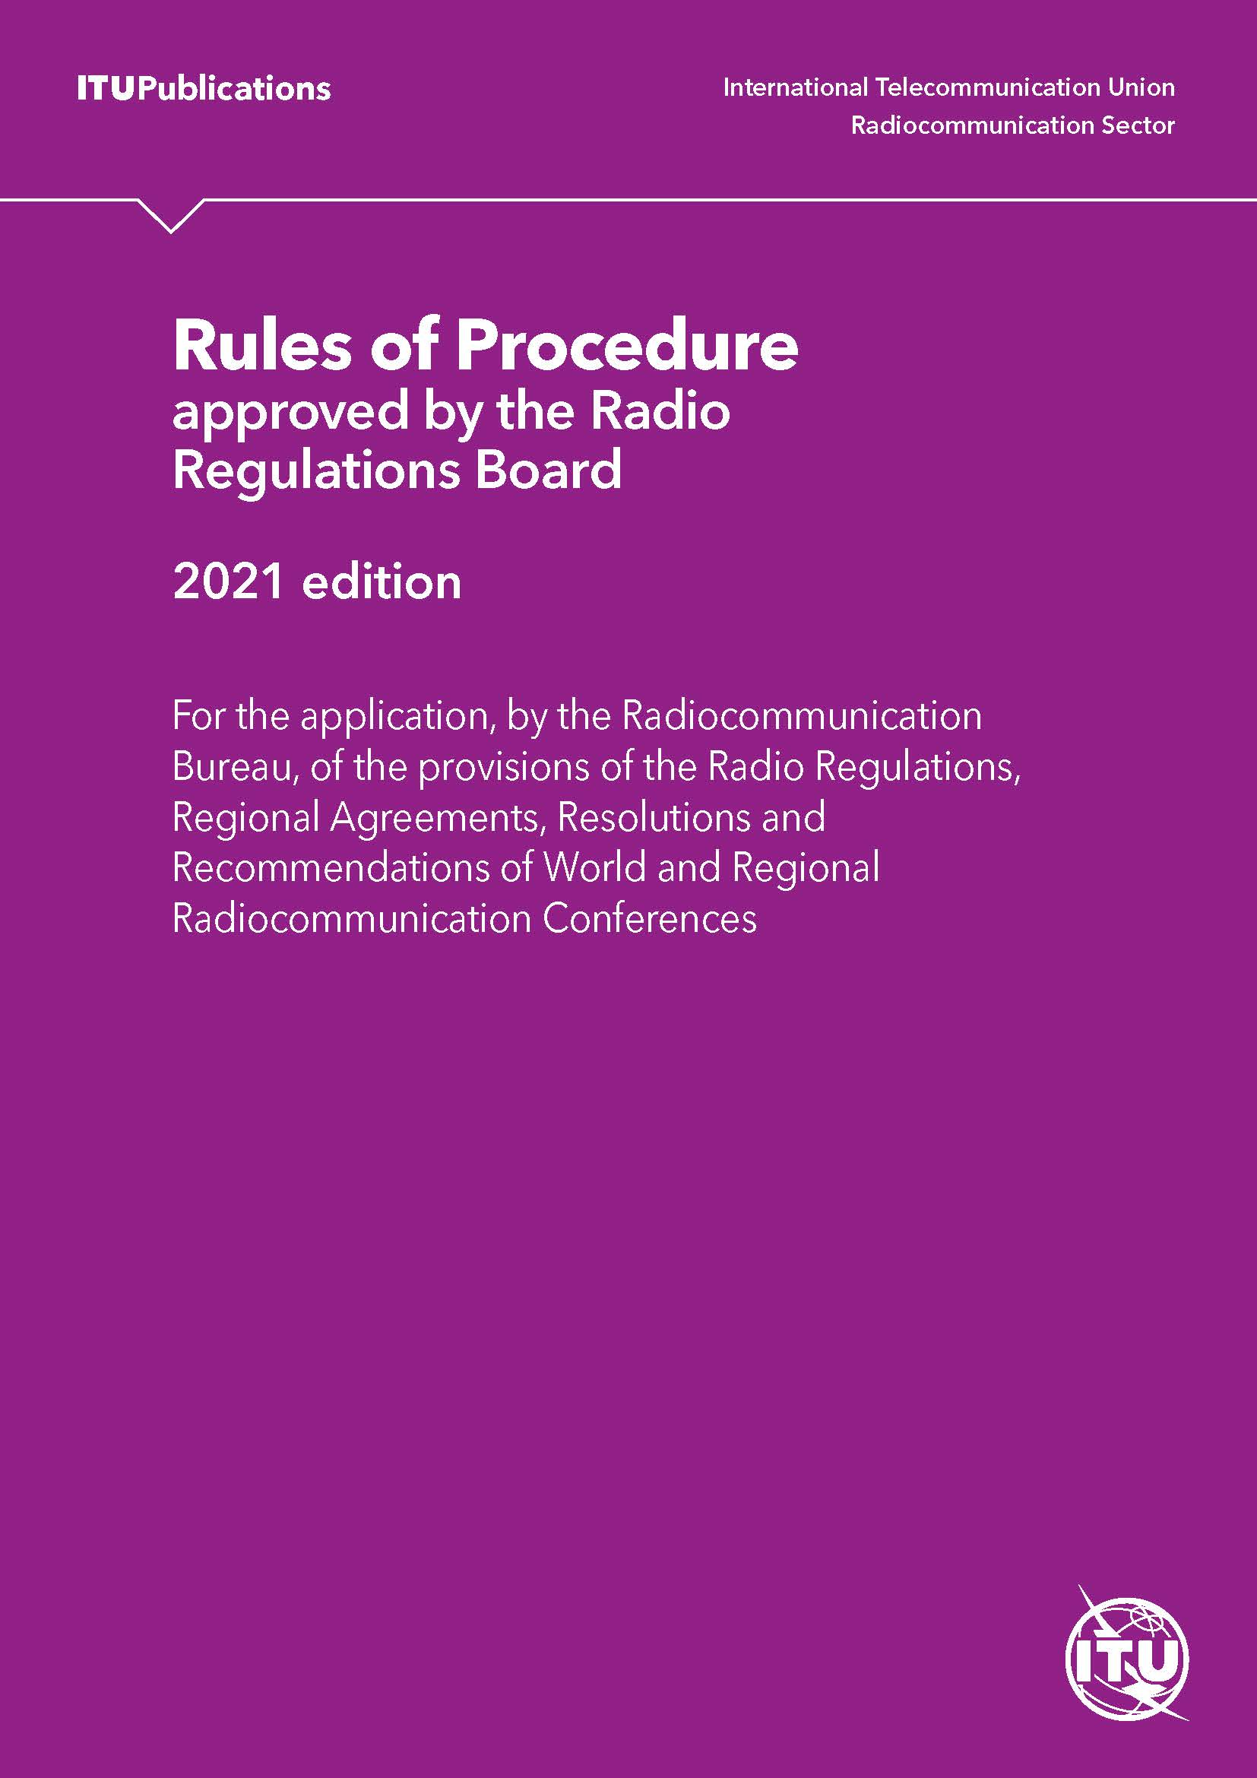
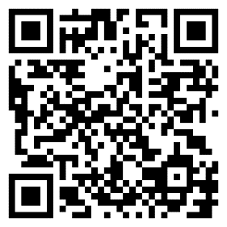
Rules of Procedure
The Rules of Procedure complement the ITU Radio Regulations (RR) by providing clarification on the application of particular Regulations or establishing the necessary practical procedures that may not be provided for in the current Regulatory Provisions.
Scan or Browse link to learn more:
www.itu.int/pub/R-REG-ROP

Slide 32
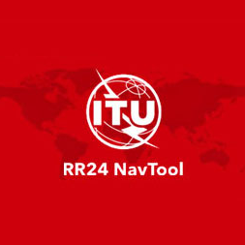
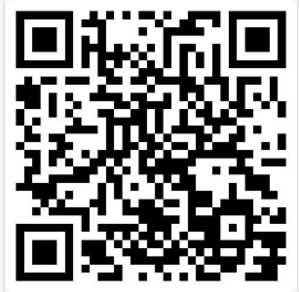
Radio Regulations Navigation Tool
2025 Edition
The Radio Regulations Navigation Tool assists users in navigating complex spectrum regulations, making them more transparent and accessible to ITU’s global membership. The tool gives users one-stop access to:
The latest ITU Radio Regulations (2024 edition), complete with all Articles, Appendices, Resolutions and Recommendations.
ITU Collection of the basic texts adopted by the Plenipotentiary Conference, including the Constitution and Convention.
ITU Rules of Procedure for radio spectrum coordination.
ITU-R Recommendations cited by reference in the Radio Regulations.
Scan or Browse link to learn more:
www.itu.int/pub/R-REG-RRX

Slide 33
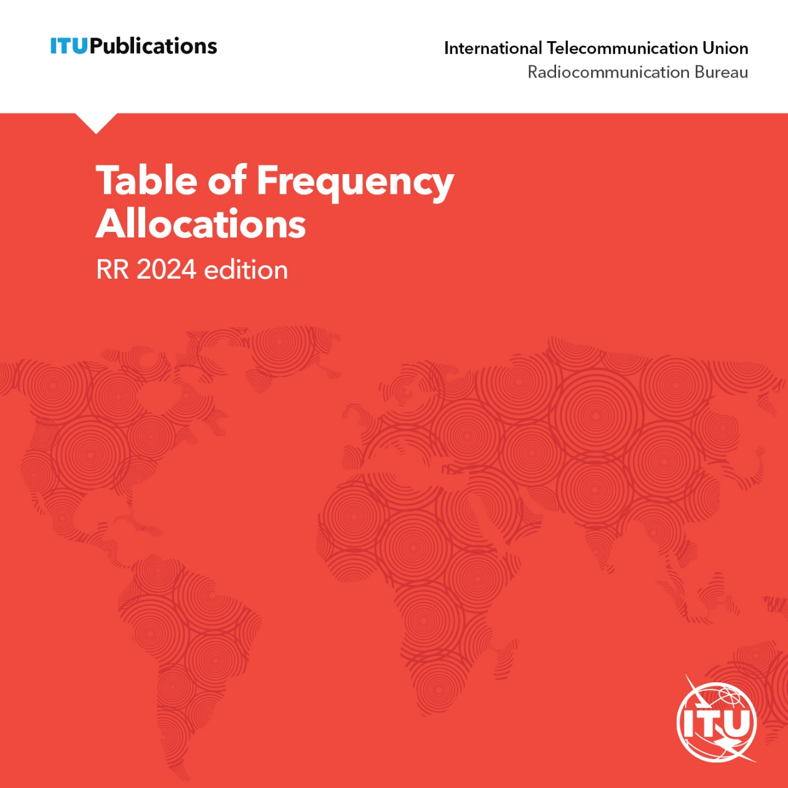
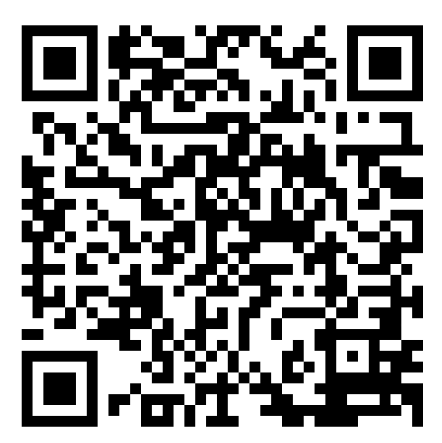
RR5 Table of Frequency Allocations Software
2024 Edition
The TFA software provides a way to electronically query and analyze the Table of Frequency Allocations (TFA) and its associated footnotes, as presented in Article 5 of the Radio Regulations, as well as related texts such as ITU-R Resolutions, Recommendations and Rules of Procedure.
It includes tools for exporting data in multiple formats, and for tracing and comparing historical changes to the Article 5 Table and its footnotes, including their evolution, introduction dates and suppression dates, from the 2001 Edition onward, where available.
It allows the extraction of regional or country-specific regulations, such as the National Table of Frequency Allocations (NTFA) for a given country, by combining the information contained in Article 5 of the Radio Regulations.
This is a standalone application that does not require a network or Internet connection.
Scan or Browse link to learn more:
www.itu.int/pub/R-REG

Slide 34
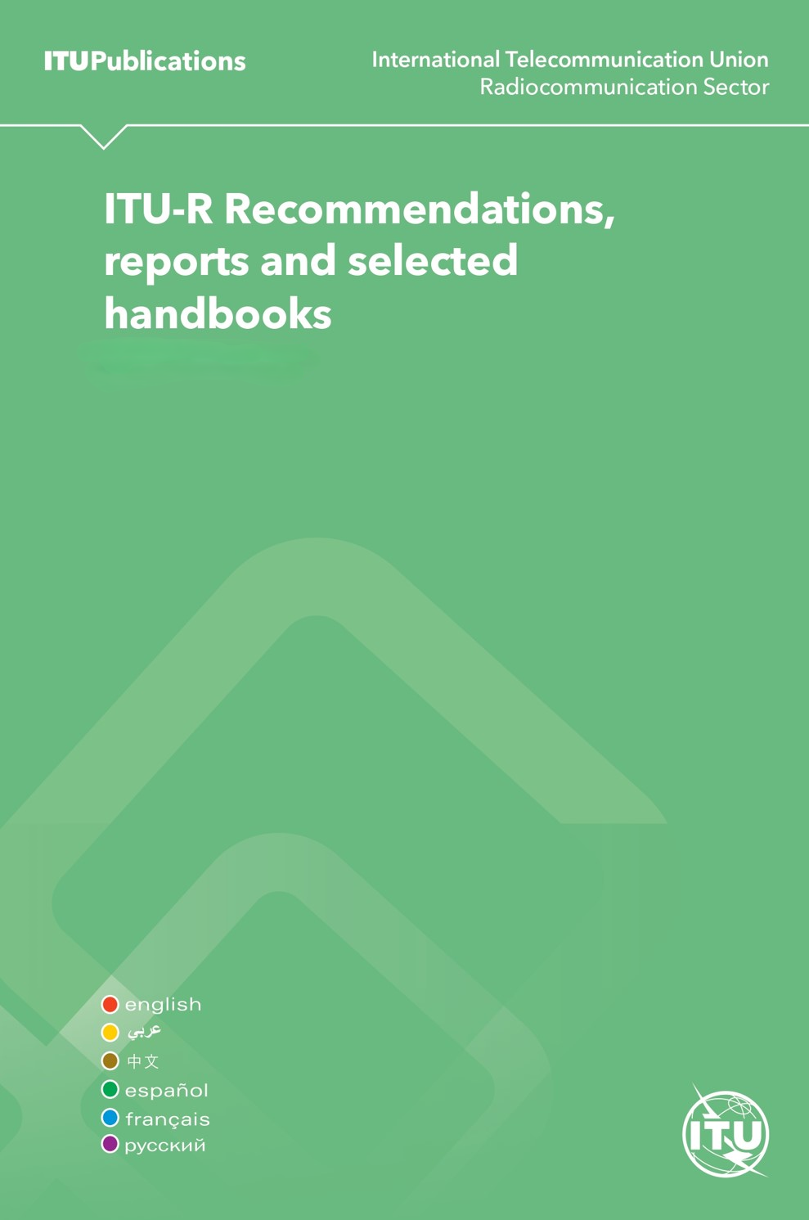
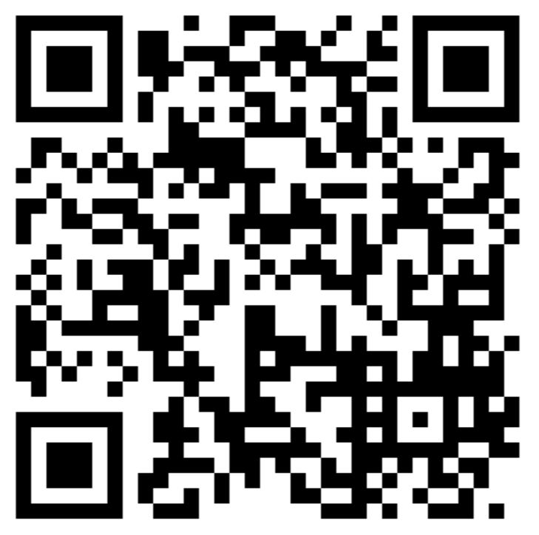
ITU-R Recommendations, Reports and selected Handbooks
ITU-R Recommendations are international standards on spectrum and orbit management, radio system performance, spectrum monitoring, and emergency radiocommunications.
ITU-R Reports provide technical, operational, or procedural information from study groups.
ITU-R Handbooks compile current knowledge and best practices in radiocommunications.
All documents available individually online:
Recommendations: www.itu.int/pub/R-REC
Reports: www.itu.int/pub/R-REP
Handbooks: www.itu.int/pub/R-HDB
Scan to learn more:

Slide 35
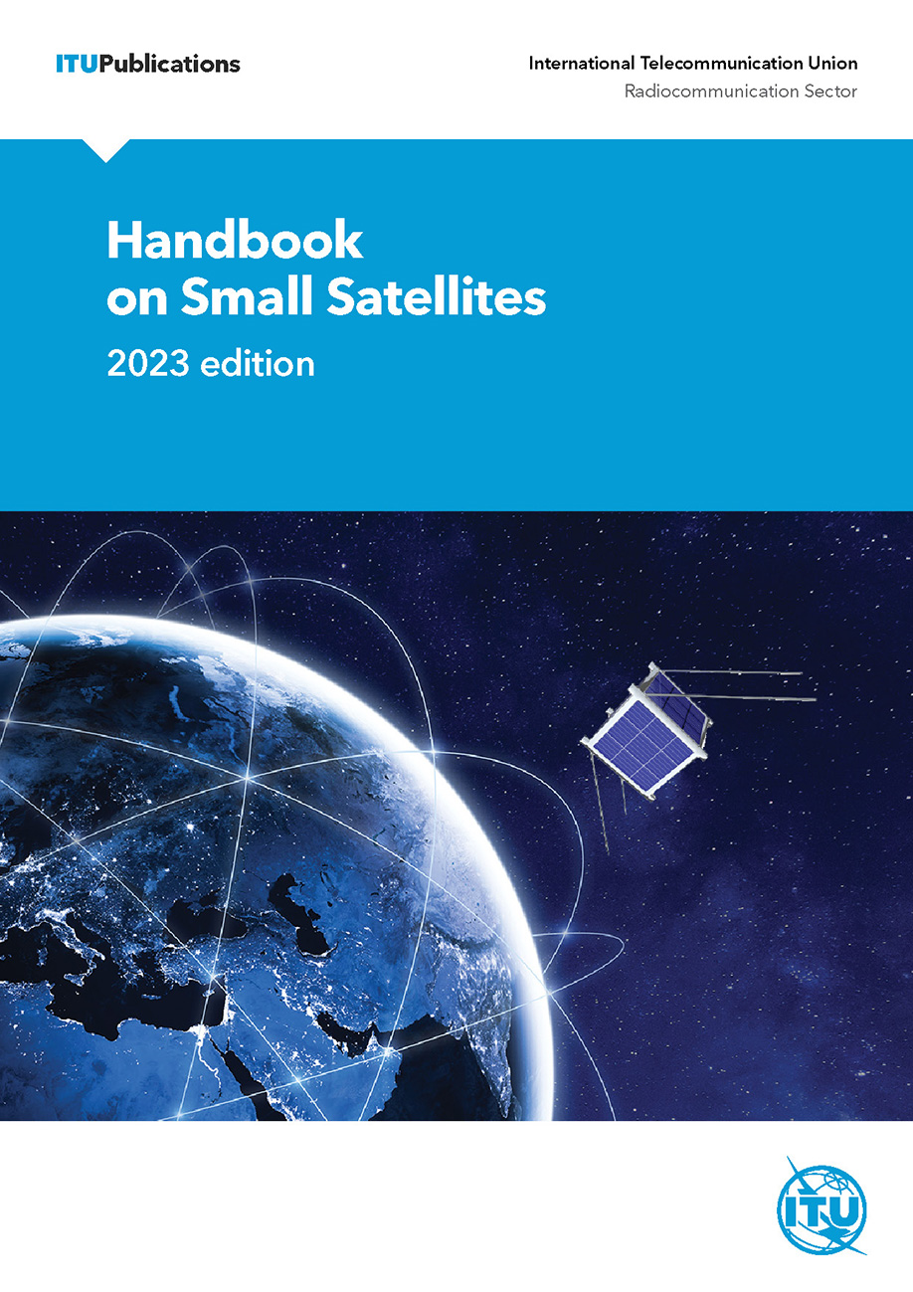
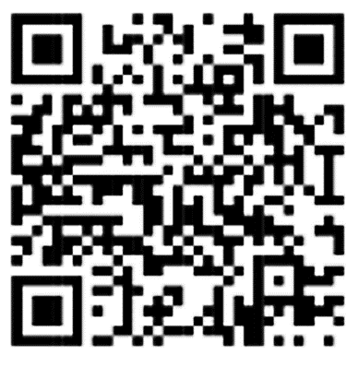
Handbook on Small Satellites
The Handbook offers insights and guidance on the design, launch and operation of Small Satellites.
Users can:
Explore radio regulatory procedures and spectrum utilization for small satellites
Learn about historical perspectives and types of small satellites
Discover different services, missions, and space object registration
Gain insights into systems engineering and characteristics of small satellite systems
Scan or Browse link to learn more:
www.itu.int/pub/R-HDB-65

Slide 36
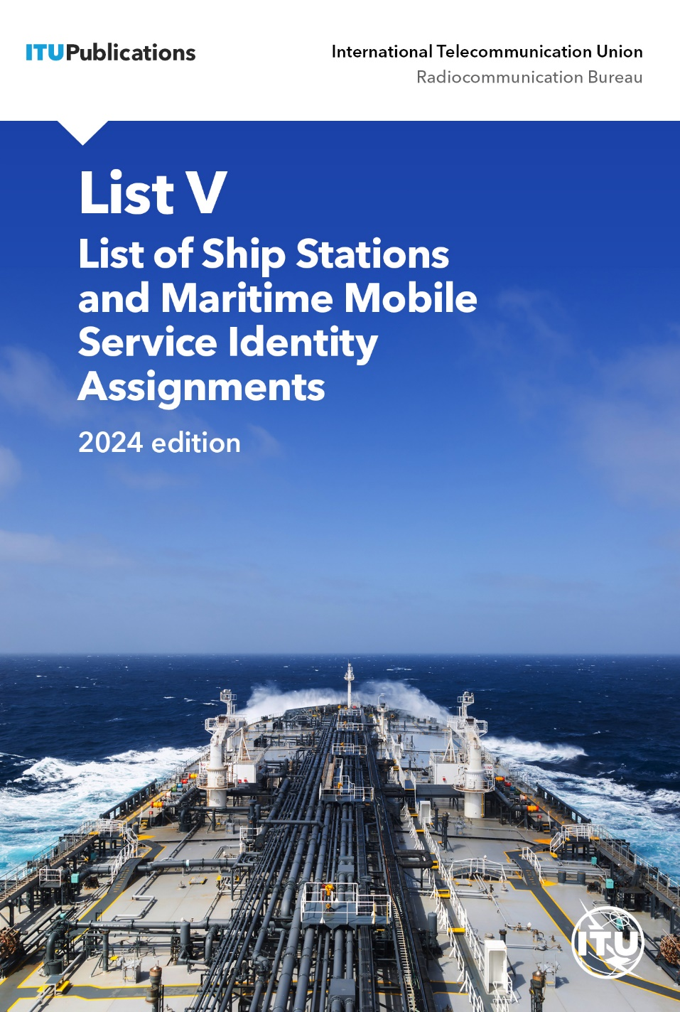
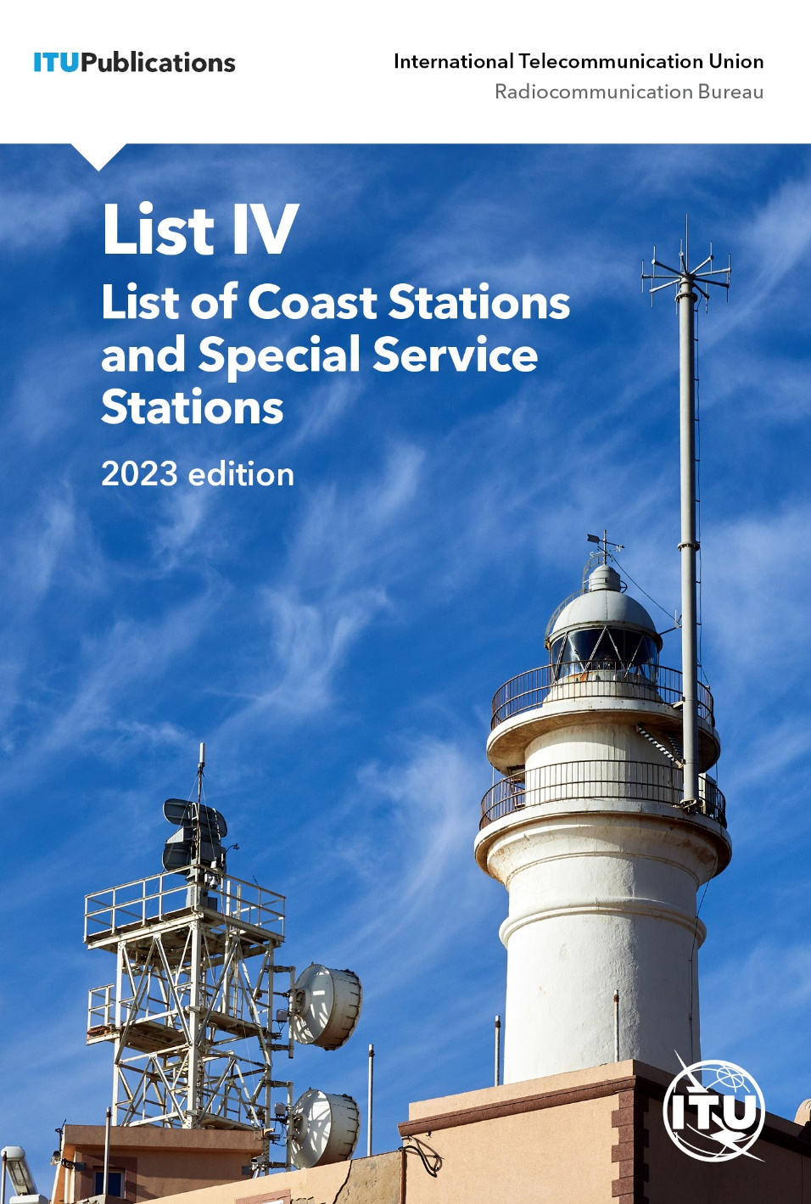
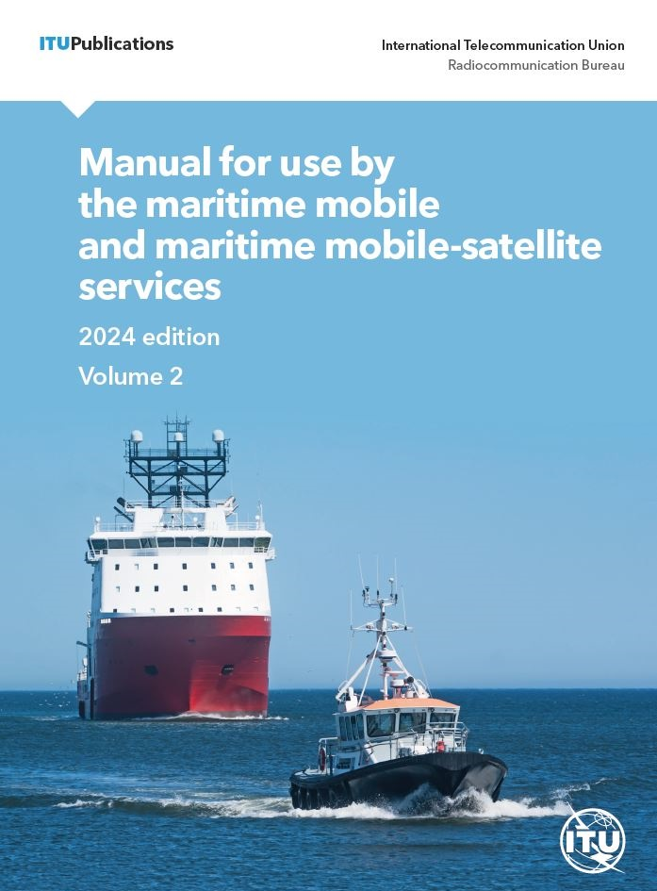
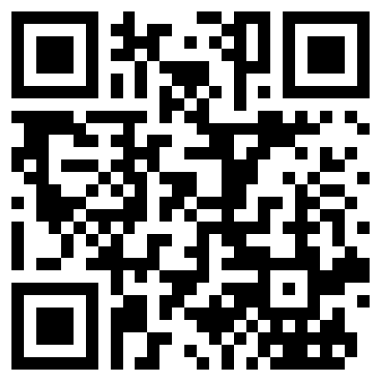
ITU Maritime publications
Manual for use by the maritime mobile and
maritime mobile-satellite services (2024)
List IV - List of Coast Stations and
Special Service Stations (2023)
List V - List of Ship Stations and
Maritime Mobile Service Identity Assignments (2024)
Scan or Browse link to learn more:
www.itu.int/pub/R-SP-LM/

Slide 37

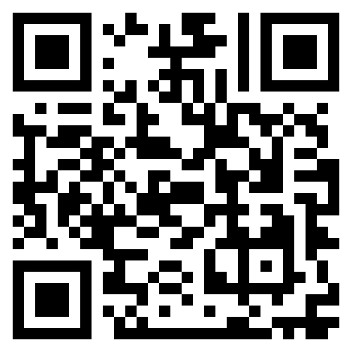
ITU-R Network of Women for WRC-27
The NOW4WRC27 is a forum for networking, mentoring, and knowledge sharing aimed at promoting gender equality and enhancing the participation of women in the ITU Radiocommunication Sector
Join us at: www.itu.int/now4wrc

Slide 38
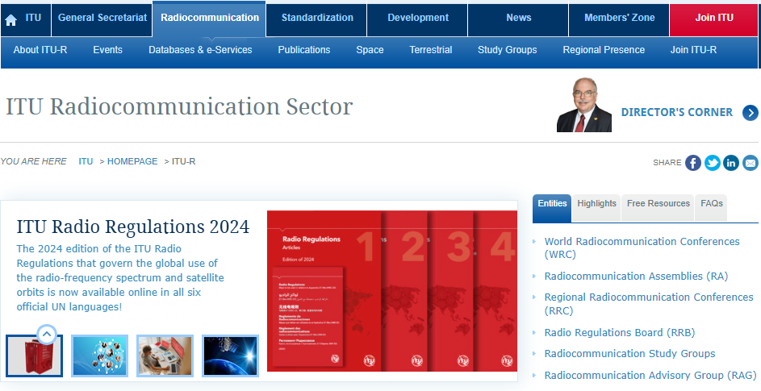
JOIN US!
ITU-R_Membership@itu.int

