Slide 1
Investing in Space Sustainability: The private sector perspective
Candace Johnson
Chair Advisory Board, Investment Advisory Committee and Partner
Seraphim Space

Slide 2
Spacetech core to deeptech
Space is a bigger market today than both A.I. and climate tech combined. It is projected to triple in size over the next decade, making it one of the largest deep tech categories
$7.4tn (8% CAGR)
= 2023 market size
= future market size
$3.4tn
$3.7tn (9% CAGR)
$2.3tn
$1.8tn (9% CAGR)
$2.0tn (29% CAGR)
$0.6tn
$0.2tn
$0.2tn (24% CAGR)
$19bn
Life sciences¹
defence²
space³
a.I.⁴
Climate tech⁵
¹ Source: Precedence Research, Nova1Advisors , Fortune Business Insights. Future market size projections for 2032 based on extrapolation of projected growth rates ,
² Source: Business Insights Research. Future market size projections for 2032
³ Source: McKinsey. Future market size projections for 2035
⁴ Source: Median composite market size based on reports including: Bain, BBG, BBG, Grand View Research, Statista, Technavio, Global Data, Deloitte, Fortune Business Insights, SkyQuest. Future market size projections for 2032 based on extrapolation of projected growth rates ,
⁵ Source: Spherical Insights . Future market size projections for 2033

Slide 3
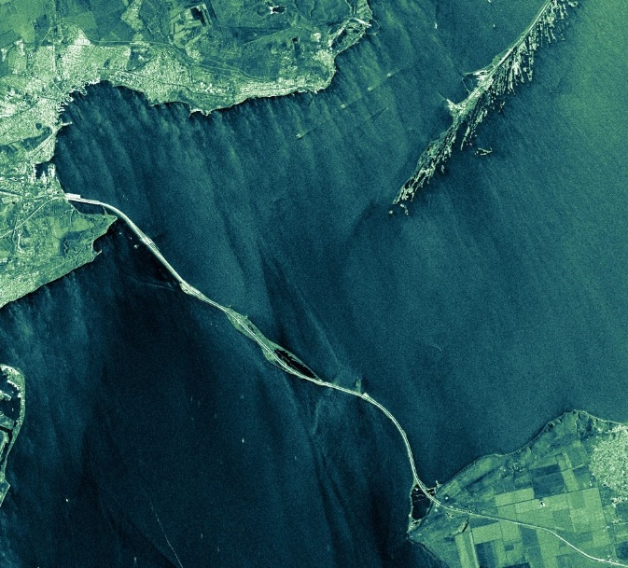
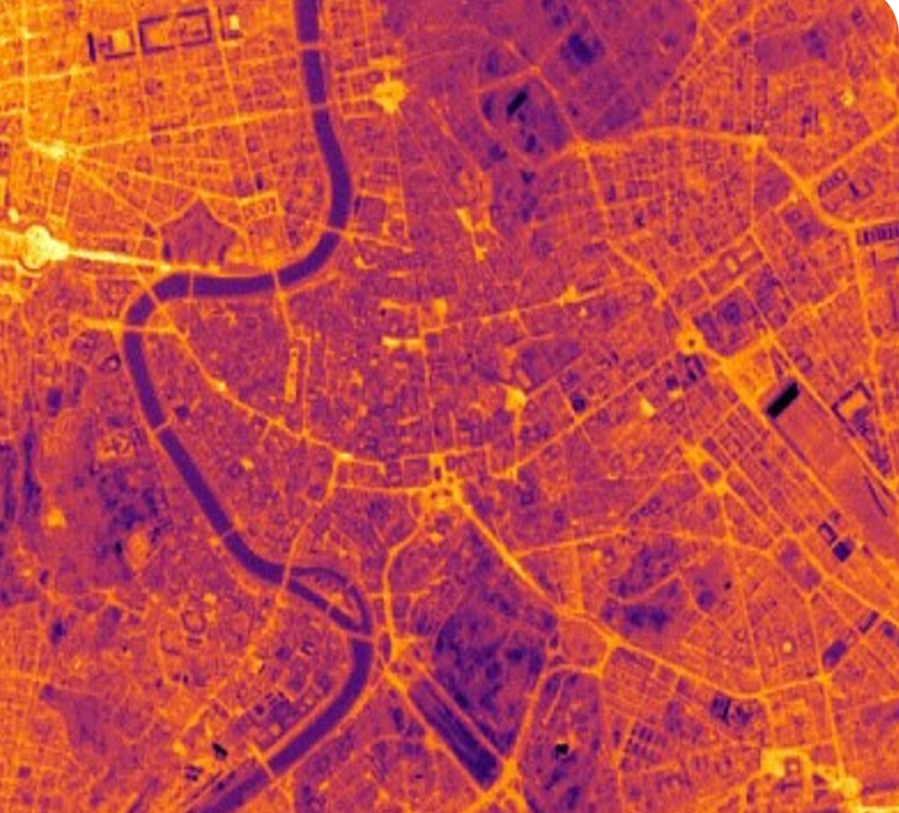
dual-use Key Themes & powerful tailwinds
Bloomberg NEF estimated that global climate tech investment would reach $1.1 trillion per year by 2030
The IEA (International Energy Agency) has highlighted that to reach net-zero emissions by 2050, $4 trillion per year would be needed by 2030 across all sectors, including energy, transport, and industry
In USA Donald Trump’s $1 trillion Defence budget includes $250 billion for Golden Dome
European leaders have committed €800 billion defence budget, whilst Germany alone has €500 billion committed to address their sovereign defence needs
Climate & Sustainability
Radar image of Kerch Strait Bridge in Crimea taken by ICEYE
Only with space-derived ‘earth intelligence’ can we combat global challenges and drive to Net Zero
Global Security
Space provides the insights and the resilience to protect democracies and combat geo-political tensions
Infrared thermal image of Rome taken by SatVu
Notes:
So these are the key themes of the fund, Security, Climate, Manufacturing and one or two Moonshots like solar farms in space to bring clean energy back to earth.

Slide 4
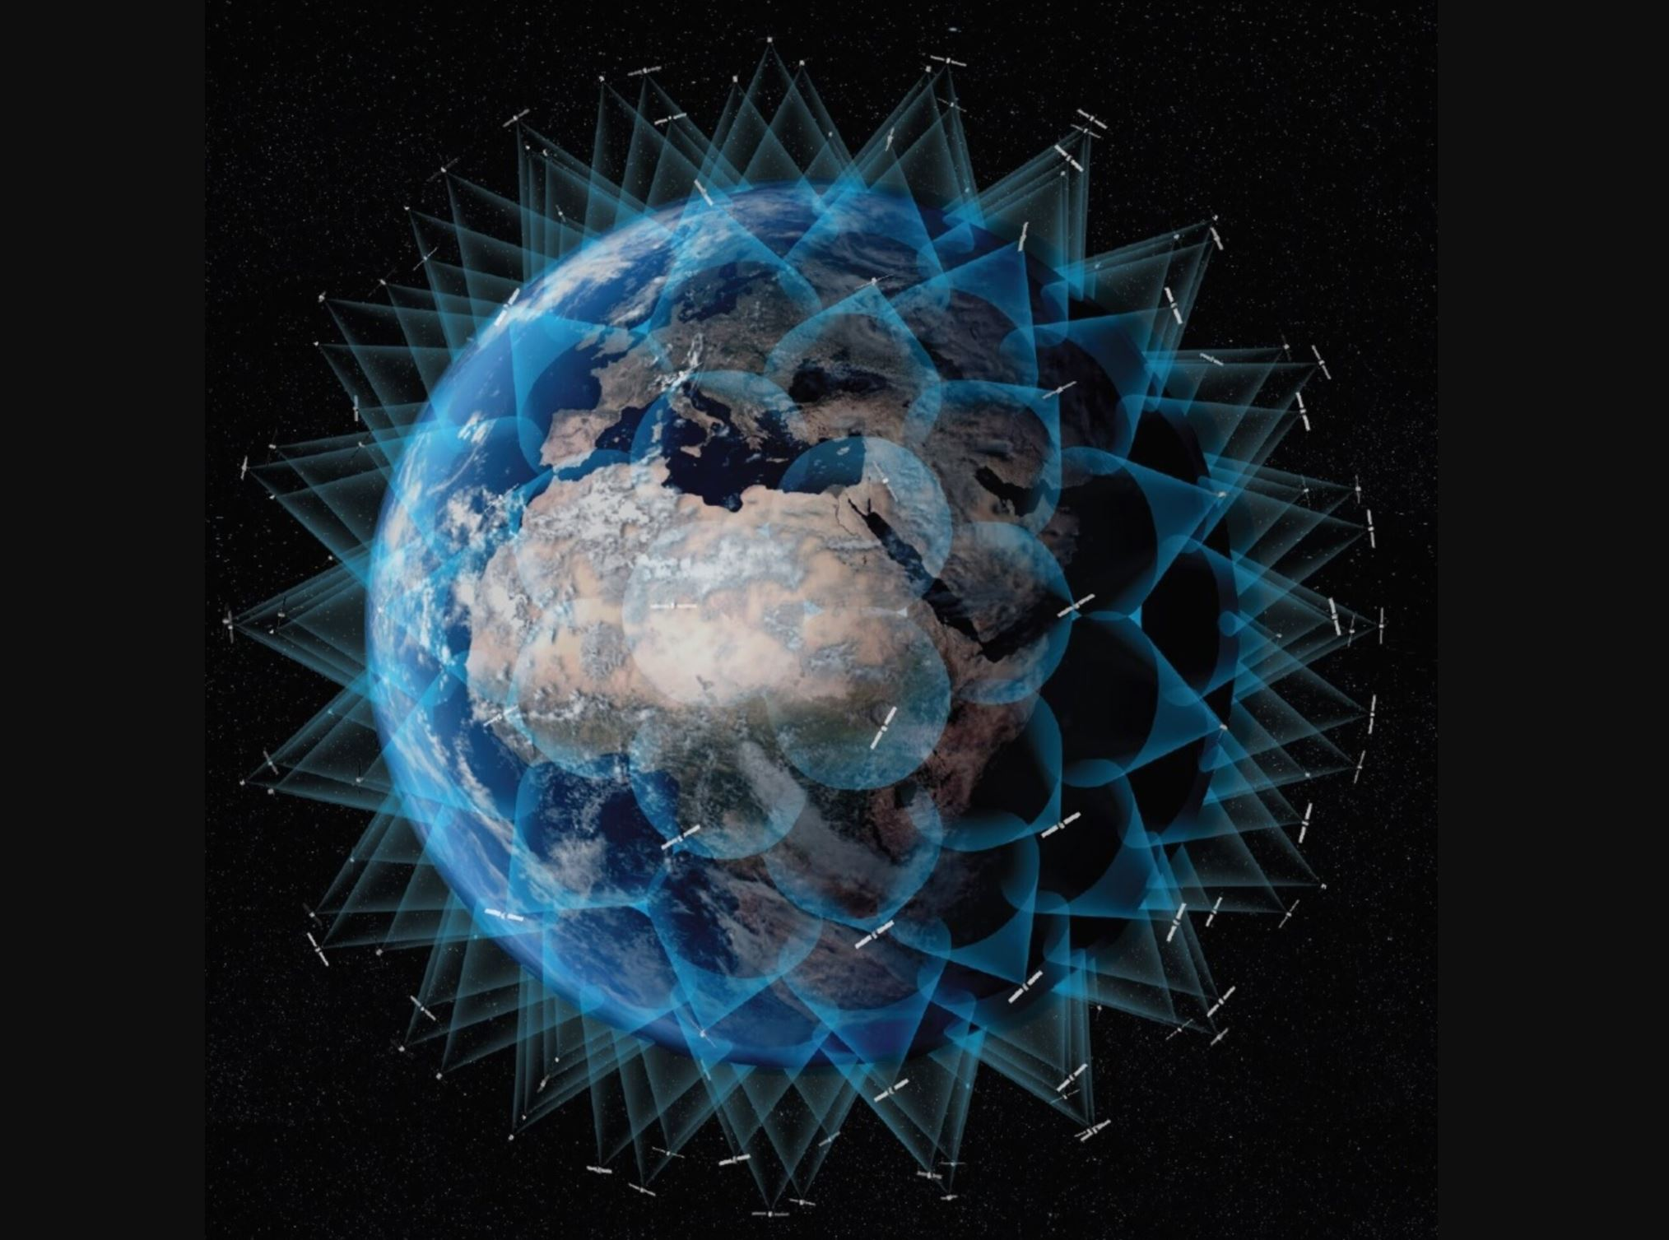
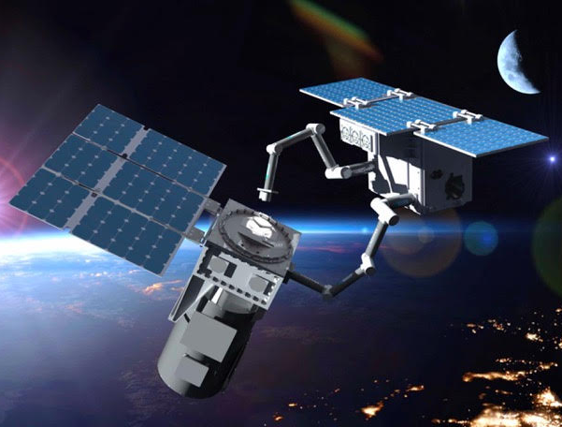
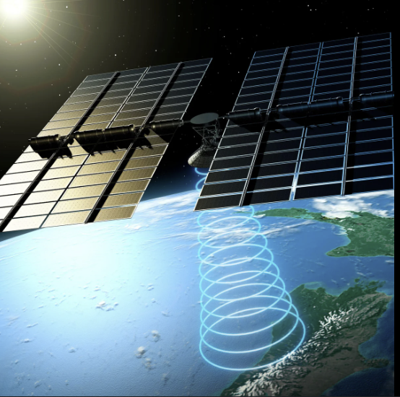
Market evolution
Driven by these tailwinds, the space market is evolving rapidly, unlocking new multi $billion greenfield opportunities that extend far beyond just the space sector
space 2.0 (now)
space 3.0 (next)
space 4.0 (future)
Space to Earth digital platform
Large constellations of satellites are creating a new digital infrastructure in the sky
Real-time insights on every m² of the planet. A.I. + data fusion = Google scale data set
Reshaping entire sectors, unlocking new applications, catalysing megatrends
From Earth to Space and back
Space-based networks on orbit edge compute, internet, communications and data relay
Sustainable space: space debris removal, satellite servicing, situational awareness
Microgravity - a new platform for R&D and manufacturing; scientific breakthroughs – new drugs, new materials
Space resources for Earth
Space-based solar energy: sun delivers more energy in an hour than world consumes in a year
Lunar / asteroid natural resources: replacement for terrestrial rare earth materials
Real estate: commercial space stations for commerce and tourism, lunar habitations and beyond
Notes:
The fund will offer diversified early exposure to future category leaders aligned with each phase of the SpaceTech market’s continued evolution
Space 2.0
Large constellations of satellites are creating a new digital infrastructure in the sky
Real time insights on every m² of the planet. A.I. + data fusion = Google scale data set
Reshaping entire sectors, unlocking new applications, catalysing megatrends
Space 3.0
Space-based networks: on orbit edge compute, internet, communications and data relay
Sustainable Space: Space debris removal, satellite servicing, situational awareness
New platforms for R&D and manufacturing; scientific breakthroughs – new drugs, new materials
Space 4.0
Space-based solar energy: sun delivers more energy in an hour than world consumes in a year
Lunar / asteroid natural resources: replacement for terrestrial rare earth materials
Real estate: commercial space stations for commerce and tourism, lunar habitations and beyond

Slide 5

2024 Index Highlights Recording the investment activity in New Space
$8.6bn invested in 2024
$6.9bn invested in 2023
25% Increase
TTM Investment ($bn)
601 deals in 2024
TTM Deals (#)
Quarterly Investment Trends: SpaceTech vs. General VC
415 deals in 2023
45% Increase

Slide 6
Once in a generation opportunity More capital in last 4 years than the rest of history
VC Investment ($bn)
Annual deal Tracker (12 months rolling)
(5 yrs)
(5 yrs)
(5 yrs)
(5 yrs)
Number of deals by stage (12 months rolling)
Investment by taxonomy ($bn)

Slide 7
Q3 25 Index Highlights Recording the investment activity in New Space
$3.5bn invested in Q3 2025
$10.4bn invested in the Trailing Twelve Months
$30m average deal size in Q3 2025 ($25.5m in Q2 2025)
$336m biggest deal closed (Galactic Energy Aerospace Technology)
Q3 2025 has been the largest in terms of investment on record at $3.5bn, surpassing the prior all-time high of Q2 2021 at $3.37bn!

Slide 8

Seraphim spaceTech Investment tracker (TTM):
Massive increase in both $ and # SpaceTech VC deals since 2020
SpaceTech outpacing general VC in last few years
SpaceTech continues to outperform general VC
Sustained growth in both $ invested and # deals over last year
Contrast with continued declining investment cadence in wider VC market

Slide 9

Sector developments
SpaceTech Investment Overview (TTM to Q2 2025)
Milestones & Market Trends (Q3)
📡 Satellite constellation race heats up, SpaceX spends $17B on spectrum licenses, Amazon’s Project Kuiper continues mass liftoff – hitting fifth successful launch in September
📊 IPO momentum builds, Firefly hits $9.8B valuation in August after IPO, following on from Voyager and Karman Holdings
🔮 Defense & infrastructure drive growth, ICEYE lands multiple 9-figure defense contracts in Q3
🚀 Historic launch: SpaceX’s Starship, the world’s most powerful rocket, pushes sub-$100/kg payload costs closer to reality
🌐 Record pace: 149 launches in H1 — averaging a liftoff to orbit every 28 hours
🚀 Q2 marked the second largest quarter of investment into SpaceTech on record, with a total of $3.1bn deployed — up from $2bn in Q1.
🏗️ Focus remained on capital-intensive sectors: hardware, infrastructure, launch, satellites.
💰 Largest deal: Impulse Space $300M Series C
🌎US captured 70% of global SpaceTech investment.
📈 Series B & C rounds made up 65% of total investment — a record high, signaling strong investor appetite for early-growth companies.

Slide 10
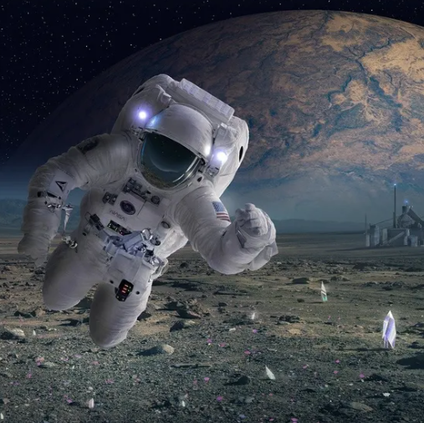
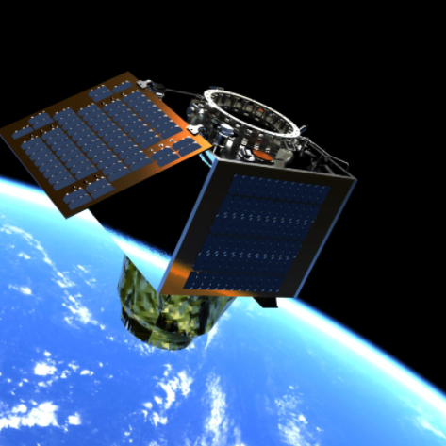
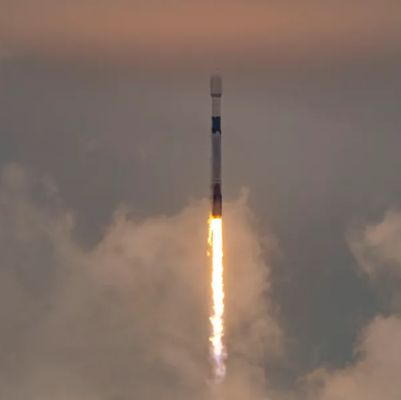
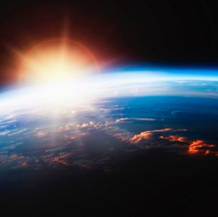
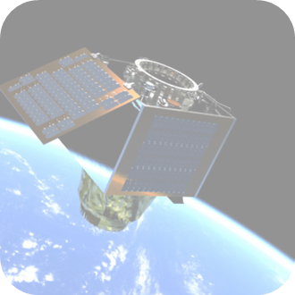



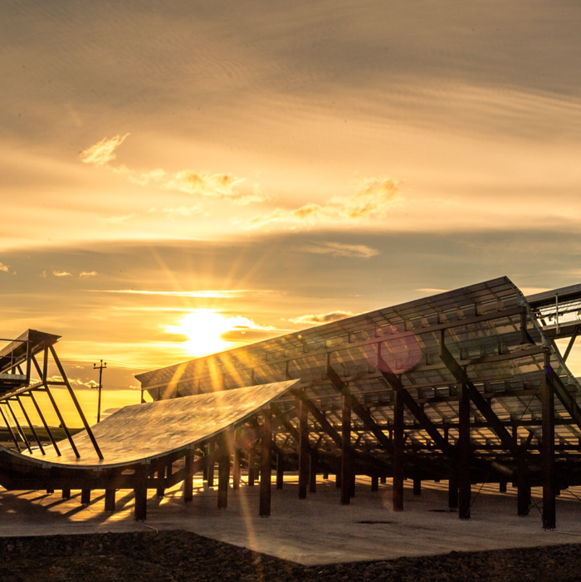
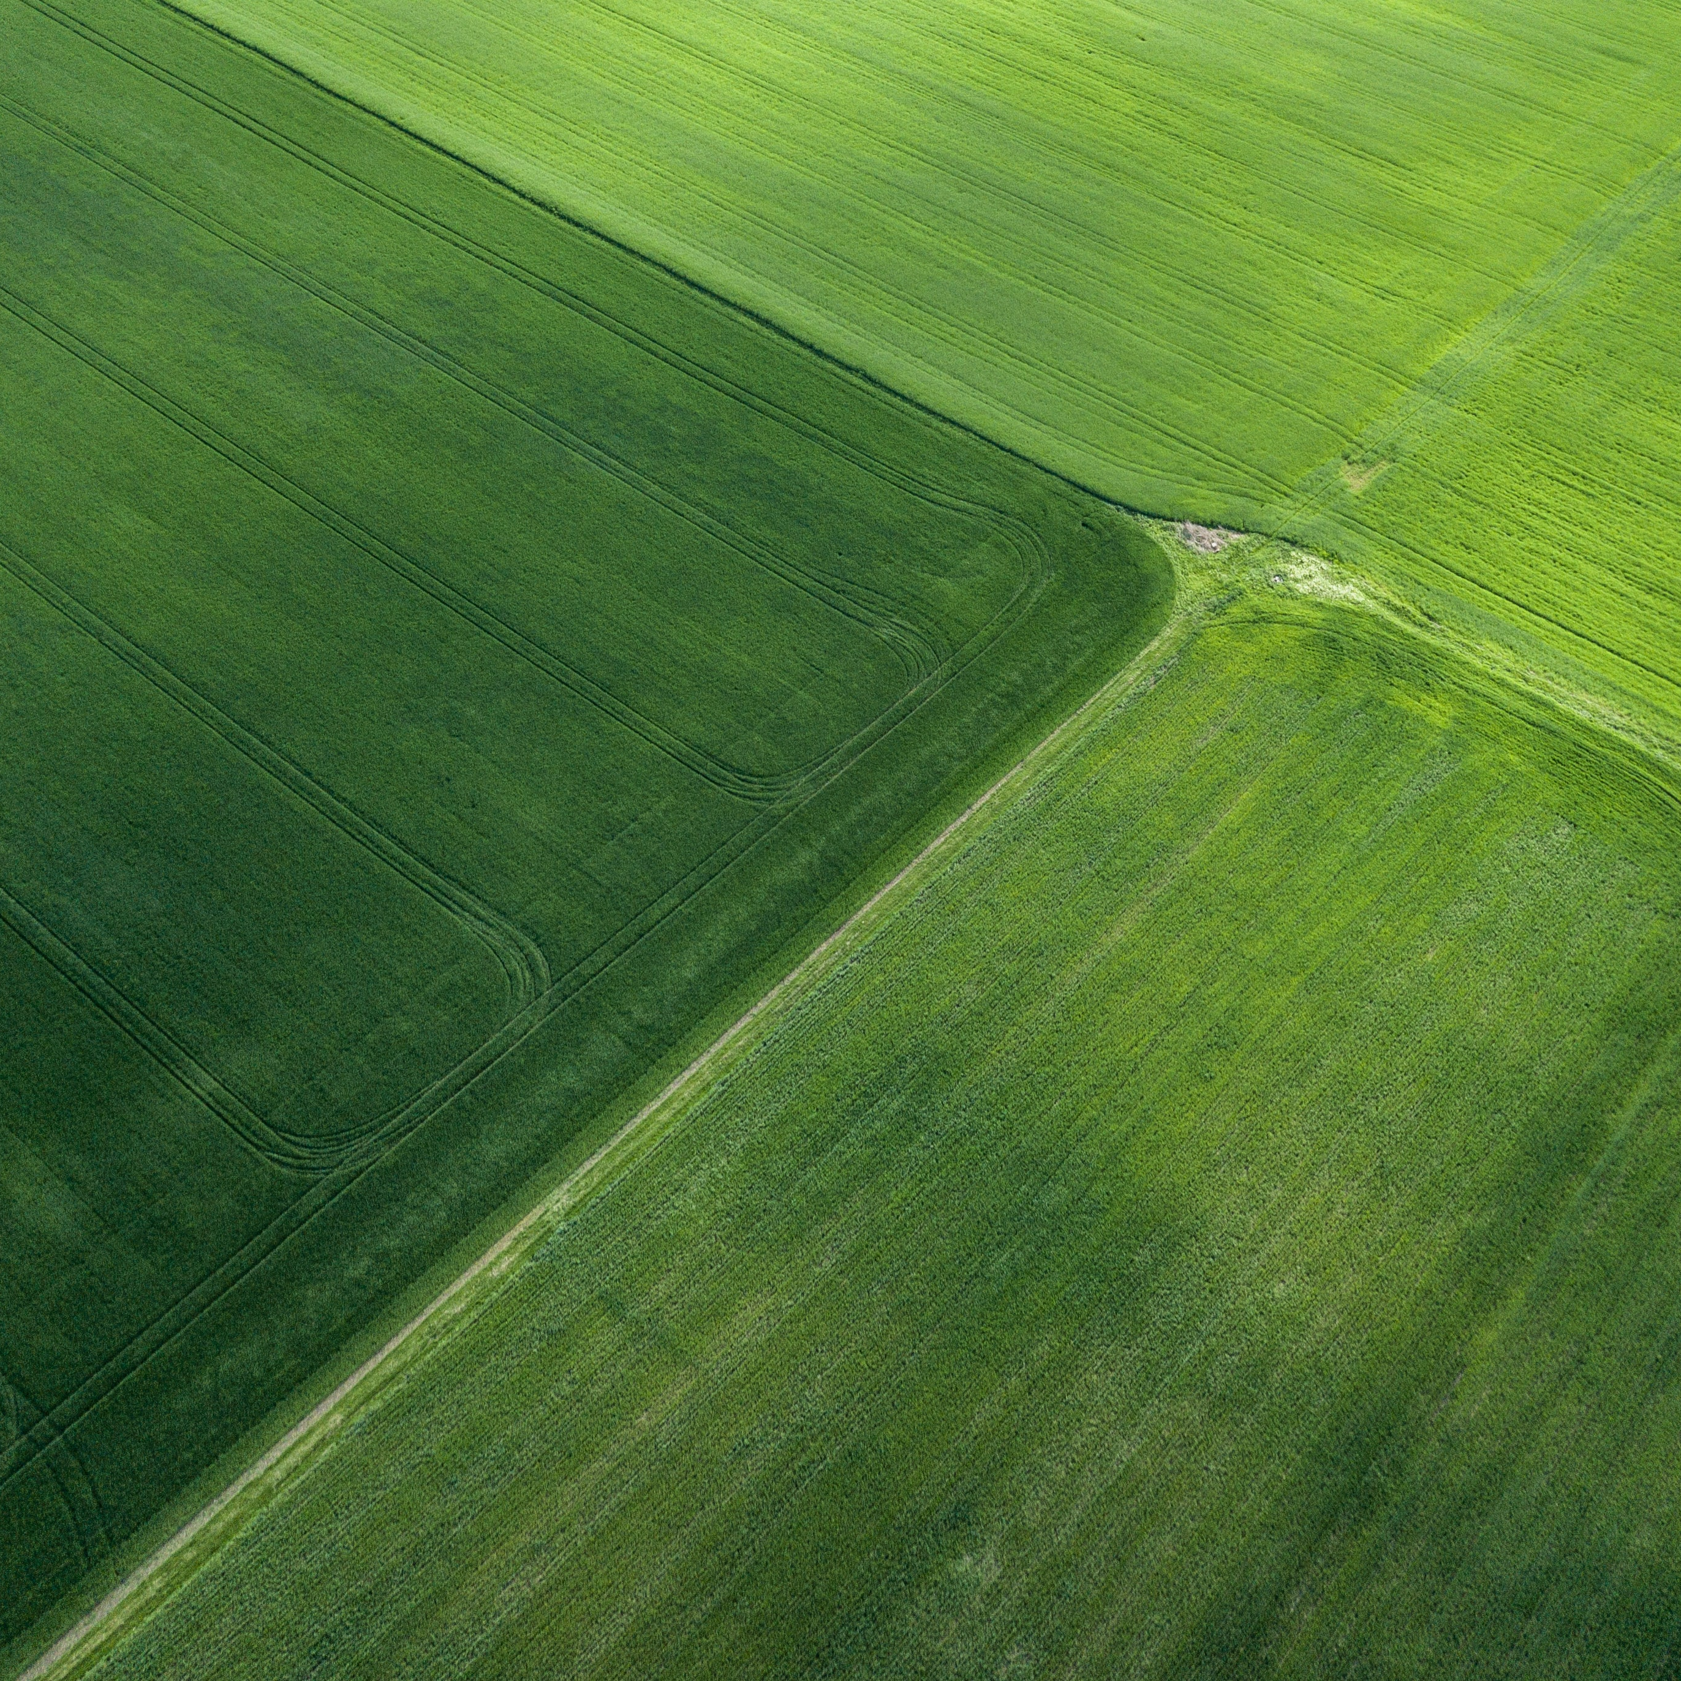
Seraphim –the WORLD’S LEADING SPACE INVESTMENT GROUP
Worlds
leading and most prolific Space Investor
Worlds 1st SpaceTech Accelerator
$800m+ invested
EU/USA/Asia
2018
world’s 1st Listed Growth Fund
LSE SSIT Plc
$350m AUM
2021
145 Companies across 33 countries
Raised over $7bn
Worlds 1st Space VC Fund 2016
Leading the world from the UK
UK HQ
British Founders
San Fran Offices
5 Unicorn IPOs to date
2 Private unicorns
Fund 1
Top decile Performance Globally PE/VC
Visibility of 75% of all global SpaceTech deals
Supporting from Inception to Exit
$250k to $25m
$400+ AUM

Slide 11
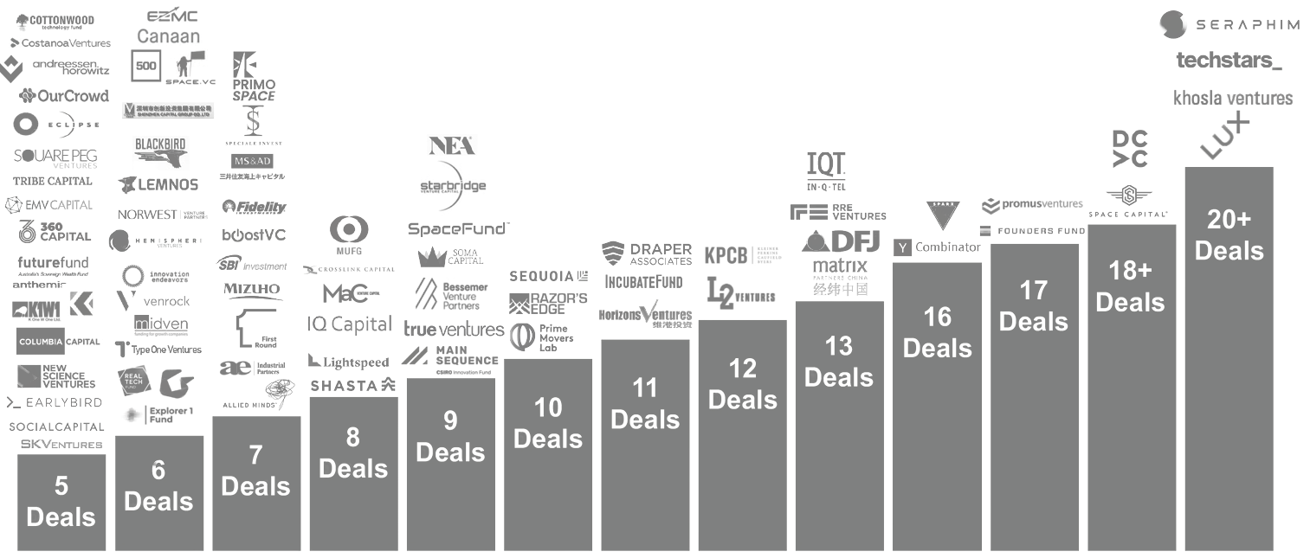
A global vc strategy
Seraphim has 140+ SpaceTech portfolio companies across the accelerator, venture and growth funds
140+
20+
17
18+
16
13
12
10
11
9
8
7
5
6
Size of SpaceTech Portfolio
Source: Bryce Space Startup Report 2023
Notes:
Turning to my final slide:
Key numbers to pick out here is that this is a US$ fund, targeting $100m fund size, $35m already committed and close date is 30th June
Other key points to know is we’re a co-investment engine for our LPs, opening co-invest in the B-series and later.
We can be your guide to the best emerging US and global space companies.
SpaceX is today valued at $350bn, we believe there are many, many SpaaceTech companies that will be valued at $10-50 billion range – and we’re confident that we’ll be invested in them.
So I hope you enjoyed this presentation, hopefully opening your eyes to the space opportunity
I’ll now open for any Q&A [MB turn to next page for Q&A]

Slide 12
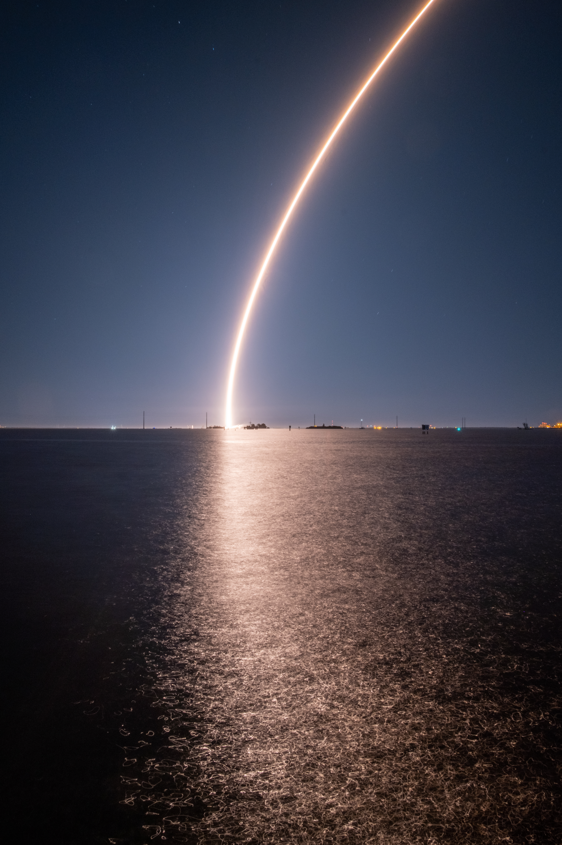
Will affect the world tomorrow
What we do today
The outlook remains positive with strong government support, geo security threats, growing investor confidence, and accelerating technological advancements!
Seraphim Space has invested in and supported over 145+ industry-leading SpaceTech startups and is the world’s leading space-focused investor headquartered in the UK with offices in London, San Francisco, and Berlin
We believe that this is just the beginning…

