Slide 1
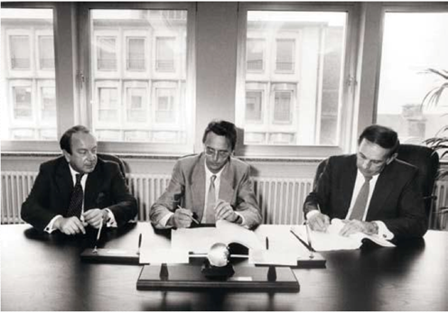
One Angel Can Make the Difference
From left to right:
Roland de Kergolay , Vice Chairman SES
Corneille Brück, Chairman SES
Charles A, Schmidt, VP/General Manager RCA Astro

Slide 2
My personal journey from using Space to provide Universal Access to Accessing the Universe to Networks for the Universe
AND
The Bang for the Buck – Defying and using Gravity: Investing in Space and Space Tech: Digital Infrastructure, Telecoms, Cloud and Software
Notes:
This is a beautiful day
Going from

Slide 3
Today, Space is related to everything in the world and in the universe
IoT – Sensors on everything
Environment
Climate
Finance (GPS)
Defense
Space in Space Technologies
Robotics
Quantum (Christophe Jurzak)
AI
- Positive Digital Transformation (Vint Cerf)

Slide 4
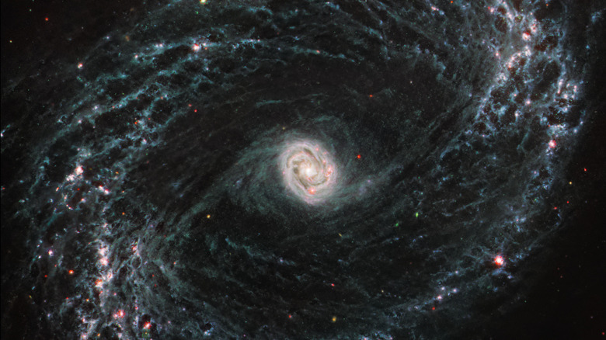

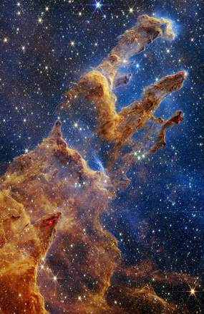

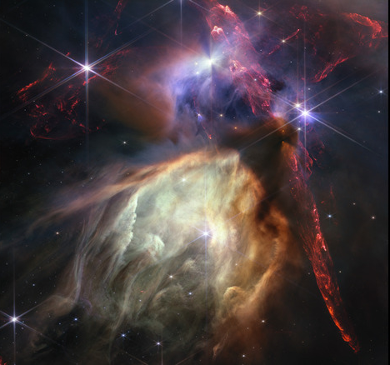
The Findings of the James Webb Telescope have led to One Space – Deep Space, Near Space and our Planet
NGC 1433
Cosmic Cliffs
Pillars of Creation
Webb's First Deep Field
Rho Ophiuchi

Slide 5
The world has never needed
So much Connectivity …
So much Interactivity …
So much Interconnectivity …
So much Instant Infrastructure …
I would like to share with you today some steps along my personal Journey of using satellites to first provide “Universal Access” to the world’s citizens and today, “Access the Universe” and always keeping the RoI front and center in my thinking.
The Digital Transfomation of the World is accelerating the need for satellites which can provide connectivity, gather and disseminate data, monitor the planet, analyte, predict and address its needs.
I have never done a government supported space program – Only privately financed, market-oriented space systems. In other words, I have been doing « New Space » for the last 40 years !

Slide 6
Using Space to provide Universal Access…
SES/Astra
Loral Teleport Europe
Iridium
Europe Online
ILS

Slide 7
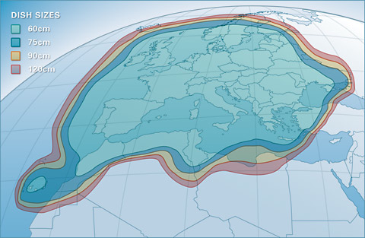
Astra Footprint – the Potential
Notes:
The footprint for our first satellite – If it failed, there would not be a second one !

Slide 8
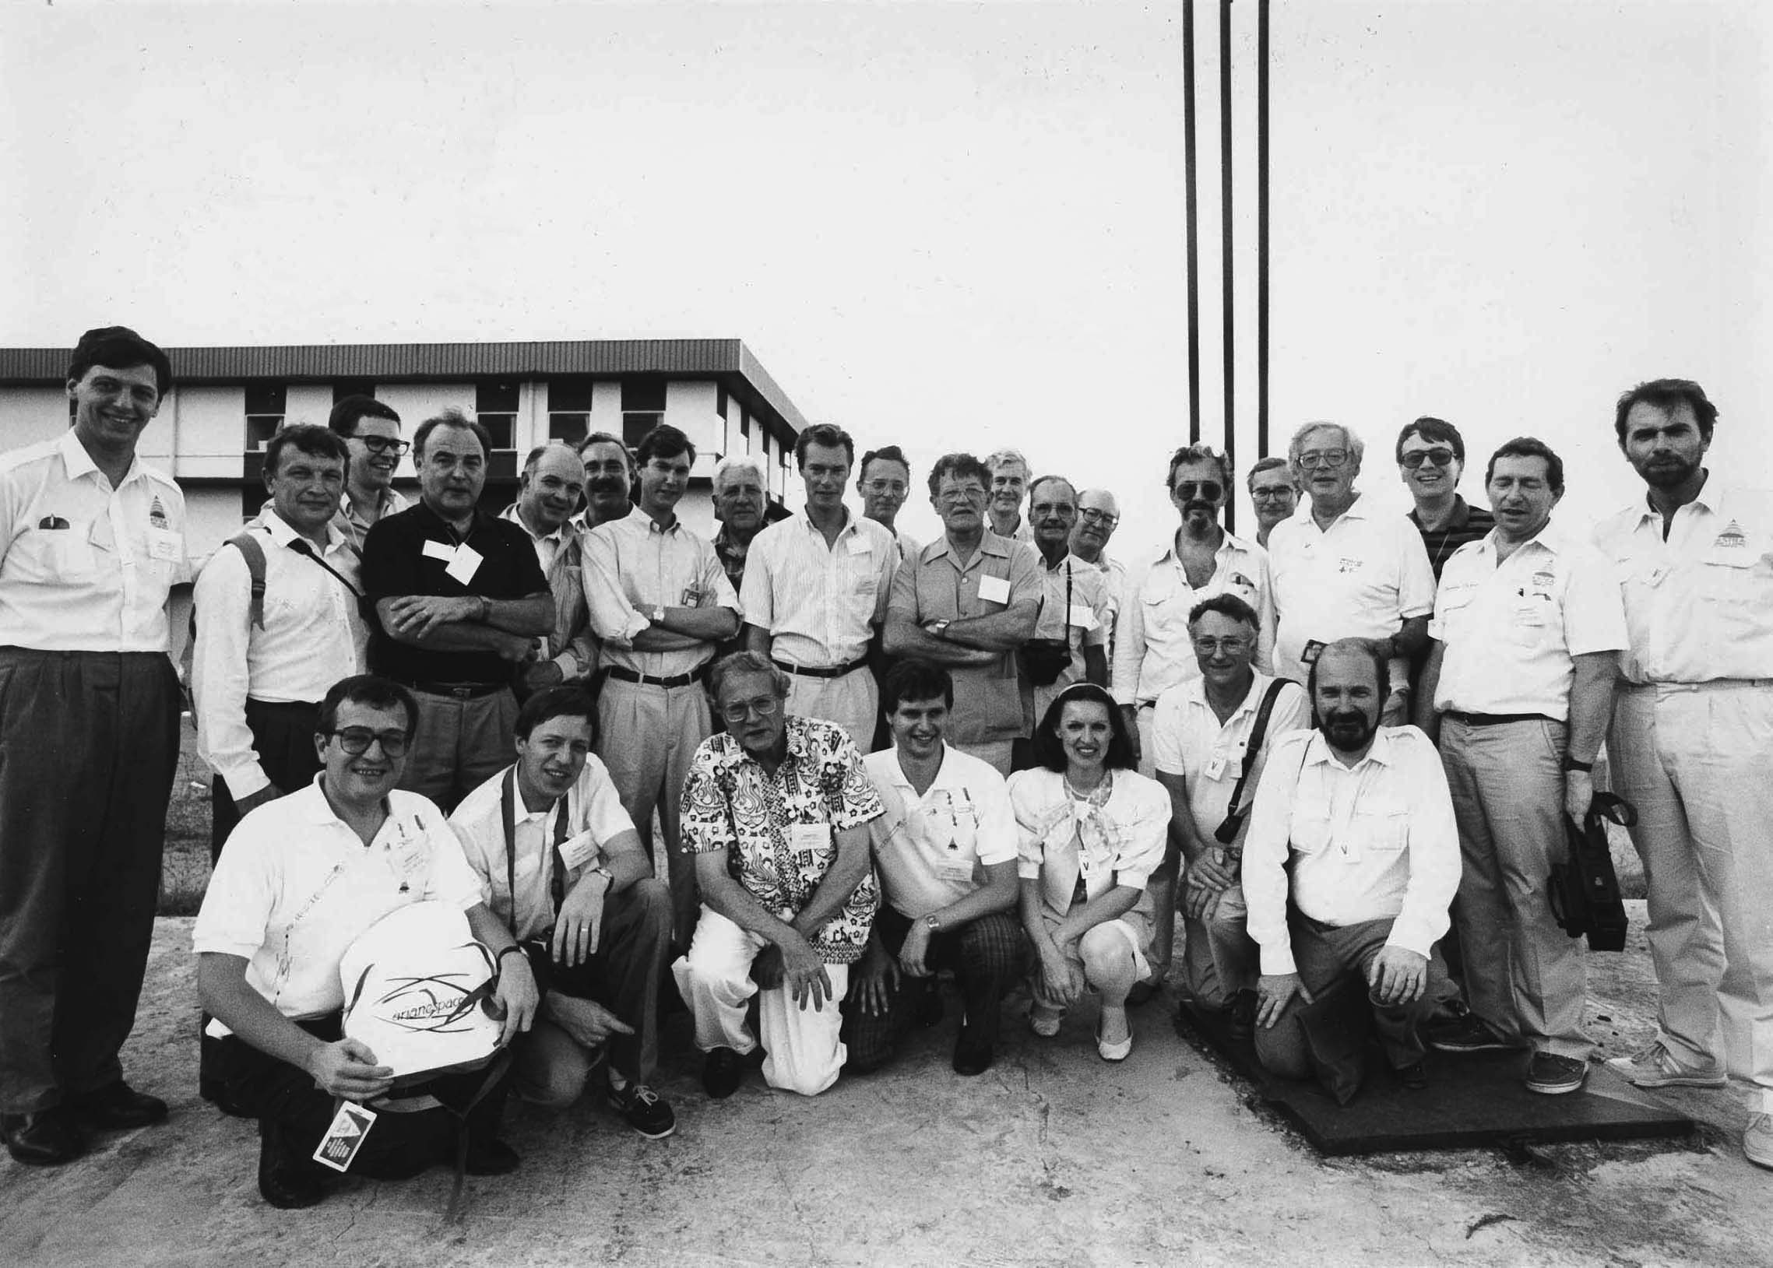
Notes:
Going from the only woman and « mother » behind SES at the launch of our first satellite in Kourou on 13 December 1988

Slide 9
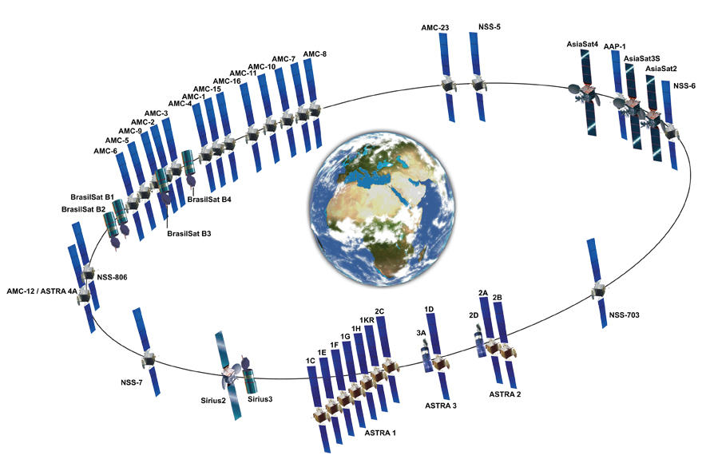
SES/ASTRA – SES/GLOBAL
First private TV satellite in Europe ( 1983-1985 )
Monopoly Breaking
Happy Day ( Ann Glover)
The Digital Revolution – Takeover (1993 – 1994)
SES Global (1997/1998 – 2000 )
Being at the top is slippery and dangerous. You must constantly go
Forward and be smarter, quicker, more innovative. Or… you can
Sell out.
Notes:
10 years later – I conceived SES Global, the world’s largest satellite system and implementd it 3 years later in 2001 – not « selling Europe’s Skies to America » as Mitterand had prophesized but rather « buying America’s skies for Europe !

Slide 10
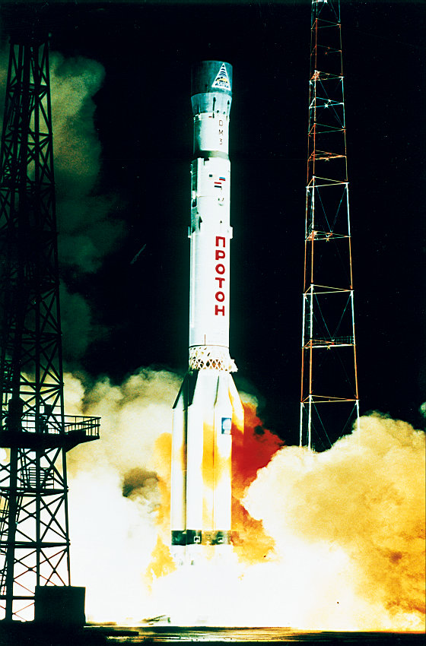

Slide 11

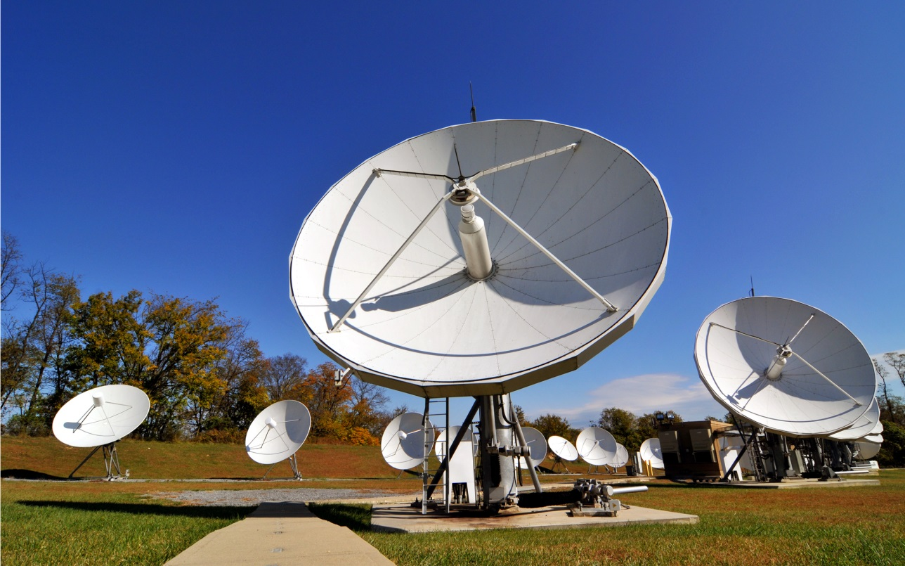
Teleport

Slide 12
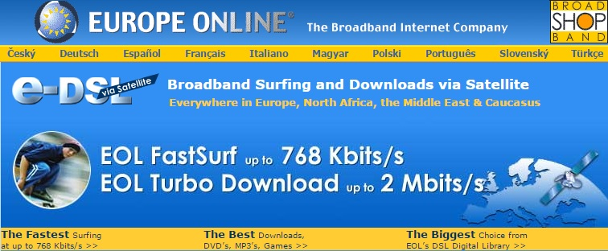
Europe Online - World's first Broadband Internet Satellite Service
Notes:
Going from Europe Online, the world’s first Broadband internet Satellite Service which I implemented in 1996 to twenty years later having OneWeb, and Loons

Slide 13
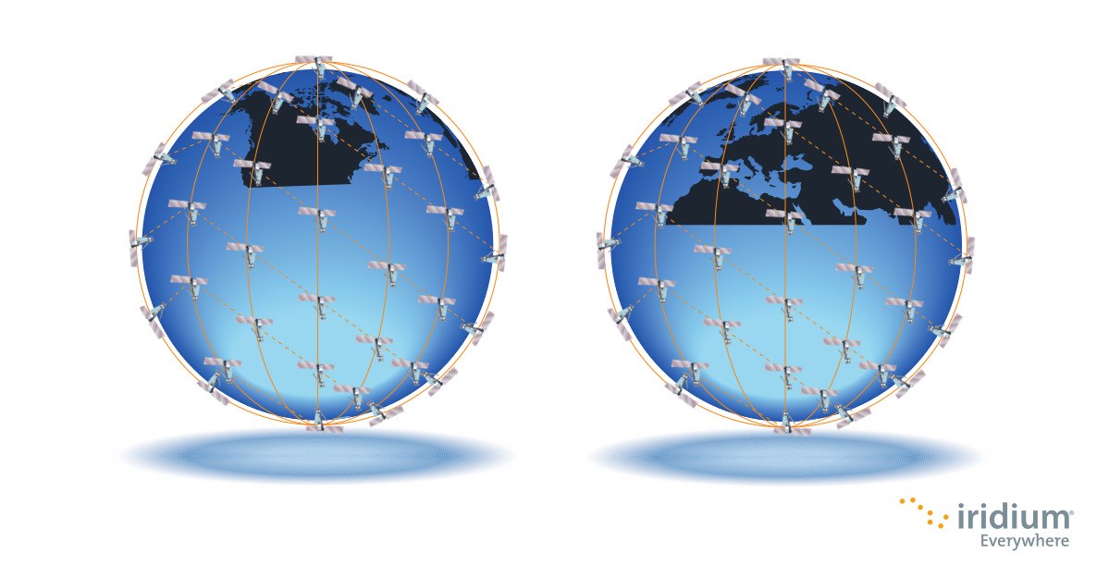
Iridium

Slide 14
To Accessing the Universe
Earth Observation
Climate
Weather
Space Situational Awareness
In Orbit Servicing, Manufacturing
- Space Stations

Slide 15
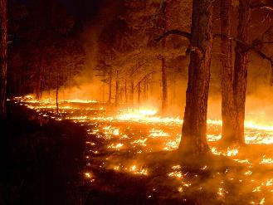
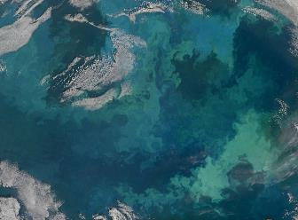


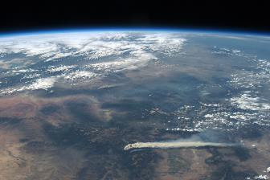
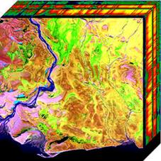
Earth Intelligence and SSA
Protecting our wild regions
Preserving our rivers and oceans
Environmentally safe exploration
Securing the world's food supply
Predicting orbital collisions
Hyperspectral imaging

Slide 16
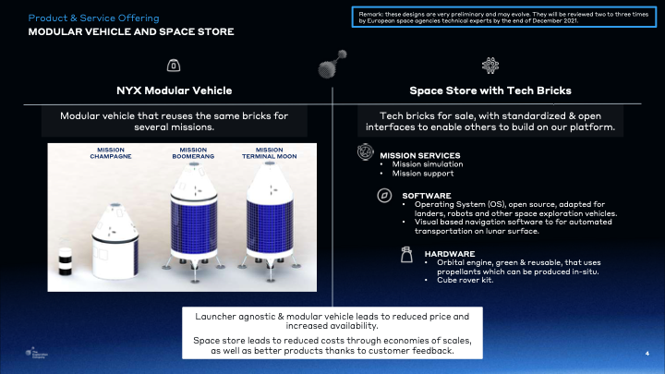
O

Slide 17
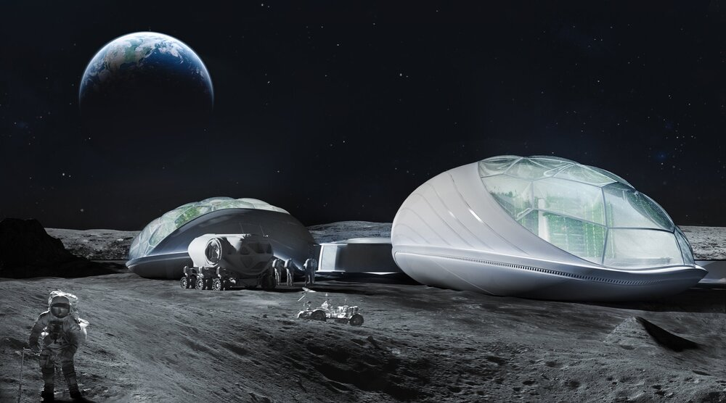
At Interstellar Lab, we build modules for sustainable living on Earth and in Space
At Interstellar Lab, we build modules for sustainable living on Earth and in Space
At Interstellar Lab, we build modules for sustainable living on Earth and in Space

Slide 18

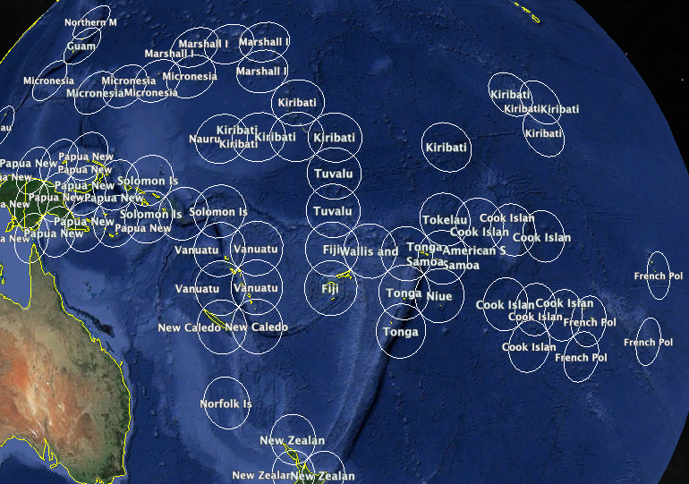
Regional Satellites: The HTS concept
applied to the Pacific market
Kacific Broadband Satellites Pte Ltd - Singapore - Proprietary Information

Slide 19

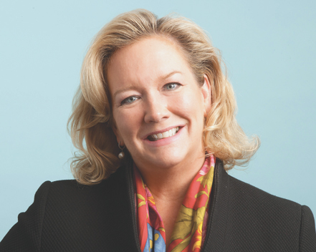




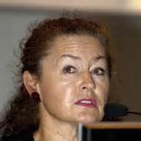
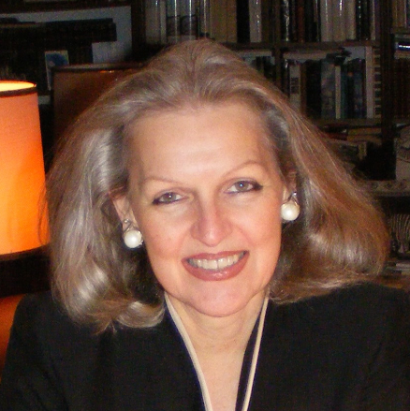
Sallye Clark
Vicki MacLeod
Bridget Cosgrave
Audrey Mandela
Ellen Strickland
Walda Roseman
Candace Johnson

Slide 20
It is not Old Space or New Space, it is Fast Space and One Space
The ability to get into Space quickly, be it by using reusable rockets, pre-configured buses, software-defined satellites, etc. is increasing in importance, in particular due to RoI, demanded by Private Investors. It is no longer Old Space or New Space but « Fast Space ».
Boundaries are being blurred between various orbits, LEO, MEO, GEO, Cis Lunar, Stratosphere. We are seeing the emergence of « One Space »

Slide 21
1). The Bang for the Buck
2). Defying and using Gravity: Investing in Space and Space Tech: Digital Infrastructure, Telecoms, Cloud and Software
Notes:
This is a beautiful day
Going from

Slide 22
The Bang for the Buck
Chatham House Rules – Or how SES a) really got financed and b) became the most profitable space system in the world
Did you ever wonder why GE got into Space?
Did you know that Jeff Bezos (Amazon- Blue Origin – Kuyper), Peter Platzer (Spire Global), Matt O’Connell (One Web, GeoEye, etc.) were all Wall Street Bankers?

Slide 23
Defying and Using Gravity - Trend toward Space in Space
Space in Space is gradually seeing the light of day with In-Orbit Fueling, In-Orbit Manufacturing, Robotics, 3D Printing and Material Science, and Docking
GEO satellites will be given a new life and serve as platforms for new services – EO and Intelligence for Telecom Satellites, Deep Space, Relay amongst various orbits
Space Stations will be built modularly in Space
Advances in Energy, Medicine, Agriculture, will be made by using micro-gravity and weightless

Slide 24
Dramatic decrease of digital component pricing, lower launch prices, and I0T are leading to the democratisation of Space and making it Accessible and Affordable for all (1/2)
Launch prices have fallen more than 30 X in the space of a decade
Sensors can be put on everything, opening up a large market to insurers, agriculture companies, mobility. Location based services, etc.
Cube Sats, Nano Sats, Small Sats are replacing many legacy, traditional heavy satellites

Slide 25
Dramatic decrease of digital component pricing, lower launch prices, and I0T are leading to the democratisation of Space and making it Accessible and Affordable for all (2/2)
Software defined Satellites: Beforehand very difficult to change a satellite or space vehicle once it was launched leading to long lead times and up to 7 year old technology being launched
Today, « Old Space », « New Space » and « Fast Space » manufacturers are building buses, platforms, systems, and networks that can be controlled, changed, and enhanced by software.
On-Board Processing, Quantum and AI are becoming the Norm, thus shifting Big Data to Space

Slide 26
Clouds in Space – The Horizons are merging
Amazon Web Services, Amazon Ground Stations, AWS Space
Microsoft – Azure Space
SES – Cloud on O3B

Slide 27
The Defense Sector is the biggest investor and procurer of Space and Space tech around the world – Dual Mission – Defence and SDG’s
The Warification of Space: NATO, DoD’s, Star Wars
Using EO, Surveillane and Intelligence for SDG’s and Defence – ICEYE, Arquit, Cappella Space, etc.
SSA,SDA, STM – NorthStar, ExoAnalytics, LeoLabs, etc
Space Regulation must be renewed – this time with the private sector!
Cyber Security in space and on the ground (National Homeland Security)
Governments wil pay private companies for Defence and Cyber Security and Private companies will pay for SDG’s as wel as Governments

Slide 28
The Colonisation of Space . Manifesto for a Clean, Safe, Equitable Peaceful Use of Space – Efficient use of Space as a Limited Resource
Companies and Countries are colonizing space
Emerging Space Nations may not have access to frequencies and orbital positions for their own sovereign needs
Space is a Limited Resource. It must not have the same fate as our oceans
EBAN Space Manifesto: https://www.eban.org/manifesto-for-a-clean-safe-equitable-and-peaceful-space-for-all-by-eban-space/

Slide 29
My tips for Investing in Space and Space Tech – Dual Mission/Space in Space
Space in Space: In Orbit Manufacturing, In Orbit Services, Robotics, 3D Printing
Multi-Orbits
Space launchers and Space Transportation
Software and On-board processing
Space Stations
Regional Connectivity Satellite Systems
Space Based Solar Power
Space Exploration
Space Experiments – Pharma, AgriTech. Habitats, space suits, etc
New Materials/New Energy Sources - Batteries

Slide 30
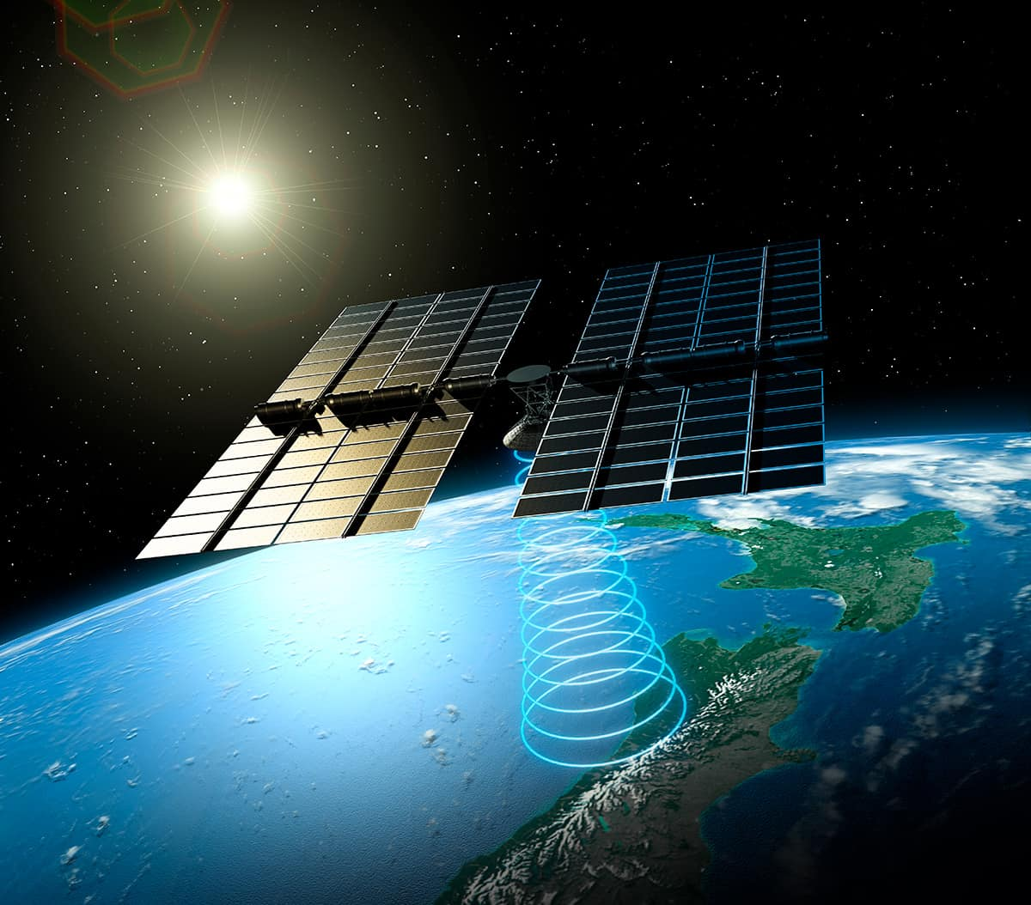
Space-based solar power

Slide 31
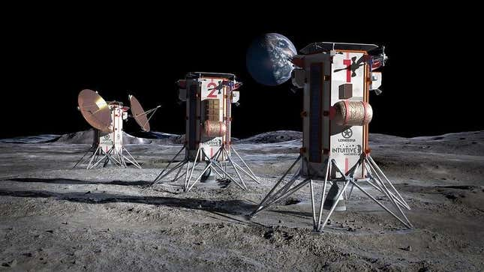
Moon Data Centers

