Slide 1

The neutral platform for global space traffic coordination
October 2025 – presentation at the ITU Space Sustainability Forum 2025 Dr. Benjamin Guyot CEO benjamin.guyot@spacetalk.ch
T. +41 76 390 02 32
www.spacetalk.ch

Slide 2






Page 2
The Spacetalk company
Spacetalk SA is a private company registered in June 2023 in Switzerland.
It is providing a neutral platform for the global space traffic coordination > Earth orbit, Moon, deep space, ...
Private Swiss shareholders
Basic services charged on a cost recovery basis
Additional (optional) services available for a fee

Slide 3
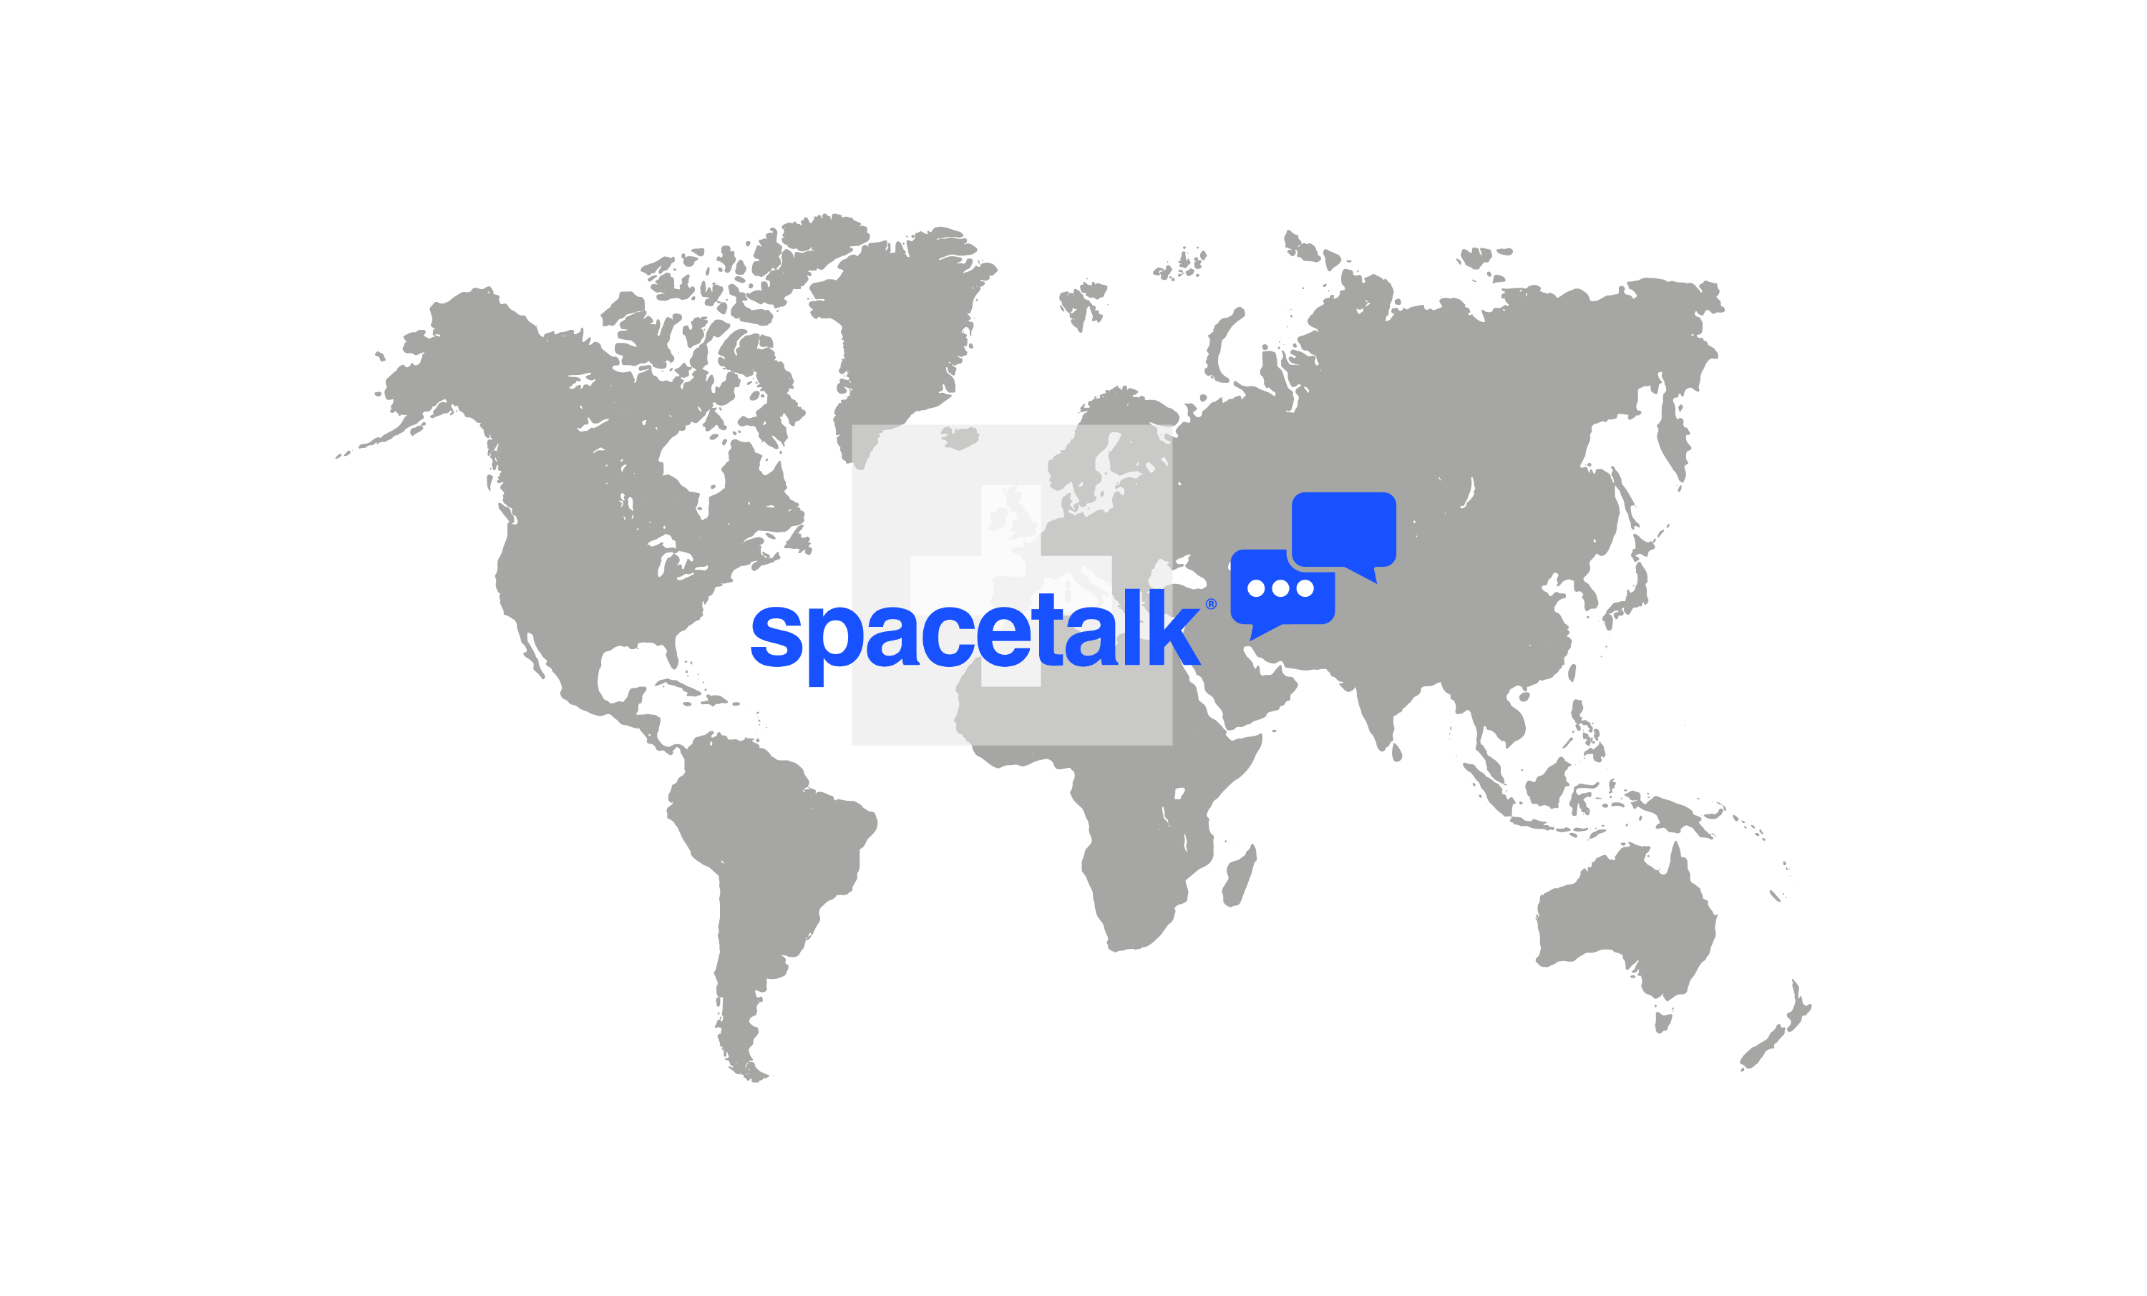







Page 3
Enable the dialogue among ALL space traffic stakeholders
Russia … STM/SSA* actors, …
China … scientists, …
USA … space operators…
Japan … space forces, …
India … STM/SSA*
actors, …
EU … scientists, …
* STM = Space Traffic Management
SSA = Space Situational Awareness

Slide 4
Building Trust
Page 4
Governance
> Agile and noncompulsory.
> Transparent and neutral.

Slide 5
A Common Technical Denominator (1/2)
Page 5
Technical approach: a digital platform…
…operational points of contact.
…space objects’ trajectories, status and operations.
…7 languages, compatible with all data communication standards, open API.

Slide 6
A Common Technical Denominator (2/2)
Page 6
Technical approach: a digital platform…
…where the administrator (Spacetalk) is not in charge of trajectory analysis.
→ Members (operators, SSA/STM) are responsible for providing orbital data and analyzing trajectories.

Slide 7



Page 7
The objective is to cover ALL space objects
Space operator
SSA/STM actor
Space operator
→ Connected to space operators or/and to SSA/STM actors acting on behalf of such operators.

Slide 8
Members
Page 8
Space operators.
Space Situational Awareness (SSA) and Space Traffic Management (STM) actors.
Space agencies and governmental entities.
Space forces.
International organizations (ITU, COPUOS) and regulatory bodies.
Academics (astronomers, scientists).
Insurers and other commercial space traffic stakeholders.

Slide 9
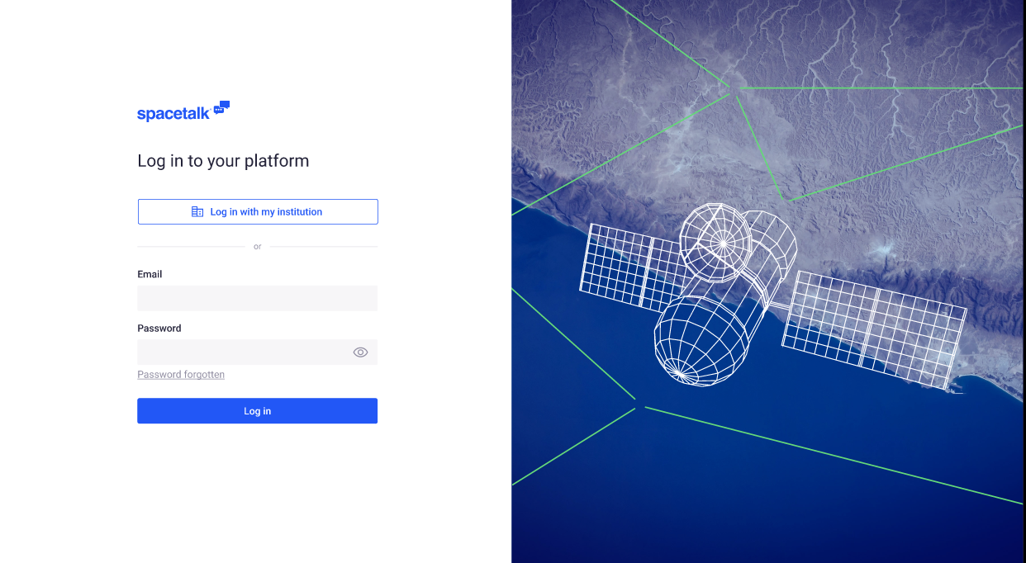

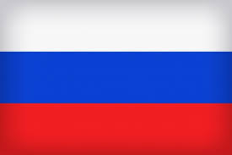



Page 9
A safe and secured system
→ Secured access provided by WISeKey Switzerland SA.
→ In several languages

Slide 10
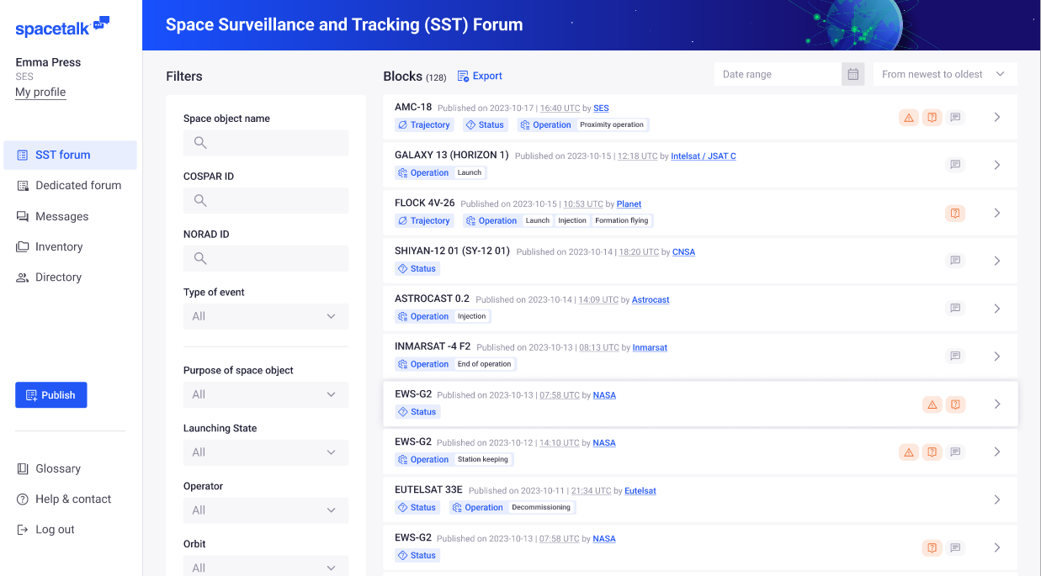
Page 10
A forum for sharing orbital data

Slide 11
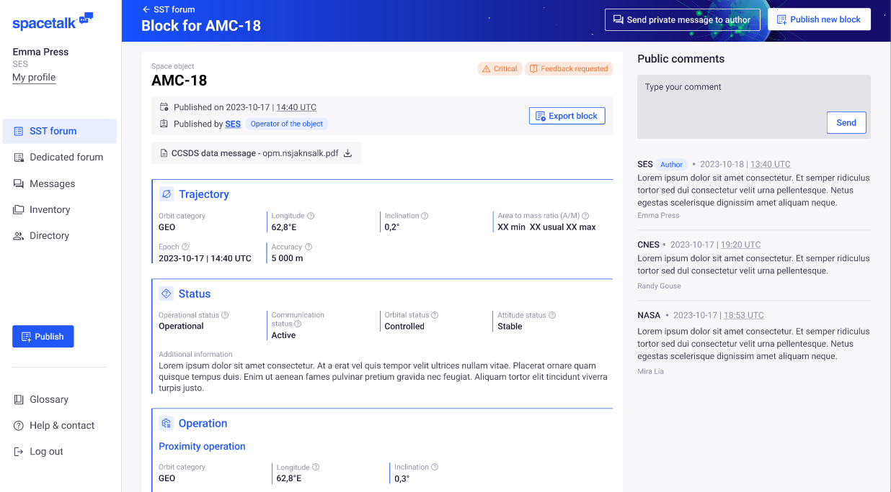
Page 11
A common language
→ data standard

Slide 12
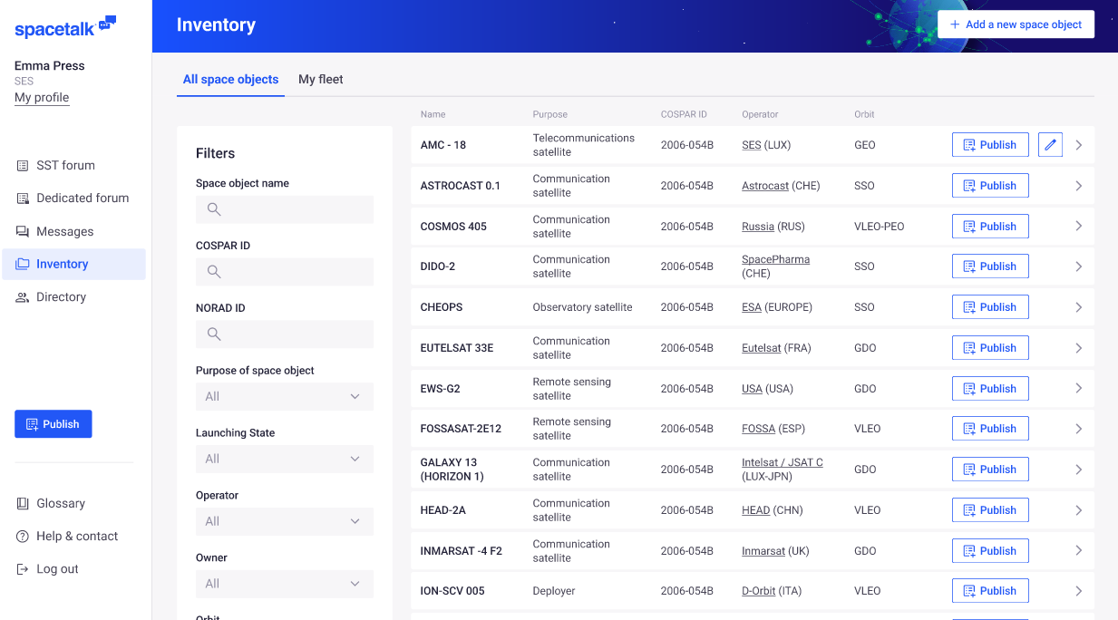
Page 12
List of space objects
→ Closely monitored Inventory (catalogue) of space objects.

Slide 13
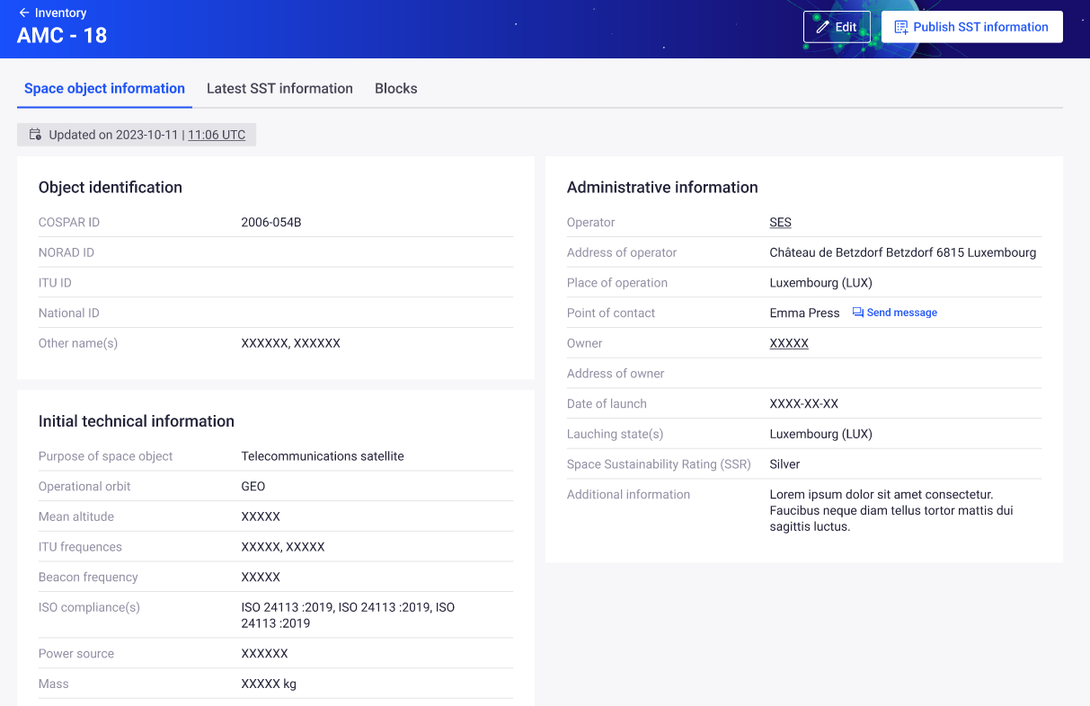
Page 13
Focused on space traffic
→ Relevant information for traffic coordination (identification, frequency, orbit, …).

Slide 14
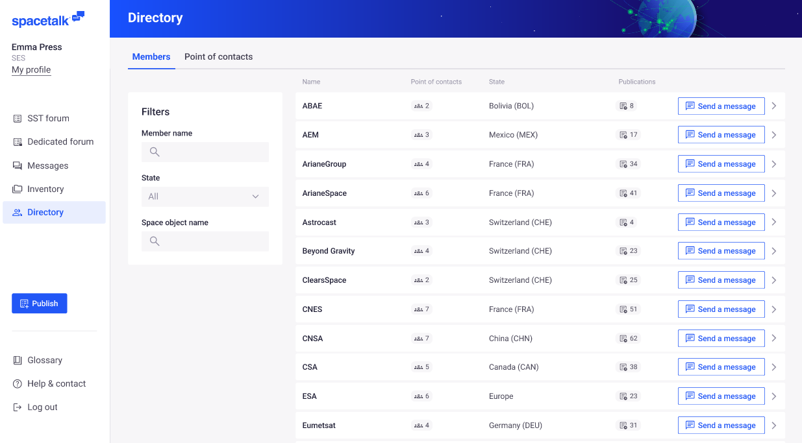
Page 14
A secure environment with known counterparts
→ Closely monitored Directory of space actors with operational Points of Contact (PoC).

Slide 15
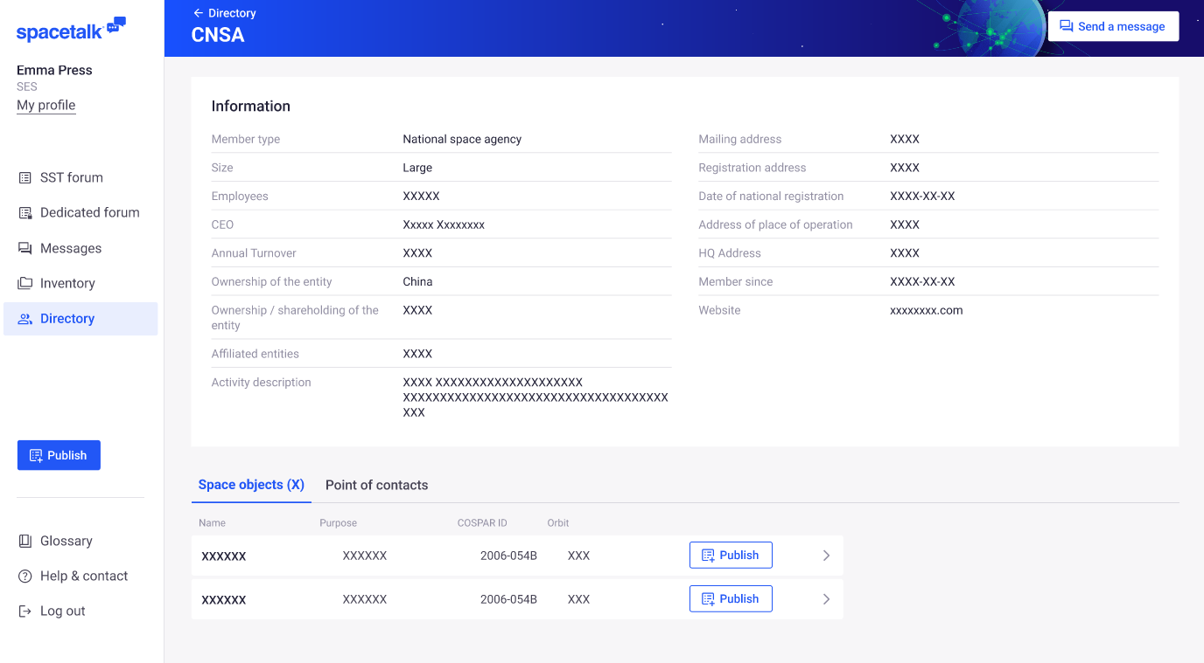
Focus on transparency
Page 15
→ A detailed Directory to bring trust between Members (KYC).

Slide 16
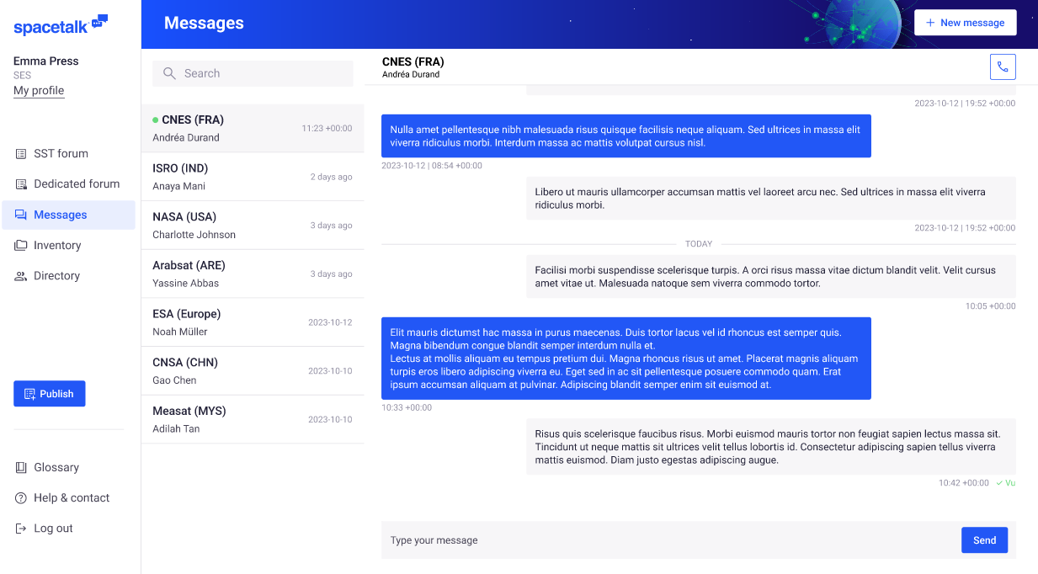
Page 16
A clearly defined scope of activities to avoid conflicts of interest
Hands-off on Members-to-Members interactions.

Slide 17








Possible governance schemes
Page 17

Slide 18

Page 18
License scheme example
monitoring
defined duration
specific conditions
competitive process
Licence

Slide 19


Roadmap
Page 19
2023 – mid 2025 | Oct 2025 | End Oct 2025 | 2026…
Prototype review MVP development MoUs … | Testing with international partners | The platform is launched for free Join us! | Improvement v.1, v.2 (fee based), …
www.spacetalk.ch

Slide 20

Questions?

