Slide 1



Traffic Coordination System for Space
(TraCSS)
Office of Space Commerce
National Oceanic and
Atmospheric Administration
U.S. Department of Commerce October 2025
Mariel Borowitz
Head of International SSA Engagement

Slide 2
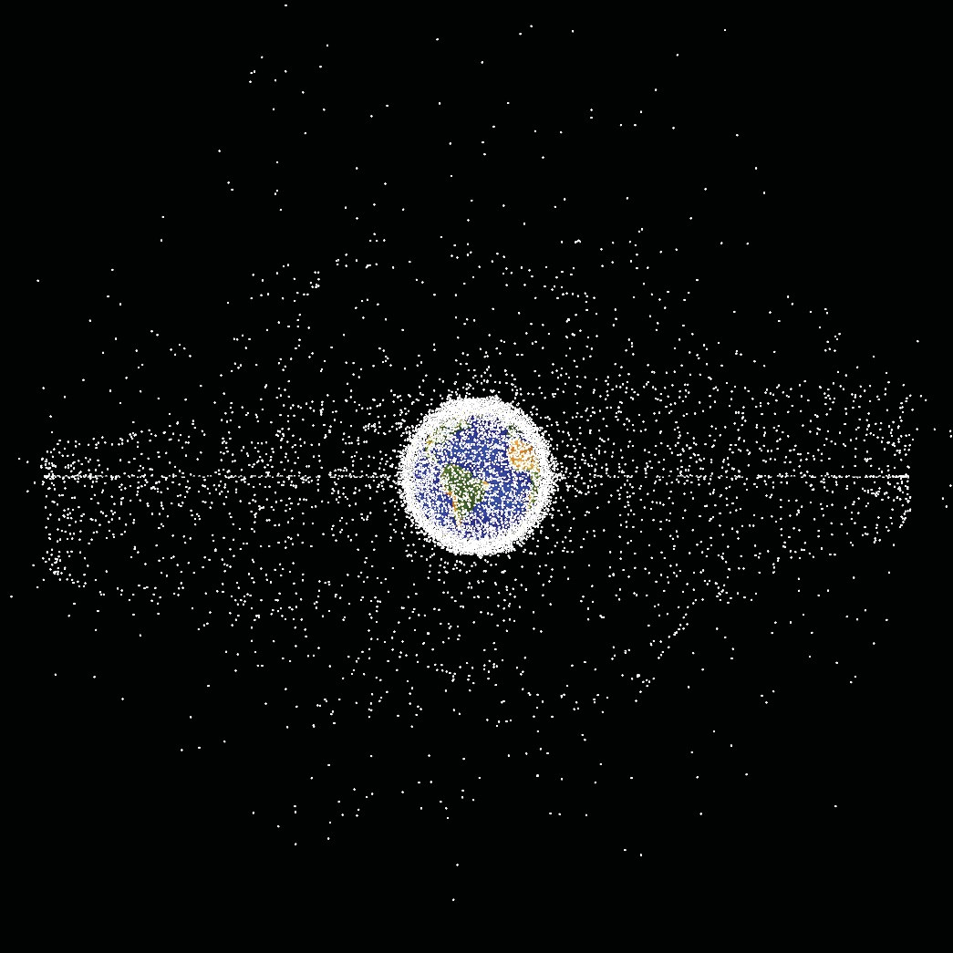
Space Situational Awareness (SSA)
and the Office of Space Commerce
Rapid growth in space activity requires improved space situational awareness to enable safe space operations
Space Policy Directive-3 transferred responsibility for providing basic SSA services for spaceflight safety from Department of Defense (DoD) to Department of Commerce (DOC)
DOC is developing the Traffic Coordination System for Space (TraCSS)
      TraCSS is currently operating in beta mode
                -14 pilot users receiving services
                TraCSS production release in January 2026
Credit: NASA ODPO

Slide 3
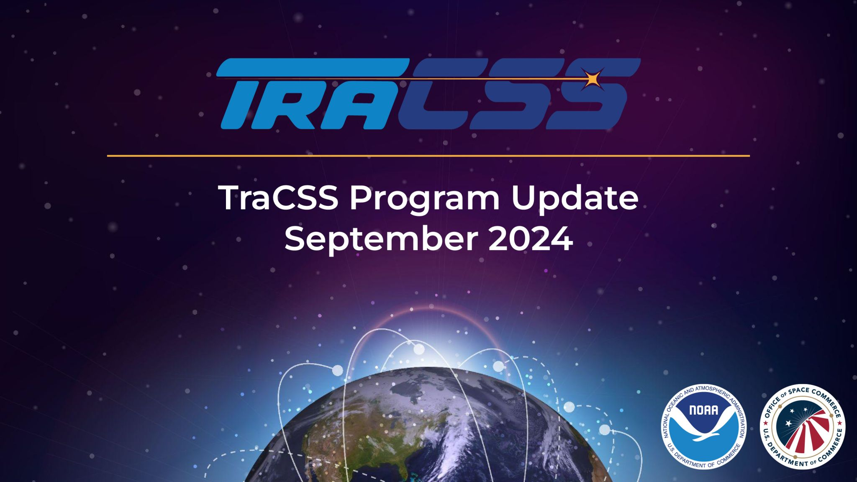

TraCSS’ Safety Services
TraCSS provides spacecraft operators with services to support spaceflight safety, including:
Conjunction screening every four hours using catalog and o/o ephemerides
Risk assessment support information
Detection and notification of emergency events
Candidate maneuver screening (on demand)
Operational contact information
SSA data and information
TraCSS will evolve using an agile process and incorporate additional capability over time.

Slide 4

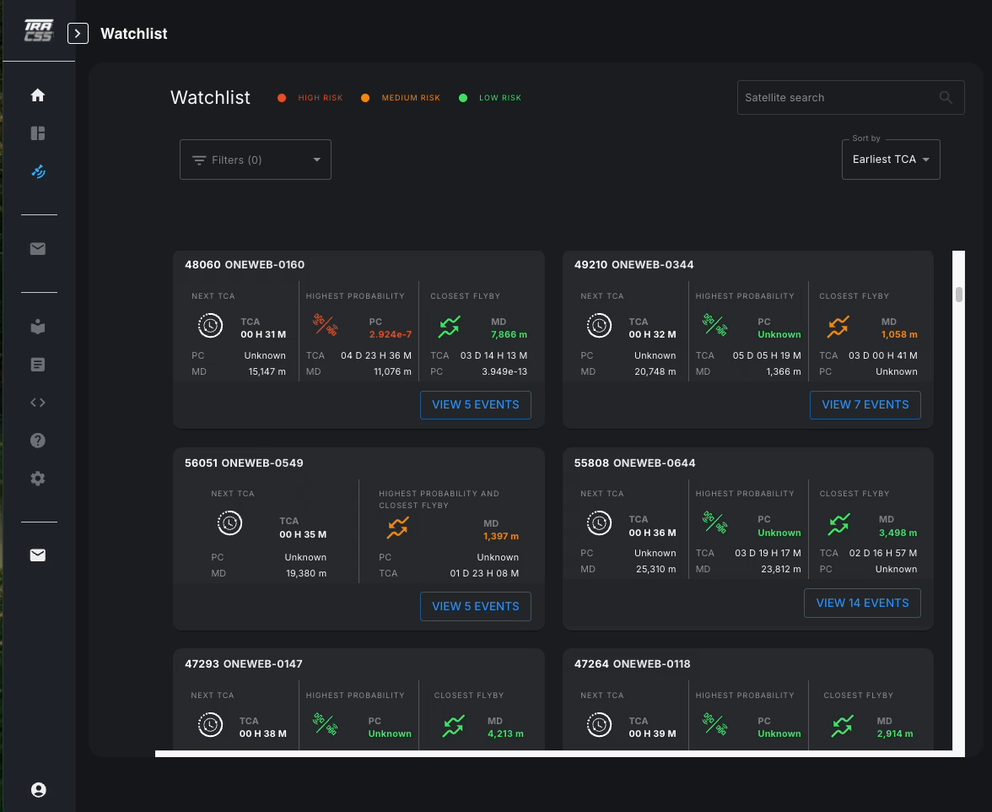
Watchlist
<ADD VIDEO>
Page open on watchlist
Circle around satellite tile, then next, then slow scroll of satellite tiles
Circle around each metric
Circle around risk levels
Point between HIGH RISK & a red metric
Point between LOW RISH & a green metric
Switch sort to Highest Probability sort
Switch to Closest Approach sort, apply High Risk only filter
High level summary of latest data on all active conjunctions
Satellite tiles highlight the highest risk conjunctions
    Time of Closest Approach
    Probability of Collision
    Miss Distance
Risk level visualization
    Based on TraCSS emergency alerting criteria
    Easy to identify & track conjunctions requiring mitigating actions
Filtering & sorting provide focused results

Slide 5
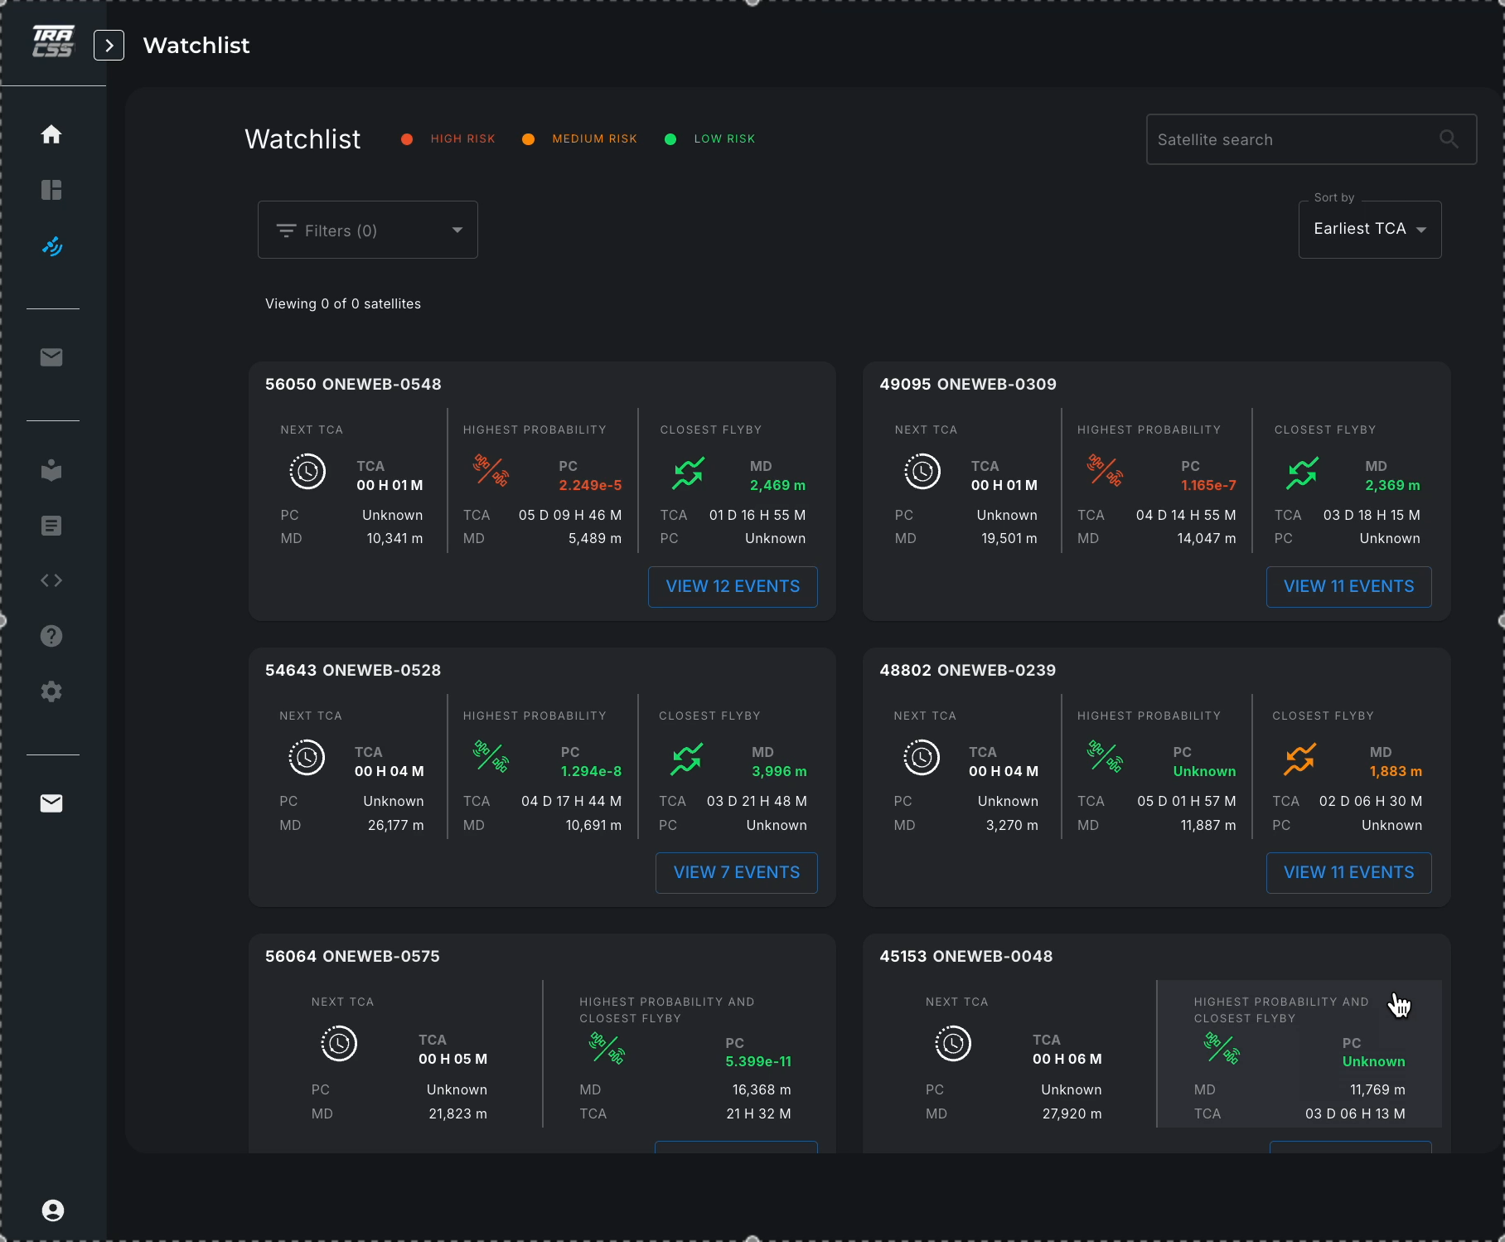
Conjunction Details
<ADD VIDEO>
Page open on watchlist
Sort by high Pc
Scroll down to 45416
Circle around metrics
Click into conjunction
Quick click to close conj list
Circle summary table
Circle conjuncting objects details
Expand PC plot
Switch between screening types
Clost plot
Expand Miss Distance Plot
Turn on just Ephem:HAC view
Show RTN views
Good pause
Click to small collision consequence plot
Show download latest CDM
Click into file history
Slow scroll circling files, hover download
Download one file & open
Highlights critical information from latest CDM
Presents evolution of key metrics over time
    Probability of Collision
    Miss Distance
    Mahalanobis Distance
Improved understanding of CDMs through uncertainty visualization and collision consequence
Easy access to all CDMs from a specific event

Slide 6
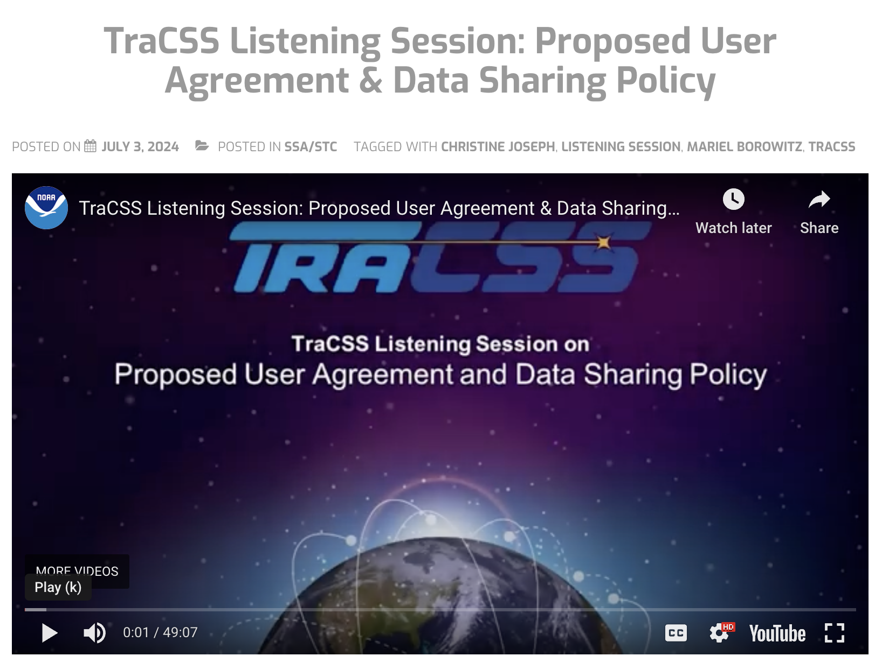
Future Development/ Global Coordination
TraCSS will also support and facilitate free and open sharing of information via our website, with no log-in required, including:
  TraCSS Satellite database with spacecraft attributes
  TLE Catalog; SP Ephem w/o covariance Catalog
  Owner/operator ephemerides
  Emergency event notifications (conjunction messages
for events that exceed a defined risk threshold)
OSC supports global coordination among independent national and regional SSA providers as well as spacecraft operators
  Information sharing, technical data standards, best practices/ procedures
  Working within UNCOPUOS SSA Expert Group
  Including coordination with private sector and other space actors

Slide 7



Engage with OSC on TraCSS
TraCSS webpage https://www.space.commerce.gov/tracss
News, videos, and information on engagements, including past and upcoming public listening sessions
Email
tracss.commerce@noaa.gov
Submit TraCSS-related questions, comments,
& feedback
Newsletter
OSC Engagement Form
Subscribe to OSC outreach and engagement lists

