Slide 2

OUR PURPOSE
“ To Incentivize and Accelerate Radical Breakthroughs Toward an Equitable and Abundant Future for Humanity.”
CONFIDENTIAL AND PROPRIETARY

Slide 3
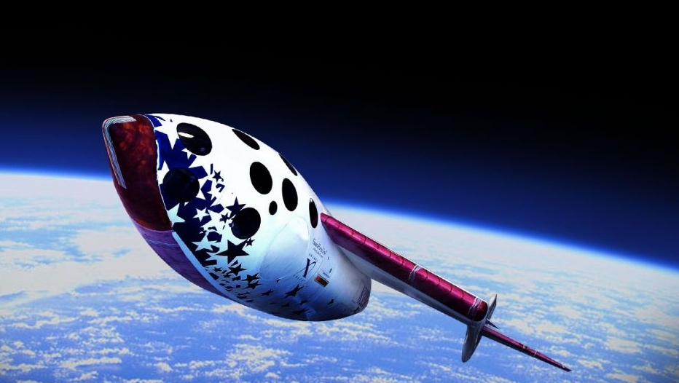

OUR FIRST CRAZY idEA
How it BEGAN
$10M Ansari XPRIZE for spaceﬂight, captured the world’s imagination launched the commercial space industry.
$100M investment by all 27 teams from 7 countries.
$6B IPO by Virgin Galactic (the winning team)

Slide 4

XPRIZE COMPETITIONS
WHY ARE XPRIZE COMPETITIONS SO IMPACTFUL?
Sets an audacious but achievable goal that aims to overcome challenges deemed impossible.
Defines and addresses a clear problem through extensive research, a design sprint, and a competition that catalyzes the development of the next breakthroughs to put humanity on the path toward a preferred future state for all.
Democratizes innovation by encouraging expert and nonexpert participation and multidisciplinary collaboration.
Catalyzes markets and revitalizes stagnant industries by increasing awareness of market failures and accelerating innovations to address them.
Is highly leveraged (31X), with competing teams attracting and mobilizing investment capital, partner support, and new members in pursuit of the prize.

Slide 5

XPRIZE SPACE DEBRIS

Slide 6

AN URGENT GLOBAL RISK
1,000,000 Mass in kg of 3500 Starlink V1 satellites currently in orbit
144,000 Collision avoidance maneuvers executed by Starlink in six months (Dec 24-May 25)
0 Commercial removals of space debris
Notes:
Stat 1 (144,000+ maneuvers):
Source: ESA Space Environment Report 2025, published April 2, 2025
"Starlink executed 144,404 collision avoidance maneuvers in six months (December 2024-May 2025)"
Compare to 50,000 in H1 2024, ~6,500 in 2020
Stat 2 (1,000,000 kg ):
Source: Jonathan McDowell satellite tracking database, October 2025
3,565 Starlink V1 satellites currently in orbit
Total mass: 1,021,300 kg (867 V1.0 at 260kg + 2,698 V1.5 at 295kg)
Concentrated at 550km (Shell 1) and 570km (Shell 2)
Stat 3 (0 removals):
All missions to date were demonstrations (RemoveDEBRIS, ELSA-d) or inspections (ADRAS-J)
First operational mission: ClearSpace-1, planned 2026
Technology proven at TRL 6-7 since 2018

Slide 7
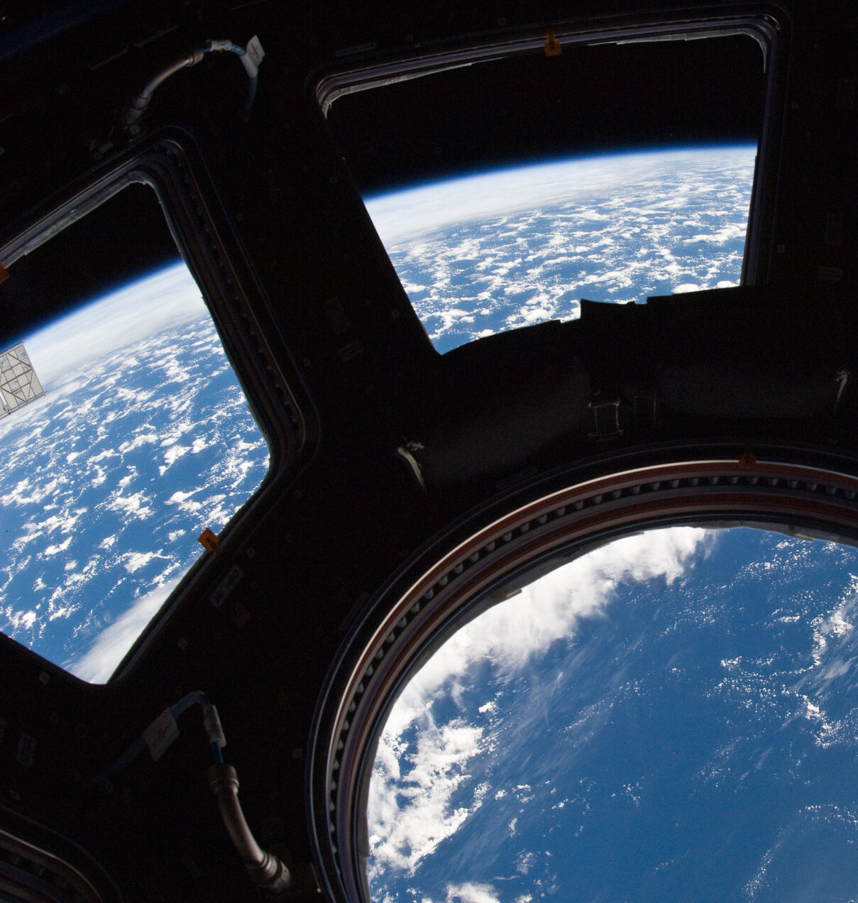
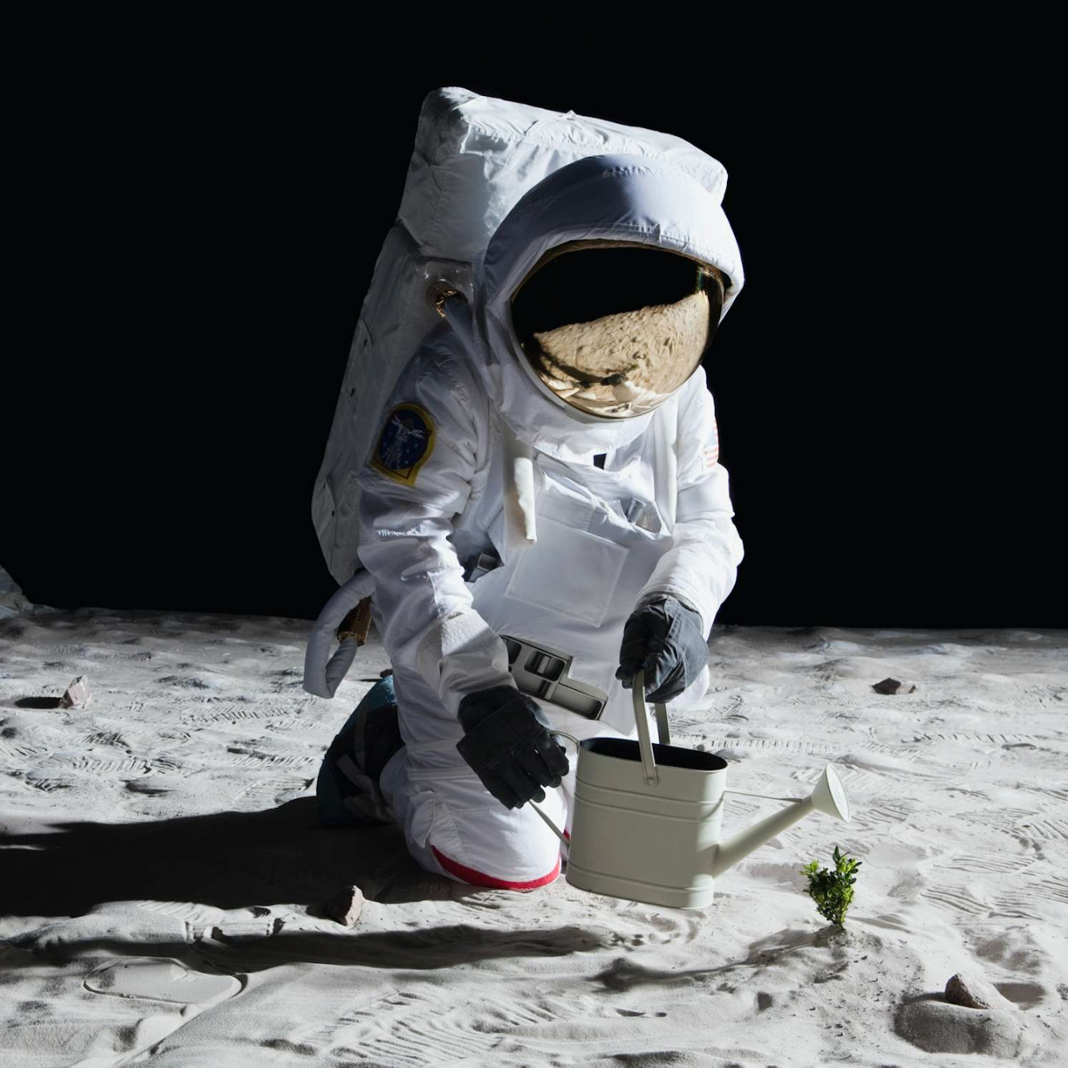
WHY AN XPRIZE IS NEEDED
No Market Incentive
No Customers at Current Costs
Political and Regulatory Ambiguity
Environmentally Urgent
Technically Audacious
Rate-limiting to space development
Notes:
The problem is not on track to be solved, we need a competition, because
No market incentive exists to compel actors toward more sustainable behavior
The market has not identified the buyers or customers for these services
Substantial political ambiguity and regulatory uncertainty remains in resolving legal authority or jurisdiction issues
Solutions themselves are likely to be technically complicated and difficult to achieve scale
Everyone thinks that we are on the track to solve it. What is it realistically? Maybe 25 years. This is a 5-year fast track to solving the problem. A catalyst for a step change in technological advancement. Problems that are this big are worth employing multiple strategies like incentive competitions.

Slide 8

The Winner of the $20M Grand Prize will:
Be the first to remove 2 regulator-approved debris objects
200kg or larger
Within 1 year of first launch to orbit
Creating 0 new debris
WHAT IS THE SPACE DEBRIS XPRIZE?

Slide 9
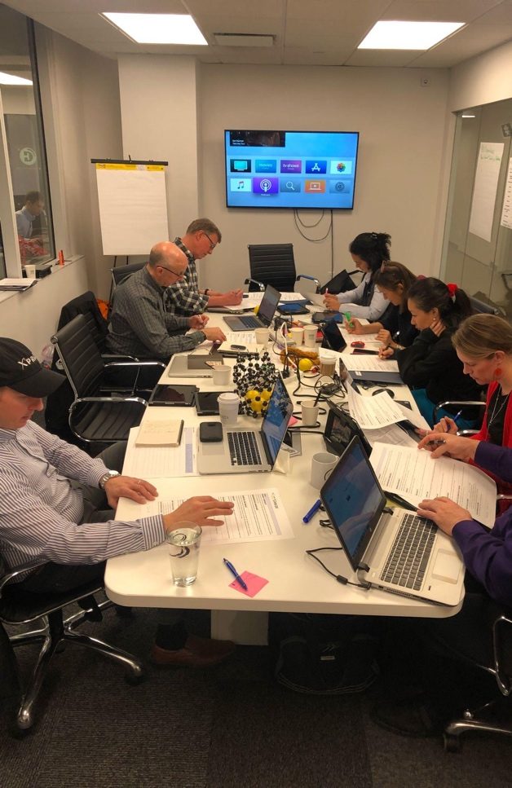
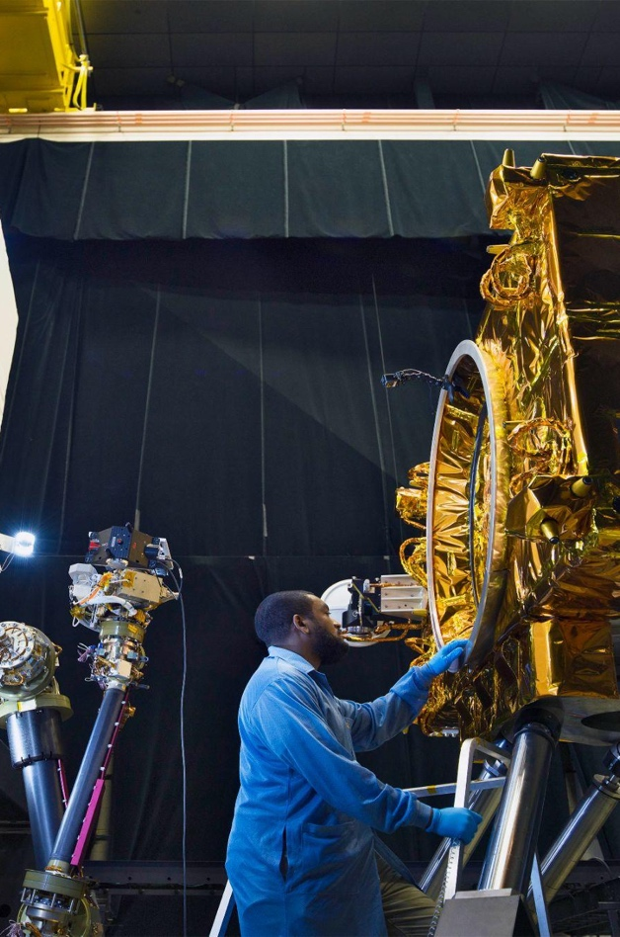
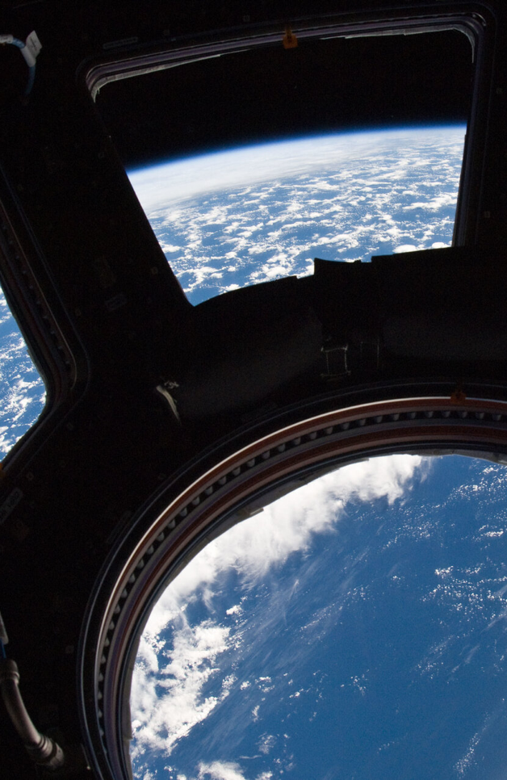
SPACE DEBRIS
THE COMPETITION
QUALIFYING ROUND
Technical Concept Review
SEMI-FINAL ROUND
Lab-Based Performance Testing Criteria
FINAL ROUND
Solution Demonstration In Earth Orbit

Slide 10
SPACE DEBRIS
OUR AUDACIOUS GOAL
Companies Competing from Multiple Countries
+$10M Prize Purses from Each Sponsor Country
International Collaboration for Space Sustainability
ROI for Every Supporting Country
Remediation of Real Debris Targets
For 10% the price of a legacy tech demo mission
Notes:
“Space Olympics” for Science and Technology

Slide 11

Norm-SETTING Space policy
Build global awareness and alignment on the urgent need to modernize space policies for the constellation age
Enable licensing frameworks for remediating derelict objects, opening clear pathways for commercial debris service
Clarify liability transfer protocols, reciprocity for cross-border orbital debris removal, boosting international collaboration
Incentivize new insurance models for debris remediation and in-orbit servicing and demise to de-risk the emerging industry
Spur social pressure for sustainable space behavior, practices and metrics to de-accumulate space debris.

Slide 12
XPRIZE
SPACE
DEBRIS
Pay when results are achieved awarding winning performance at earliest possible opportunity.
Leverage private investment by focusing the industry on a clear problem statement.
Facilitate collaboration, market-making and adjacent possibilities as teams combine existing capabilities into new solutions.
Learn in an exploratory regulatory sandbox with the effect of new law in global prize rules.
Frame a solution and its pricing which can immediately be commercially deployed by teams going into business with the same space vehicle, liability and regulatory tools used to win the prize.

Slide 13
“If we keep doing what we’ve done, we’ll keep getting what we’ve got.”
Chris.Lewicki@xprize.org
Co-Chair, Space Domain @ XPRIZE

