Slide 1
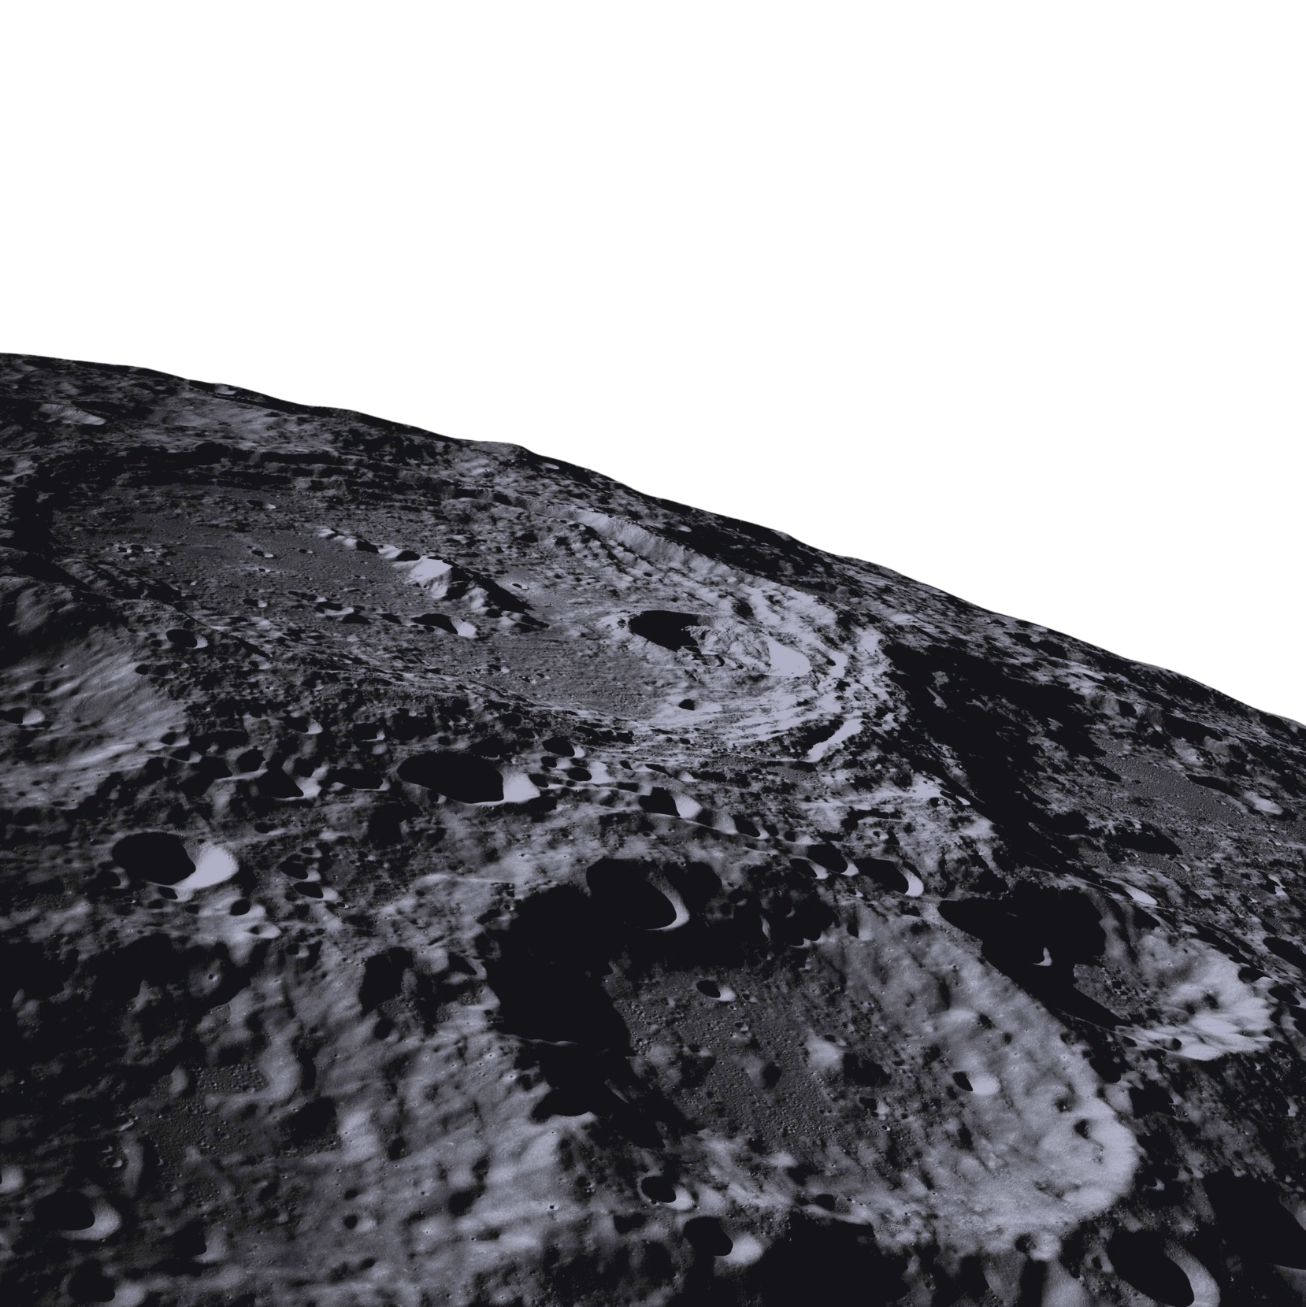

WELCOME
THE LUNAR LEDGER:
Building Transparency for Lunar Operations

Slide 2
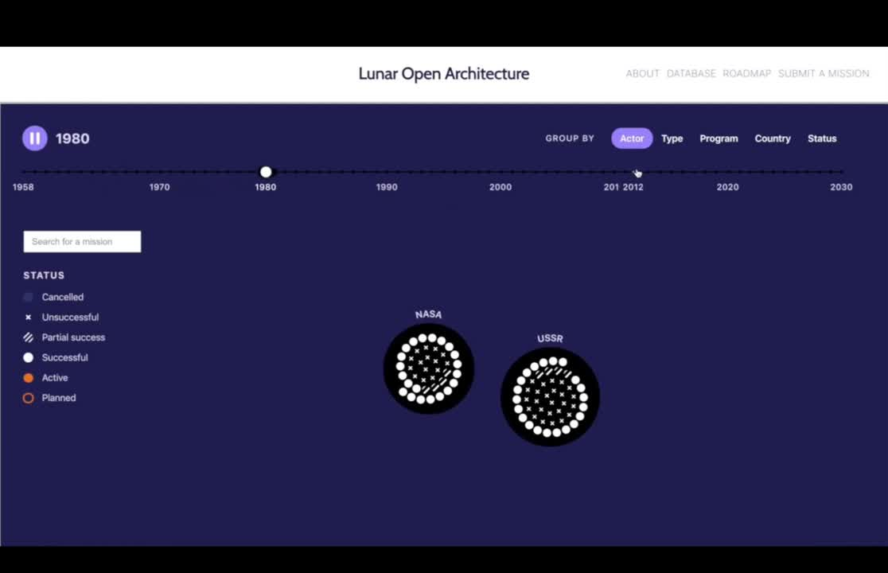

The Lunar Ledger
In an increasingly active environment, information sharing is ad-hoc and fragmented.
An open-access database of lunar activities and objects—a single, trusted source of truth

Slide 3
250+
Global collaboration for lunar transparency
Total stakeholders from six continents
government & space agencies,
commercial actors,
science & academia

Slide 4















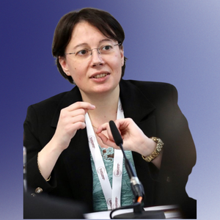






BACKED BY LEADING EXPERTS
Dr. Ulpia-Elena Botezatu
Dr. Jonathan McDowell
Dr. Berna Akcali Gur
Dr. Guoyu Wang
Marieta Valdivia Lefort
Dr. Anna Mittelholz
Dr. Christopher Newman
Dr. Lucy Mason
Kaitlyn Johnson
Dr. Rossana Deplano
Dr. Thomas González Roberts
Hasan Abbas

Slide 5
DEMONSTRATING THE LUNAR LEDGER: TRANSPARENCY IN ACTION

Slide 6
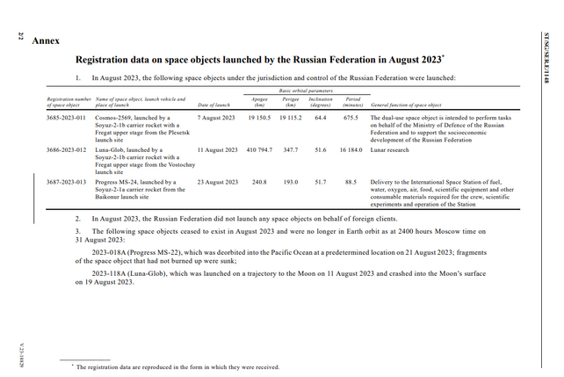
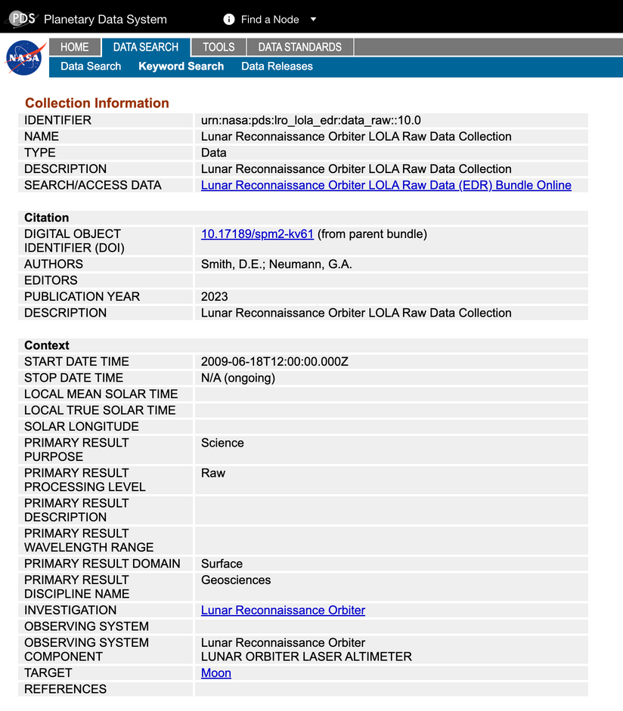
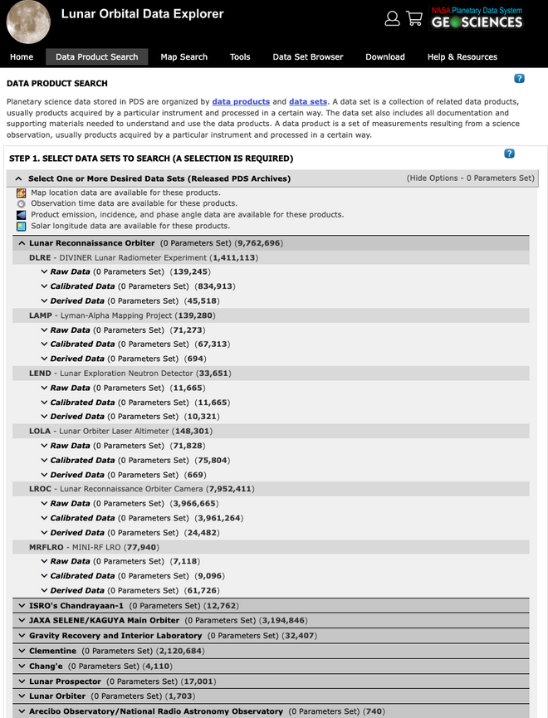
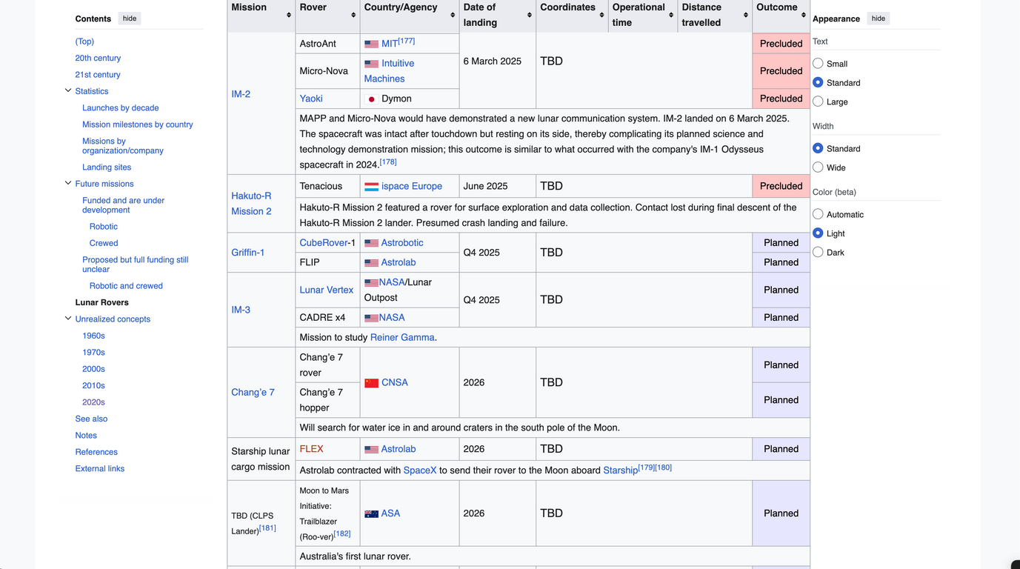
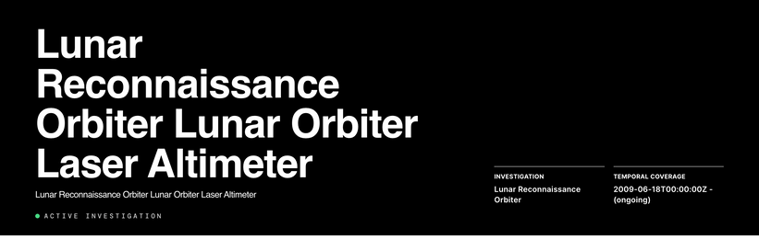
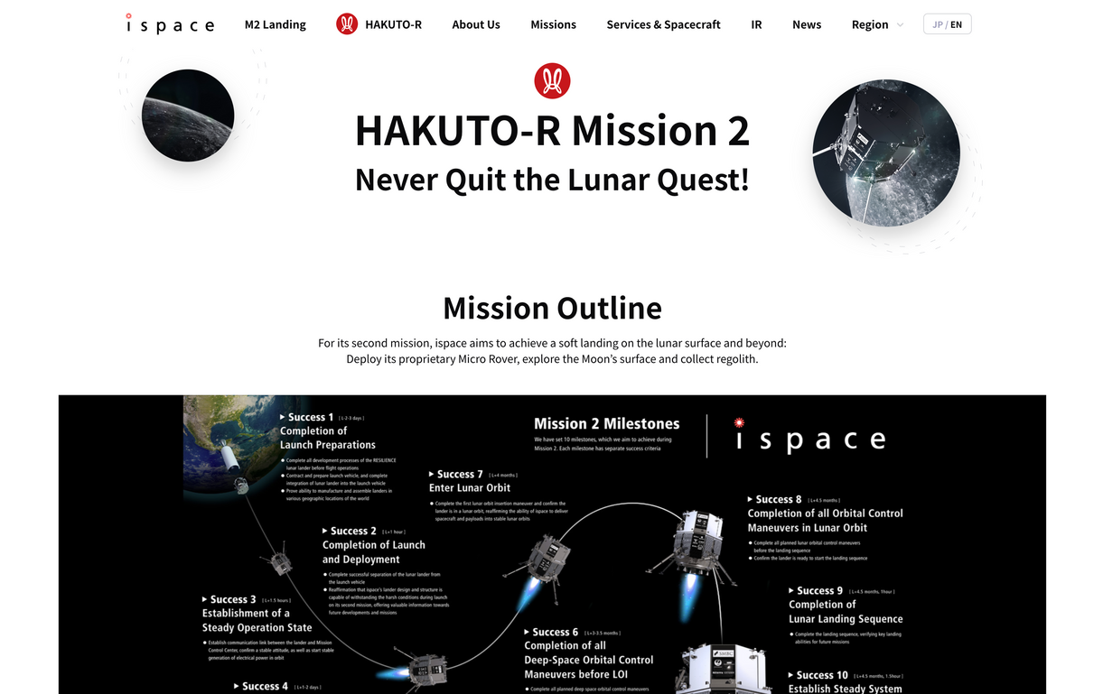
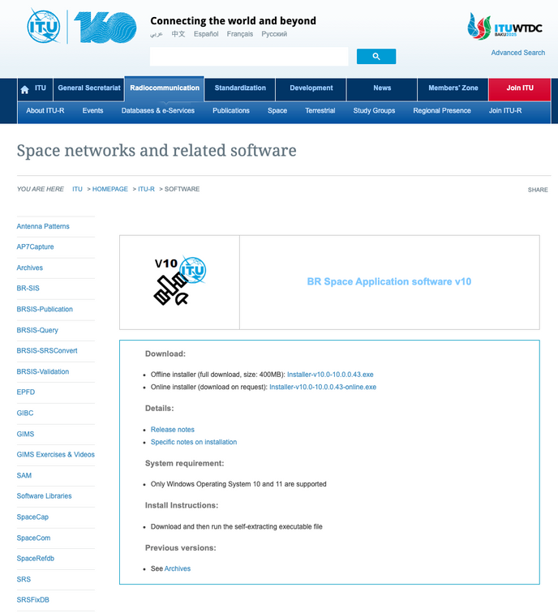

Information on lunar missions is fragmented, scattered, and prone to being out-of-date
Notes:
As lunar traffic increases, so does the risk: of conjunction, of lost investment, and of missed science. Today’s demo shows exactly how the Ledger addresses these, with simplicity and immediacy for every early adopter.

Slide 7
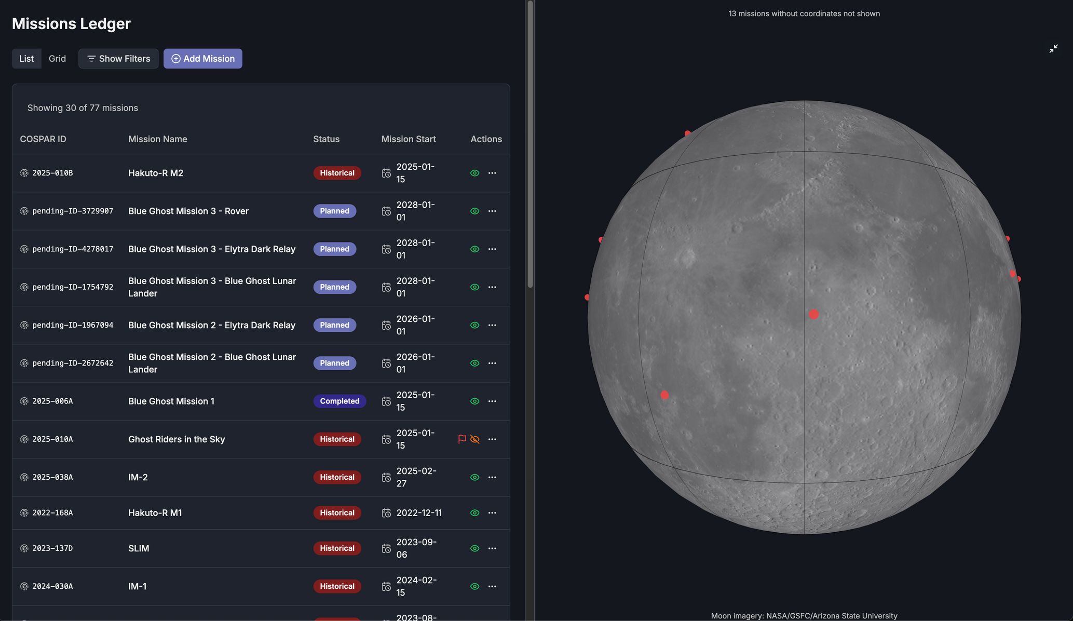
LUNAR LEDGER TECH DEMO: VISUALIZE OPPORTUNITY
Notes:
But coordination isn’t only about avoiding risk, it’s about multiplying value. Here, mission operators can flag if they’re interested in rideshare, payload hosting, or data sharing during registration.
Already, our first cohort is using this to spark collaborative discussions and expand what each mission can achieve

Slide 8
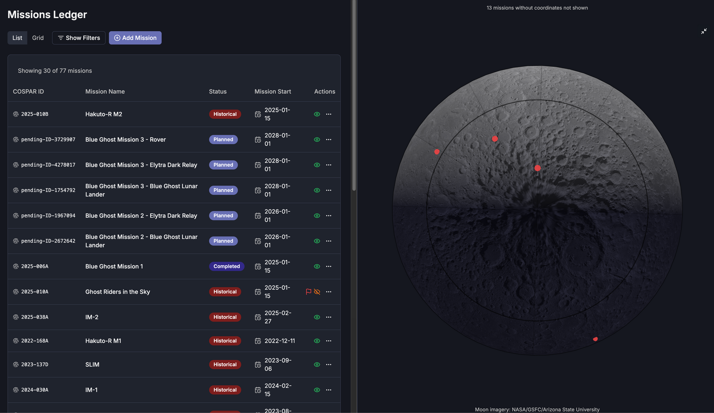
LUNAR LEDGER TECH DEMO: VISUALIZE OPPORTUNITY (PSR)
Notes:
But coordination isn’t only about avoiding risk, it’s about multiplying value. Here, mission operators can flag if they’re interested in rideshare, payload hosting, or data sharing during registration.
Already, our first cohort is using this to spark collaborative discussions and expand what each mission can achieve

Slide 9
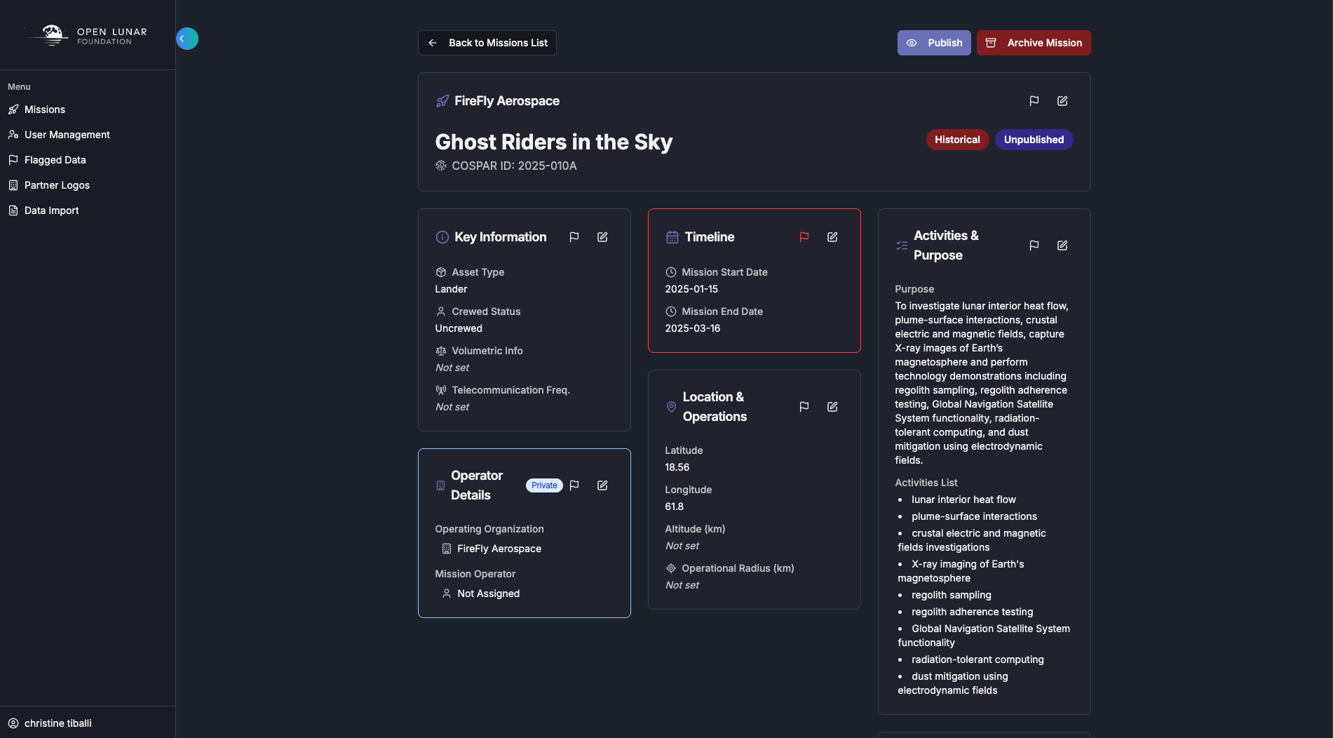
LUNAR LEDGER TECH DEMO: MANUAL OVERLAP FLAGGING
Notes:
Now imagine another operator, XXXX, submits a mission in a potentially overlapping area and timeframe. While full automation is coming, right now our admin team carefully reviews every entry.
This is human-driven, not automated, so early users get rapid, personal outreach from our team. It’s safe, it’s traceable, and it’s a conversation starter. And your feedback shapes how we automate next

Slide 10
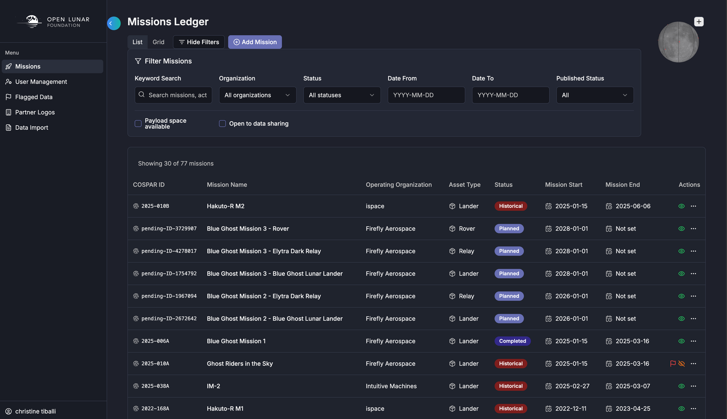
LUNAR LEDGER TECH DEMO: SEARCH AND FILTER
INDICATE PAYLOAD SPACE OR DATA SHARING
Notes:
Now imagine another operator, XXXX, submits a mission in a potentially overlapping area and timeframe. While full automation is coming, right now our admin team carefully reviews every entry.
This is human-driven, not automated, so early users get rapid, personal outreach from our team. It’s safe, it’s traceable, and it’s a conversation starter. And your feedback shapes how we automate next

Slide 11
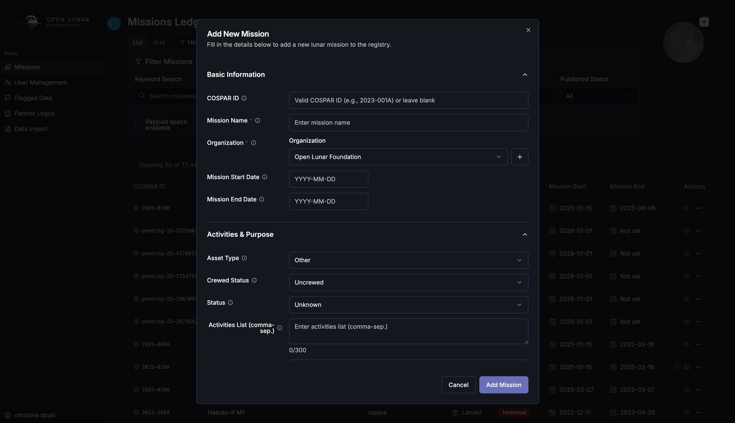
LUNAR LEDGER TECH DEMO: ADD NEW MISSION
Notes:
But coordination isn’t only about avoiding risk, it’s about multiplying value. Here, mission operators can flag if they’re interested in rideshare, payload hosting, or data sharing during registration.
Already, our first cohort is using this to spark collaborative discussions and expand what each mission can achieve

Slide 12
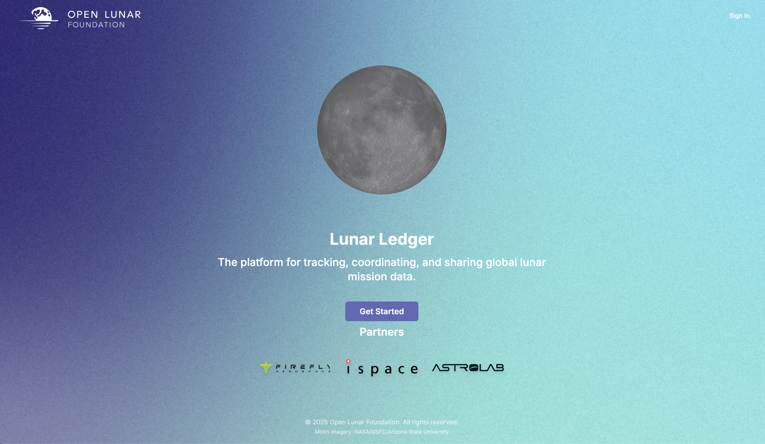
LUNAR LEDGER TECH DEMO: BUILD THE FUTURE
Notes:
But coordination isn’t only about avoiding risk, it’s about multiplying value. Here, mission operators can flag if they’re interested in rideshare, payload hosting, or data sharing during registration.
Already, our first cohort is using this to spark collaborative discussions and expand what each mission can achieve

